Slide 1
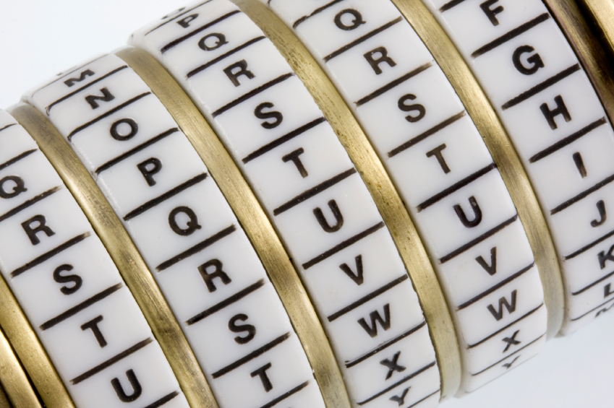
Cryptography
An Introduction
Continued…
Shon Harris
CISSP, 5th Edition

Slide 2
3.2 Cryptography Definitions
Algorithm Set of mathematical rules used in encryption and decryption
Cipher Another name for algorithm
Cryptography Science of secret writing that enables you to store and transmit data in a form that is available only to the intended individuals
Cryptosystem Hardware or software implementation of cryptography that transforms a message to ciphertext and back to plaintext

Slide 3
Cryptanalysis Practice of breaking cryptic systems
Cryptology The study of both cryptography and cryptanalysis
Data origin authentication Proving the source of a message (system based authentication)
Encipher Act of transforming data into an unreadable format

Slide 4
Entity authentication Proving the identity of the entity that sent a message
Decipher Act of transforming data into a readable format
Key Secret sequence of bits and instructions that governs the act of encryption and decryption

Slide 5
Keyspace A range of possible values used to construct keys
Plaintext Data in readable format, also referred to as cleartext
Receipt Acknowledgment that a message has been received
Work factor Estimated time, effort, and resources necessary to break a cryptosystem

Slide 6
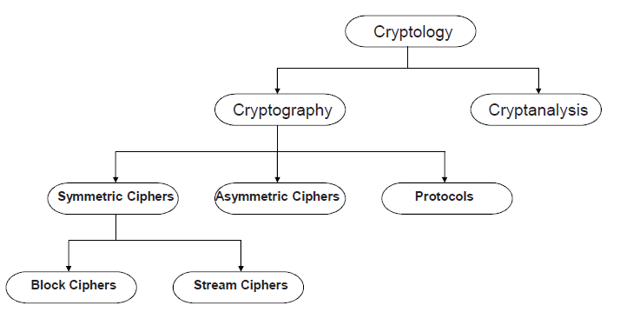
Classification Of The Field Of Cryptology

Slide 7
3.3 One-time Pad
A one-time pad is a perfect encryption scheme because it is considered unbreakable if implemented properly
It was invented by Gilbert Vernam in 1917, so sometimes it is referred to as the Vernam cipher
This cipher does not use shift alphabets, as do the Caesar and Vigenere ciphers discussed earlier, but instead uses a pad made up of random values

Slide 8
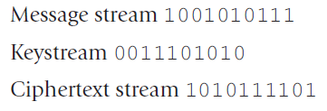
Our plaintext message that needs to be encrypted has been converted into bits, and our one-time pad is made up of random bits
This encryption process uses a binary mathematic function called exclusive-OR, usually abbreviated as XOR.

Slide 9
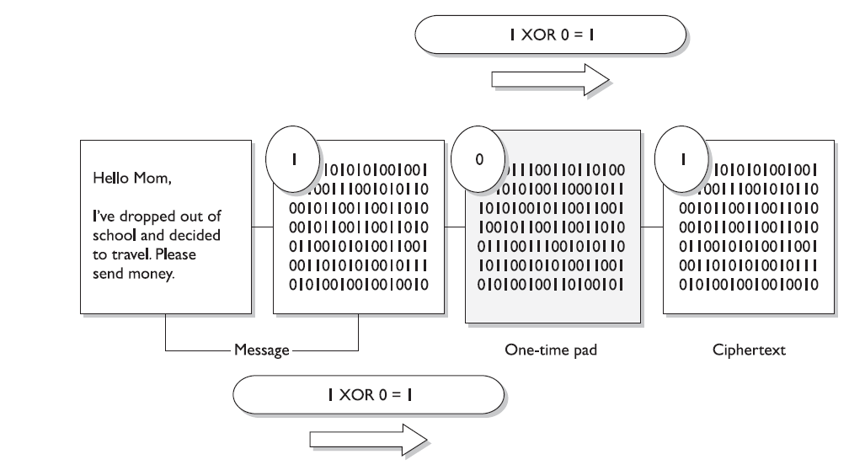
The first bit of the message is XORed to the first bit of the onetime pad, which results in the ciphertext value 1. The second bit of the message is XORed with the second bit of the pad, which results in the value 0

Slide 10
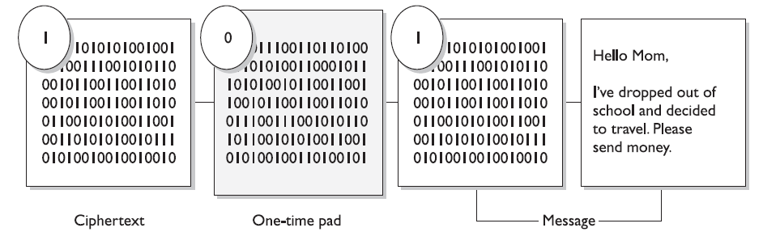
The receiver must have the same one-time pad to decrypt the message, by reversing the process.
The receiver takes the first bit of the encrypted message and XORs it with the first bit of the pad. This results in the plaintext value.

Slide 11
One-Time Pad Requirements
For a one-time pad encryption scheme to be considered unbreakable, each pad in the scheme must be:
Made up of truly random values
Used only one time
Securely distributed to its destination
Secured at sender’s and receiver’s sites
At least as long as the message

Slide 12
A number generator is used to create a stream of random values and must be seeded by an initial value. This piece of software obtains its seeding value from some component within the computer system (time, CPU cycles, and so on).
Although a computer system is complex, it is a predictable environment, so if the seeding value is predictable in any way, the resulting values created are not truly random—but pseudorandom.

Slide 13
3.4 Steganography
Steganography is a method of hiding data in another media type so the very existence of the data is concealed as illustrated in the Figure
Only the sender and receiver are supposed to be able to see the message because it is secretly hidden in a graphic, wave file, document, or other type of media.
The message is not encrypted, just hidden

Slide 14
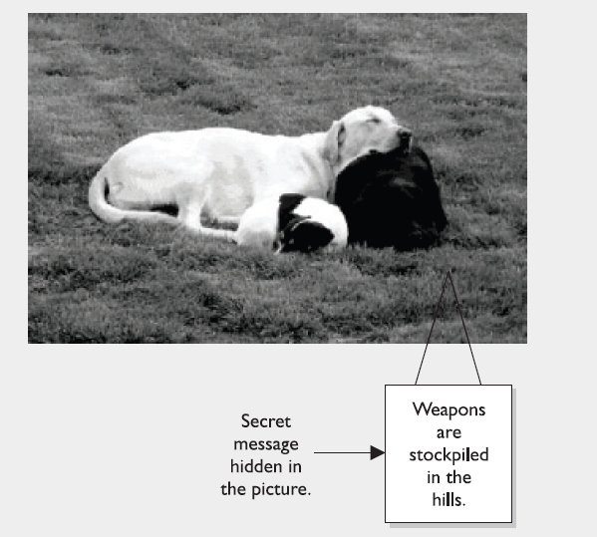

Slide 15
A method of embedding the message into some type of medium is to use the least significant bit (LSB).
Many types of files have some bits that can be modified and not affect the file they are in, which is where secret data can be hidden without altering the file in a visible manner

Slide 16
In the LSB approach, graphics with a high resolution or an audio file that has many different types of sounds (high bit rate) are the most successful for hiding information within.
There is commonly no noticeable distortion, and the file is usually not increased to a size that can be detected

Slide 17

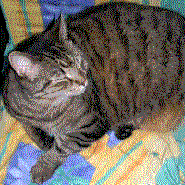
Steganography Example
Image of a cat extracted
from the image of the tree
Image of a tree. Removing all but the two least significant bits of each color component produces an almost completely black image. Making that image 85 times brighter produces the image of the cat.

Slide 18
Digital Watermarking
The embedded logo or trademark is called a digital watermark. Instead of having a secret message within a graphic that is supposed to be invisible to you, digital watermarks are usually visible. These are put into place to deter people from using material that is not theirs.
This type of steganography is referred to as Digital Rights Management (DRM). The goal is to restrict the usage of material that is owned by a company or individual.

Slide 19
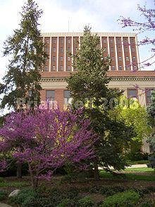

Slide 20
3.5 Types of Ciphers
Symmetric encryption ciphers come in two basic types:
  Substitution
  Transposition

Slide 21
Substitution Ciphers
The substitution cipher replaces bits, characters, or blocks of characters with different bits, characters, or blocks

Slide 22
Example Substitution
Cipher
Plaintext | Key | Ciphertext
n | 4 | r
o | 8 | w
w | 15 | l
i | 16 | …
s | 23 | …
t | 16 | …
h | 3 | …
e | 9 | …
t | 12 | …
i | 20 | …
m | 6 | …
e | 25 | …
+4
n o p q r
This is a very weak cipher
Real ciphers use complex math

Slide 23
A substitution cipher uses a key to dictate how the substitution should be carried out
In the Caesar cipher, each letter is replaced with the letter three places beyond it in the alphabet. The algorithm is the alphabet, and the key is the instruction “shift up three.”
Substitution is used in today’s symmetric algorithms, but it is extremely complex compared to this example

Slide 24
Transposition Ciphers
In a transposition cipher, the values are scrambled, or put into a different order
The key determines the positions the values are moved to, as illustrated in the Figure

Slide 25
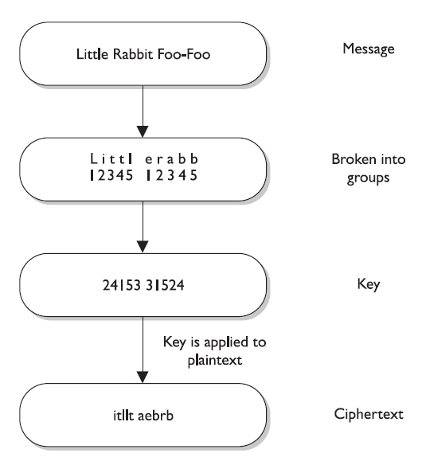

Slide 26
This is a simplistic example of a transposition cipher and only shows one way of performing transposition
When implemented with complex mathematical functions, transpositions can become quite sophisticated and difficult to break

Slide 27
Symmetric algorithms employed today use both long sequences of complicated substitutions and transpositions on messages
The algorithm contains the possible ways that substitution and transposition processes can take place (represented in mathematical formulas).
The key is used as the instructions for the algorithm, dictating exactly how these processes will happen and in what order

Slide 28
To understand the relationship between an algorithm and a key, let’s look at the Figure
Conceptually, an algorithm is made up of different boxes, each of which has a different set of mathematical formulas that dictates the substitution and transposition steps that will take place on the bits that enter the box
To encrypt our message, the bit values must go through these different boxes

Slide 29
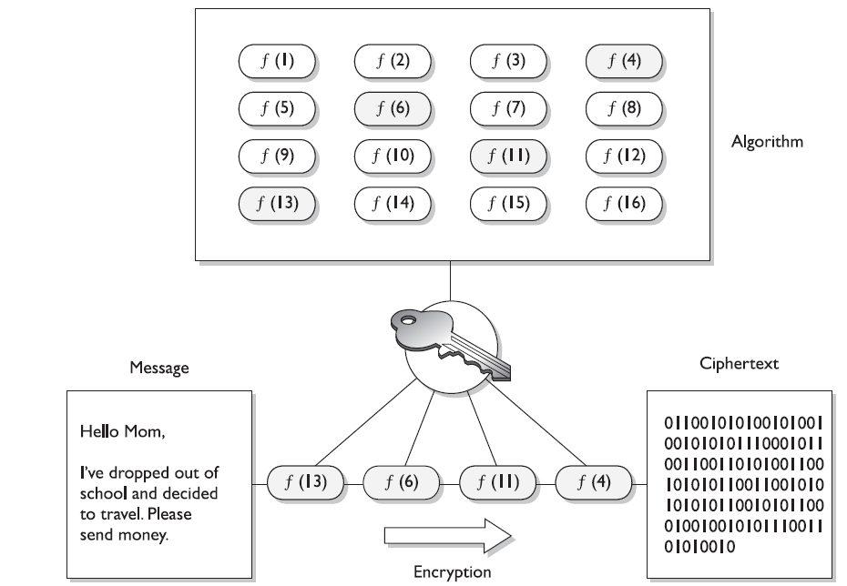

Slide 30
If each of our messages goes through each of these different boxes in the same order with the same values, the evildoer will be able to easily reverse-engineer this process and uncover our plaintext message
To foil an evildoer, we use a key, which is a set of values that indicates which box should be used, in what order, and with what values

Slide 31
So if message A is encrypted with key 1, the key will make the message go through boxes 1, 6, 4, and then 5
When we need to encrypt message B, we will use key 2, which will make the message go through boxes 8, 3, 2, and then 9
It is the key that adds the randomness and the secrecy to the encryption process

