Slide 1
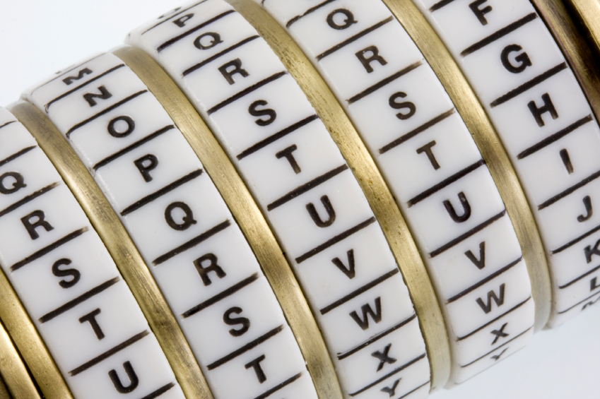
Cryptography
An Introduction
Shon Harris
CISSP, 5th Edition

Slide 2
Cryptography
3.1.1 Definitions and Concepts
When data is stored on a computer, it is usually protected by logical and physical access controls
When this same sensitive information is sent over a network, it can no longer take these controls for granted, and the information is in a much more vulnerable state

Slide 3
Cryptography
Definitions and Concepts
Encryption is a method of transforming readable data, called plaintext, into a form that appears to be random and unreadable, which is called ciphertext
This enables the transmission of confidential information over insecure channels without unauthorized disclosure

Slide 4
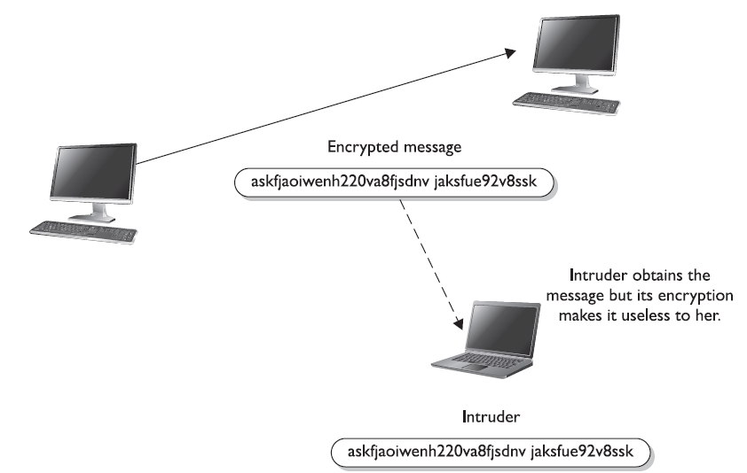
Receiver
Sender
Without the right key, the captured
message is useless to an attacker.

Slide 5
Cryptography
Definitions and Concepts
A system or product that provides encryption and decryption is referred to as a cryptosystem and can be created through hardware components or program code in an application
The cryptosystem uses an encryption algorithm
Most algorithms are complex mathematical formulas that are applied in a specific sequence to the plaintext

Slide 6
Cryptosystems
A cryptosystem encompasses all of the necessary components for encryption and decryption to take place. Pretty Good Privacy (PGP) is just one example of a cryptosystem.
A cryptosystem is made up of at least the following:
• Software
• Protocols
• Algorithms
• Keys

Slide 7
Cryptography
Definitions and Concepts
Most encryption methods use a secret value called a key (usually a long string of bits), which works with the algorithm to encrypt and decrypt the text
The algorithm, the set of rules also known as the cipher, dictates how enciphering and deciphering takes place
Many of the mathematical algorithms used in computer systems today are publicly known and are not the secret part of the encryption process

Slide 8
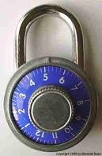

If the internal mechanisms of the algorithm are not a secret, then something must be
The secret piece of using a well-known encryption algorithm is the key

Slide 9
Cryptography
Definitions and Concepts
In encryption, the key (cryptovariable) is a value that comprises a large sequence of random bits
An algorithm contains a keyspace, which is a range of values that can be used to construct a key

Slide 10
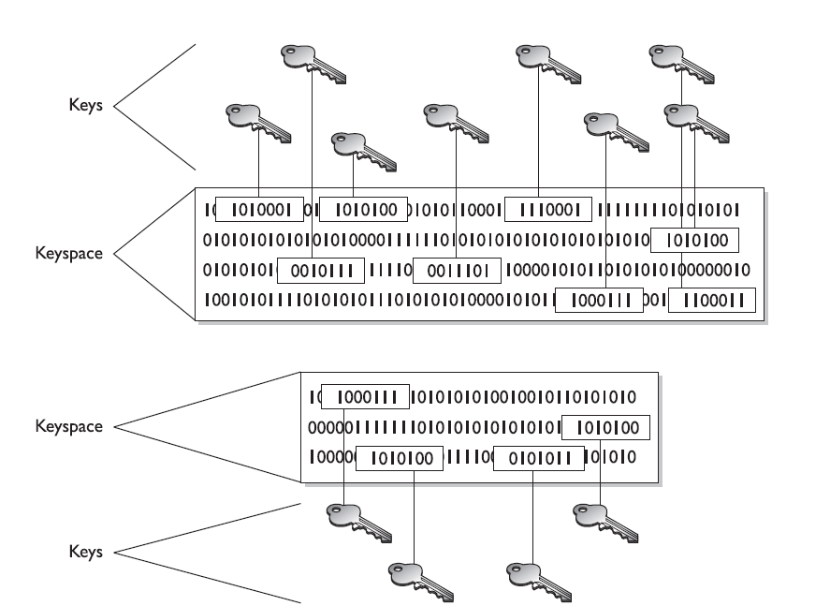
The larger the keyspace, the more available values can be used to represent different keys—and the more random the keys are, the harder it is for intruders to figure them out

Slide 11
Cryptography
Definitions and Concepts
When the algorithm needs to generate a new key, it uses random values from this keyspace
For example, if an algorithm allows a key length of 2 bits, the keyspace for that algorithm would be 4, which indicates the total number of different keys that would be possible. That would not be a very large keyspace, and certainly it would not take an attacker very long to find the correct key that was used.

Slide 12
Cryptography
Definitions and Concepts
A large keyspace allows for more possible keys.
Today, we are commonly using key sizes of 128, 256, 512, or even 1,024 bits and larger. So a key size of 512 bits would provide a 2⁵¹² possible combinations (the keyspace)
The encryption algorithm should use the entire keyspace and choose the values to make up the keys as randomly as possible.

Slide 13

Key Length and Exhaustive Search Time
Key Length in Bits | Number of Possible Keys
1 | 2
2 | 4
4 | 16
8 | 256
16 | 65,536
40 | 1,099,511,627,776
56 | 72,057,594,037,927,900
112 | 5,192,296,858,534,830,000,000,000,000,000,000
112 | 5.1923E+33
168 | 3.74144E+50
256 | 1.15792E+77
512 | 1.3408E+154
Each extra bit
doubles the number of keys
Shaded keys are
Strong symmetric keys (>=100 bits)

Slide 14
Time Required For Decryption
Key Size (bits) | Number of Alternative Keys | Time required at 1 decryption/µs | Time required at 10⁶ decryptions/µs
32 | 2³² = 4.3 × 10⁹ | 2³¹ µs = 35.8 minutes | 2.15 milliseconds
56 | 2⁵⁶ = 7.2 × 10¹⁶ | 2⁵⁵ µs = 1142 years | 10.01 hours
128 | 2¹²⁸ = 3.4 × 10³⁸ | 2¹²⁷ µs = 5.4 × 10²⁴ years | 5.4 × 10¹⁸ years
168 | 2¹⁶⁸ = 3.7 × 10⁵⁰ | 2¹⁶⁷ µs = 5.9 × 10³⁶ years | 5.9 × 10³⁰ years
26 characters (permutation) | 26! = 4 × 10²⁶ | 2 × 10²⁶ µs = 6.4 × 10¹² years | 6.4 × 10⁶ years

Slide 15
Major Symmetric Key Encryption Ciphers
 | RC4 | DES | 3DES | AES
Key Length (bits) | 40 bits or more | 56 | 112 or 168 | 128, 192, or 256
Key Strength | Very weak at 40 bits | Weak | Strong | Strong
Processing Requirements | Low | Moderate | High | Low
RAM Requirements | Low | Moderate | Moderate | Low
Remarks | Can use keys of variable length | Created in the 1970s | Applies DES three times with two or three different DES keys | Today’s gold standard for symmetric key encryption

Slide 16
3.1.2 Kerckhoffs’ Principle
Auguste Kerckhoffs published a paper in 1883 stating that the only secrecy involved with a cryptography system should be the key. He claimed that the algorithm should be publicly known.
He asserted that if security were based on too many secrets, there would be more vulnerabilities to possibly exploit

Slide 17
Cryptographers in the private and academic sectors agree with Kerckhoffs’ principle, because making an algorithm publicly available means that many more people can view the source code, test it, and uncover any type of flaws or weaknesses
It is the attitude of “many heads are better than one.” Once someone uncovers some type of flaw, the developer can fix the issue, and provide society with a much stronger algorithm

Slide 18
But, not everyone agrees with this philosophy. Governments around the world create their own algorithms that are not released to the public. Their stance is that if a smaller number of people know how the algorithm actually works, then a smaller number of
people will know how to possibly break it
Cryptographers in the private sector do not agree with this practice and do not trust algorithms they cannot examine
It is basically the same as the open-source versus compiled software debate that is in full force today.

Slide 19
3.1.3 The Strength of the Cryptosystem
The strength of an encryption method comes from the algorithm, the secrecy of the key, the length of the key, the initialization vectors, and how they all work together within the cryptosystem.
When strength is discussed in encryption, it refers to how hard it is to figure out the algorithm or key, whichever is not made public.

Slide 20
The strength of an encryption method correlates to the amount of necessary processing power, resources, and time required to break the cryptosystem or to figure out the value of the key.
Breaking a cryptosystem can be accomplished by a brute force attack, which means trying every possible key value until the resulting plaintext is meaningful
Depending on the algorithm and length of the key, this can be an easy task or one that is close to impossible

Slide 21
The goal when designing an encryption method is to make compromising it too expensive or too time-consuming
Another name for cryptography strength is work factor, which is an estimate of the effort and resources it would take an attacker to penetrate a cryptosystem

Slide 22
Important elements of encryption are to use an algorithm without flaws, use a large key size, use all possible values within the keyspace, and to protect the actual key.
If one element is weak, it could be the link that dooms the whole process.
Even if a user employs an algorithm that has all the requirements for strong encryption, including a large keyspace and a large and random key value, if he shares his key with others, the strength of the algorithm becomes almost irrelevant.

Slide 23
3.1.4 Services of Cryptosystems
Confidentiality
Integrity
Authentication
Authorization
Nonrepudiation

Slide 24
Services of Cryptosystems
Confidentiality
Renders the information unintelligible except by authorized entities
Integrity
Data has not been altered in an unauthorized manner since it was created, transmitted, or stored
Authentication
Verifies the identity of the user or system that created information
Authorization
Upon proving identity, the individual is then provided with the key or password that will allow access to some resource
Nonrepudiation
Ensures that the sender cannot deny sending the message.

Slide 25
If David sends a message and then later claims he did not send it, this is an act of repudiation.
When a cryptography mechanism provides nonrepudiation, the sender cannot later deny he sent the message.
(He can try to deny it, but the cryptosystem proves otherwise)

Slide 26
Suppose your boss sends you a message telling you that you will be receiving a raise that doubles your salary.
The message is encrypted, so you can be sure it really came from your boss (authenticity)
Someone did not alter it before it arrived at your computer (integrity)
No one else was able to read it as it traveled over the network (confidentiality)
Your boss cannot deny sending it later when he comes to his senses (nonrepudiation)

Slide 27
Military and intelligence agencies are very concerned about keeping information confidential, so they would choose encryption mechanisms that provide a high degree of secrecy
Financial institutions care about confidentiality, but they also care about the integrity of the data being transmitted, so the encryption mechanism they would choose may differ from the military’s encryption methods
If messages were accepted that had a misplaced decimal point or zero, the ramifications could be far reaching in the financial world

Slide 28
Legal agencies may care most about the authenticity of the messages they receive
If information received ever needed to be presented in a court of law, its authenticity would certainly be questioned; therefore, the encryption method used must ensure authenticity, which confirms who sent the information

