Slide 1

Section 4:
Network Security Topics
Firewalls

Slide 2
In The Last lecture
What is a firewall ?
Packet filtering firewalls
Attacks on packet firewalls
  IP address spoofing
  Source routing attacks
  Tiny fragment attacks
Stateful packet filters
Application level gateway (or proxy)

Slide 3
What Is A Firewall ?
Provide a choke point of control and monitoring
Interconnect networks with differing trust
Impose restrictions on network services
  only authorized traffic is allowed
Auditing and controlling access
  can implement alarms for abnormal behavior
Provide NAT & usage monitoring (e.g. Audit logs)
Implement VPNs using IPSec
Must be immune to penetration since it will be a target of attack

Slide 4
4. Circuit Level Gateway
Relays two TCP connections
Imposes security by limiting which such connections are allowed
Once created usually relays traffic without examining contents
Typically used when trust internal users by allowing general outbound connections
SOCKS is commonly used
Notes:
A fourth type of firewall is the circuit-level gateway or circuit-level proxy. This can be a stand-alone system or it can be a specialized function performed by an application-level gateway for certain applications. A circuit-level gateway relays two TCP connections, one between itself and an inside TCP user, and the other between itself and a TCP user on an outside host. Once the two connections are established, it relays TCP data from one connection to the other without examining its contents. The security function consists of determining which connections will be allowed. It is typically used when internal users are trusted to decide what external services to access.
One of the most common circuit-level gateways is SOCKS, defined in RFC 1928. It consists of a SOCKS server on the firewall, and a SOCKS library & SOCKS-aware applications on internal clients. When a TCP-based client wishes to establish a connection to an object that is reachable only via a firewall (such determination is left up to the implementation), it must open a TCP connection to the appropriate SOCKS port on the SOCKS server system. If the connection request succeeds, the client enters a negotiation for the authentication method to be used, authenticates with the chosen method, and then sends a relay request. The SOCKS server evaluates the request and either establishes the appropriate connection or denies it. UDP exchanges are handled in a similar fashion.

Slide 5
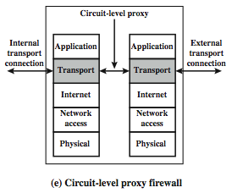
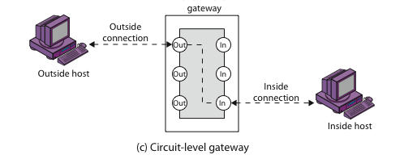
Firewalls - Circuit Level Gateway
The Figure illustrates a circuit-level gateway,
showing how it relays between 2 TCP connections.
Notes:
Stallings Figure 22.1e (along with 4/e Figure 20.1c) illustrates a circuit-level gateway, showing how it relays between 2 TCP connections. Note that it can be implemented in a stand-alone system or can be a specialized function in an application-level gateway for certain applications. Note also that relaying UDP packets is more problematical, because of the lack of connection context, and require a parallel TCP connection to provide these details.

Slide 6
Circuit Level Gateway
A circuit-level gateway relays two TCP connections, one between itself and an inside TCP user, and the other between itself and a TCP user on an outside host.
Once the two connections are established, it relays TCP data from one connection to the other without examining its contents.

Slide 7
Firewalls – Circuit Level Gateway
One of the most common circuit-level gateways is SOCKS, defined in RFC 1928.
It consists of a SOCKS server on the firewall, and a SOCKS library & SOCKS-aware applications on internal clients.
When a TCP-based client wishes to establish a connection to an object that is reachable only via a firewall (such determination is left up to the implementation), it must open a TCP connection to the appropriate SOCKS port on the SOCKS server system.

Slide 8
Firewalls – Circuit Level Gateway
If the connection request succeeds, the client enters a negotiation for the authentication method to be used, authenticates with the chosen method, and then sends a relay request.
The SOCKS server evaluates the request and either establishes the appropriate connection or denies it. UDP exchanges are handled in a similar fashion.

Slide 9
5. Bastion Host
Highly secure host system
Runs circuit / application level gateways
Or provides externally accessible services
Potentially exposed to "hostile" elements
Hence is secured to withstand this
May support 2 or more net connections
May be trusted to enforce policy of trusted separation between these net connections
  Relaying traffic only according to policy
Notes:
It is common to base a firewall on a stand-alone machine running a common operating system, such as UNIX or Linux. Firewall functionality can also be implemented as a software module in a router or LAN switch.
A bastion host is a critical strong point in the network’s security, serving as a platform for an application-level or circuit-level gateway, or for external services. It is thus potentially exposed to "hostile" elements and must be secured to withstand this. Common characteristics of a bastion host include that it:
• executes a secure version of its O/S, making it a trusted system
• has only essential services installed on the bastion host
• may require additional authentication before a user may access to proxy services
• configured to use only subset of standard commands, access only specific hosts
• maintains detailed audit information by logging all traffic
• each proxy module a very small software package designed for network security
• has each proxy independent of other proxies on the bastion host
• have a proxy performs no disk access other than read its initial configuration file
• have each proxy run as a non-privileged user in a private and secured directory
A bastion host may have two or more network interfaces (or ports), and must be trusted to enforce trusted separation between these network connections, relaying traffic only according to policy.

Slide 10
Bastion Host
Common characteristics of a bastion host:
• Executes a secure version of its O/S, making it a trusted system
• Has only essential services installed on the bastion host
• May require additional authentication before a user may access to proxy services
• Configured to use only subset of standard commands, access only specific hosts
• Maintains detailed audit information by logging all traffic
Notes:
It is common to base a firewall on a stand-alone machine running a common operating system, such as UNIX or Linux. Firewall functionality can also be implemented as a software module in a router or LAN switch.
A bastion host is a critical strong point in the network’s security, serving as a platform for an application-level or circuit-level gateway, or for external services. It is thus potentially exposed to "hostile" elements and must be secured to withstand this. Common characteristics of a bastion host include that it:
• executes a secure version of its O/S, making it a trusted system
• has only essential services installed on the bastion host
• may require additional authentication before a user may access to proxy services
• configured to use only subset of standard commands, access only specific hosts
• maintains detailed audit information by logging all traffic
• each proxy module a very small software package designed for network security
• has each proxy independent of other proxies on the bastion host
• have a proxy performs no disk access other than read its initial configuration file
• have each proxy run as a non-privileged user in a private and secured directory
A bastion host may have two or more network interfaces (or ports), and must be trusted to enforce trusted separation between these network connections, relaying traffic only according to policy.

Slide 11
6. Host-Based Firewalls
S/W module used to secure individual host
  Available in many operating systems
  Or can be provided as an add-on package
Often used on servers
Advantages:
  Can tailor filtering rules to host environment
  Protection is provided independent of topology
  Provides an additional layer of protection
Notes:
A host-based firewall is a software module used to secure an individual host. Such modules are available in many operating systems or can be provided as an add-on package. Like conventional stand-alone firewalls, host-resident firewalls filter and restrict the flow of packets. A common location for such firewalls is a server. There are several advantages to the use of a server-based or workstation-based firewall:
• Filtering rules can be tailored to the host environment. Specific corporate security policies for servers can be implemented, with different filters for servers used for different application.
• Protection is provided independent of topology. Thus both internal and external attacks must pass through the firewall.
• Used in conjunction with stand-alone firewalls, the host-based firewall provides an additional layer of protection. A new type of server can be added to the network, with its own firewall, without the necessity of altering the network firewall configuration.

Slide 12
7. Personal Firewalls
Controls traffic between PC/workstation and Internet or enterprise network
A software module on personal computer
Or in home/office DSL/cable/ISP router
Typically much less complex than other firewall types
Primary role to deny unauthorized remote access to the computer, and
Monitor outgoing activity for malware
Notes:
A personal firewall controls the traffic between a personal computer or workstation on one side and the Internet or enterprise network on the other side. Personal firewall functionality can be used in the home environment and on corporate intranets. Typically, the personal firewall is a software module on the personal computer. In a home environment with multiple computers connected to the Internet, firewall functionality can also be housed in a router that connects all of the home computers to a DSL, cable modem, or other Internet interface.
Personal firewalls are typically much less complex than either server-based firewalls or stand-alone firewalls. The primary role of the personal firewall is to deny unauthorized remote access to the computer. The firewall can also monitor outgoing activity in an attempt to detect and block worms and other malware.

Slide 13
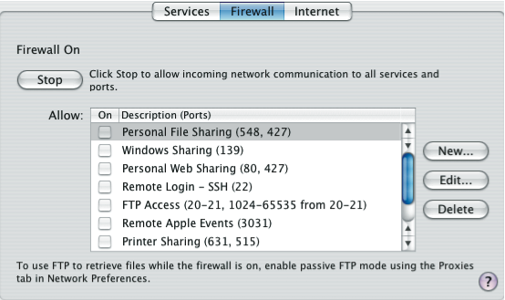
Personal Firewalls
Notes:
An example of a personal firewall is the capability built in to the Mac OS X operating system. When the user enables the personal firewall in Mac OS X, all inbound connections are denied except for those the user explicitly permits. Stallings Figure 22.2 shows this simple interface. There is a list of inbound services that can be selectively re-enabled, with their port numbers. For increased protection, advanced firewall features are available through easy-to- configure checkboxes. Stealth mode hides the Mac on the Internet by dropping unsolicited communication packets, making it appear as though no Mac is present. UDP packets can be blocked, restricting network traffic to TCP packets only for open ports. The firewall also supports logging, an important tool for checking on unwanted activity.
Similar features are provided by the firewalls provided in Windows and Linux systems.

Slide 14
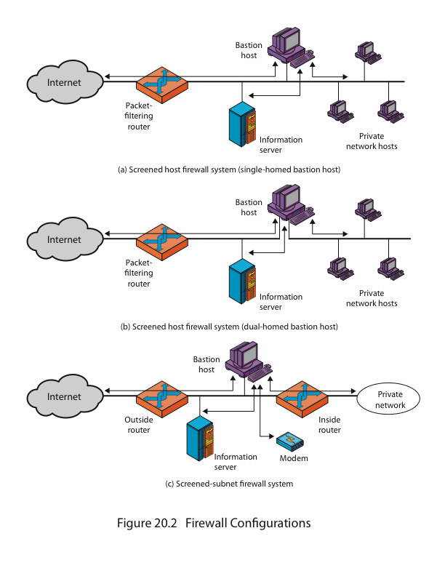
4.3.3 Firewall Configurations – Screened Host Firewall (Single Homed Bastion Host)
The firewall consists of two systems:
A packet-filtering router - allows Internet packets to/from bastion only
A bastion host - performs authentication and proxy functions
This configuration has greater security, as it implements both packet-level & application-level filtering, forces an intruder to generally penetrate two separate systems to compromise internal security, & also affords flexibility in providing direct Internet access to specific internal servers (eg web) if desired.
Notes:
As Figure 22.1a indicates, a firewall is positioned to provide a protective barrier between an external, potentially untrusted source of traffic and an internal network. With that general principle in mind, a security administrator must decide on the location and on the number of firewalls needed.
In addition to the use of a simple configuration consisting of a single system, more complex configurations are possible and indeed more common. Stallings 4/e Figure 20.2 illustrates three common firewall configurations.
4/e Figure 20.2a shows the “screened host firewall, single-homed bastion configuration”, where the firewall consists of two systems:
a packet-filtering router - allows Internet packets to/from bastion only
a bastion host - performs authentication and proxy functions
This configuration has greater security, as it implements both packet-level & application-level filtering, forces an intruder to generally penetrate two separate systems to compromise internal security, & also affords flexibility in providing direct Internet access to specific internal servers (eg web) if desired.

Slide 15
Firewall Configurations – Screened Host Firewall (Dual Homed Bastion Host)
This configuration physically separates the external and internal networks, ensuring two systems must be compromised to breach security.
The advantages of dual layers of security are also present here. Again, an information server or other hosts can be allowed direct communication with the router if this is in accord with the security policy, but are now separated from the internal network.
Notes:
Stallings 4/e Figure 20.2b illustrates the “screened host firewall, dual-homed bastion configuration” which physically separates the external and internal networks, ensuring two systems must be compromised to breach security. The advantages of dual layers of security are also present here. Again, an information server or other hosts can be allowed direct communication with the router if this is in accord with the security policy, but are now separated from the internal network.

Slide 16
Firewall Configurations – Screened Subnet Firewall
Notes:
Stallings 4/e Figure 20.2c shows the “screened subnet firewall configuration”, being the most secure shown. It has two packet-filtering routers, one between the bastion host and the Internet and the other between the bastion host and the internal network, creating an isolated subnetwork. This may consist of simply the bastion host but may also include one or more information servers and modems for dial-in capability. Typically, both the Internet and the internal network have access to hosts on the screened subnet, but traffic across the screened subnet is blocked.
This configuration offers several advantages:
• There are now three levels of defense to thwart intruders
• The outside router advertises only the existence of the screened subnet to the Internet; therefore the internal network is invisible to the Internet
• Similarly, the inside router advertises only the existence of the screened subnet to the internal network; hence systems on the inside network cannot construct direct routes to the Internet

Slide 17
Firewall Configurations – Screened Subnet Firewall System
Most secure configuration
It has two packet-filtering routers, one between the bastion host and the Internet and the other between the bastion host and the internal network, creating an isolated subnetwork.
This may consist of simply the bastion host but may also include one or more information servers and modems for dial-in capability.
Typically, both the Internet and the internal network have access to hosts on the screened subnet, but traffic across the screened subnet is blocked.

Slide 18
Firewall Configurations – Screened Subnet Firewall System
This configuration offers several advantages:
  There are now three levels of defense to thwart intruders
  The outside router advertises only the existence of the screened subnet to the Internet; therefore the internal network is invisible to the Internet
  Similarly, the inside router advertises only the existence of the screened subnet to the internal network; hence systems on the inside network cannot construct direct routes to the Internet

Slide 19
DMZ
“Screened subnet”, also known as a demilitarized zone (DMZ), located between an internal and an external firewall.
Typically, the systems in the DMZ require or foster external connectivity, such as a corporate Web site, an e-mail server, or a DNS (domain name system) server.
The external firewall provides a measure of access control and protection for the DMZ systems consistent with their need for external connectivity. The external firewall also provides a basic level of protection for the remainder of the enterprise network.

Slide 20
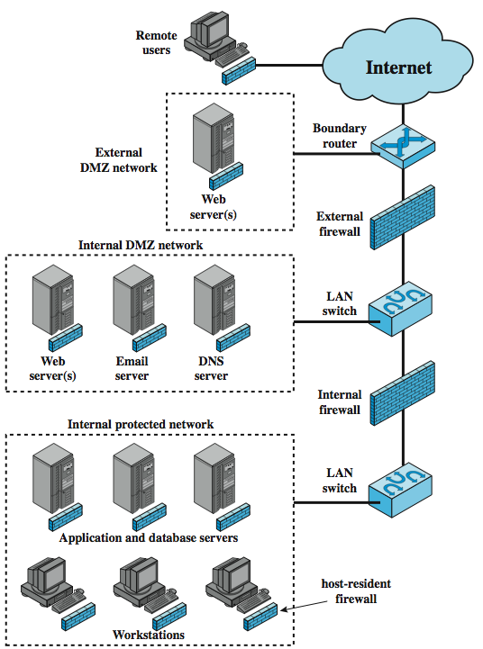
Distributed Firewalls
Notes:
A distributed firewall configuration involves stand-alone firewall devices plus host-based firewalls working together under a central administrative control. Stallings Figure 22.5 suggests a distributed firewall configuration. Administrators can configure host-resident firewalls on hundreds of servers and workstation as well as configure personal firewalls on local and remote user systems. Tools let the network administrator set policies and monitor security across the entire network. These firewalls protect against internal attacks and provide protection tailored to specific machines and applications. Stand-alone firewalls provide global protection, including internal firewalls and an external firewall, as discussed previously. With distributed firewalls, it may make sense to establish both an internal and an external DMZ. Web servers that need less protection because they have less critical information on them could be placed in an external DMZ, outside the external firewall. What protection is needed is provided by host-based firewalls on these servers. An important aspect of a distributed firewall configuration is security monitoring. Such monitoring typically includes log aggregation and analysis, firewall statistics, and fine-grained remote monitoring of individual hosts if needed.

