Slide 1

Section 4:
Network Security Topics
Firewalls

Slide 2
4.3.1 Firewalls
Typically Firewalls are used to provide perimeter defence as part of a comprehensive security strategy
Firewalls can be an effective means of protecting a local system or network of systems from network-based security threats while at the same time affording access to the outside world via wide area networks and the Internet
However they need to be part of a wider security strategy including host security

Slide 3
What Is A Firewall ?
Provide a choke point of control and monitoring
Interconnect networks with differing trust
Impose restrictions on network services
  only authorized traffic is allowed
Auditing and controlling access
  can implement alarms for abnormal behavior
Provide NAT & usage monitoring (e.g. Audit logs)
Implement VPNs using IPSec
Must be immune to penetration since it will be a target of attack

Slide 4
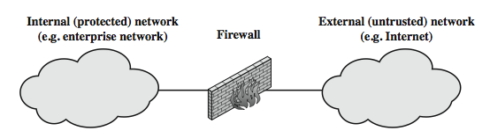
Firewalls

Slide 5
Firewall Limitations
Cannot protect from attacks bypassing it
  Utility modems, trusted organisations, trusted services (eg SSL/SSH)
Cannot protect against internal threats
  eg disgruntled or colluding employees
Cannot protect against access via WLAN
  if improperly secured against external use
Cannot protect against malware imported via laptop, PDA, storage infected outside the corporate network, and then attached and used internally
Notes:
Firewalls have their limitations, including that they:
1. cannot protect against attacks that bypass the firewall, eg PCs with dial-out capability to an ISP, or dial-in modem pool use
2. do not protect against internal threats, eg disgruntled employee or one who cooperates with an attacker
3. An improperly secured wireless LAN may be accessed from outside the organization. An internal firewall that separates portions of an enterprise network cannot guard against wireless communications between local systems on different sides of the internal firewall.
4. A laptop, PDA, or portable storage device may be used and infected outside the corporate network, and then attached and used internally.

Slide 6
4.3.2 Types Of Firewalls
1. Packet Filters
  A packet-filtering router applies a set of rules to each incoming and outgoing IP packet to forward or discard the packet.
  Filtering rules are based on information contained in a network packet such as src & dest IP addresses, ports, transport protocol & interface
  Some advantages are simplicity, transparency & speed.
Foundation of any firewall system
possible default policies
  that not expressly permitted is prohibited
  that not expressly prohibited is permitted
Notes:
Have three common types of firewalls: packet filters, application-level gateways, & circuit-level gateways.
A packet-filtering router applies a set of rules to each incoming and outgoing IP packet to forward or discard the packet. Filtering rules are based on information contained in a network packet such as src & dest IP addresses, ports, transport protocol & interface. Some advantages are simplicity, transparency & speed.
If there is no match to any rule, then one of two default policies are applied:
• that which is not expressly permitted is prohibited (default action is discard packet), conservative policy
• that which is not expressly prohibited is permitted (default action is forward packet), permissive policy

Slide 7
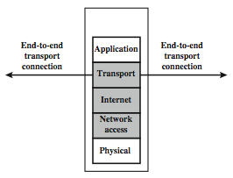
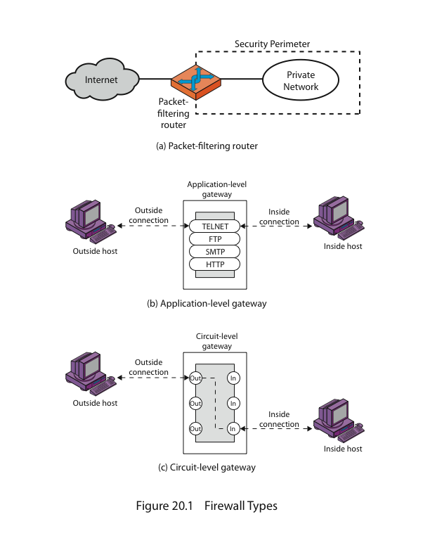
Firewalls – Packet Filters
The Figure illustrates the packet filter firewall role as utilising information from
the transport, network & data link layers to make decisions on allowable traffic flows,
and its placement in the border region between the external less-trusted Internet
and the internal more trusted private network.
Notes:
Stallings Figure 22.1b (along with 4/e Figure 20.1a) illustrates the packet filter firewall role as utilising information from the transport, network & data link layers to make decisions on allowable traffic flows, and its placement in the border router between the external less-trusted Internet and the internal more trusted private network.

Slide 8
Attacks On Packet FWs
Some of the attacks that can be made on packet-filtering routers & countermeasures are:
IP address spoofing: where intruder transmits packets from the outside with internal host source IP addr,
  need to filter & discard such packets
Source routing attacks: where source specifies the route that a packet should take to bypass security measures,
  should discard all source routed packets
Tiny fragment attacks: intruder uses the IP fragmentation option to create extremely small fragments and force the TCP header information into separate fragments to circumvent filtering rules needing full header info,
  can enforce minimum fragment size to include full header

Slide 9
2. Stateful Packet Filters
Traditional packet filters do not examine higher layer context
  ie matching return packets with outgoing flow
Stateful packet filters address this need
They examine each IP packet in context
  keep track of client-server sessions
  check each packet validly belongs to one
Hence are better able to detect bogus packets out of context
May even inspect limited application data
Notes:
A traditional packet filter makes filtering decisions on an individual packet basis and does not take into consideration any higher layer context. In general, when an application that uses TCP creates a session with a remote host, it creates a TCP connection in which the TCP port number for the remote (server) application is a number less than 1024 and the TCP port number for the local (client) application is a number between 1024 and 65535. A simple packet filtering firewall must permit inbound network traffic on all these high- numbered ports for TCP-based traffic to occur. This creates a vulnerability that can be exploited by unauthorized users. A stateful inspection packet filter tightens up the rules for TCP traffic by creating a directory of outbound TCP connections, and will allow incoming traffic to high-numbered ports only for those packets that fit the profile of one of the entries in this directory. Hence they are better able to detect bogus packets sent out of context. A stateful packet inspection firewall reviews the same packet information as a packet filtering firewall, but also records information about TCP connections. Some stateful firewalls also keep track of TCP sequence numbers to prevent attacks that depend on the sequence number, such as session hijacking. Some even inspect limited amounts of application data for some well-known protocols like FTP, IM and SIPS commands, in order to identify and track related connections.

Slide 10
Firewalls – Stateful Packet Filters
A stateful inspection packet filter tightens up the rules for TCP traffic by creating a directory of outbound TCP connections, and will allow incoming traffic to high-numbered ports only for those packets that fit the profile of one of the entries in this directory.
Hence they are better able to detect bogus packets sent out of context.
A stateful packet inspection firewall reviews the same packet information as a packet filtering firewall, but also records information about TCP connections.

Slide 11
3. Application Level Gateway
(or Proxy)
An application-level gateway (or proxy server), acts as a relay of application-level traffic
A user contacts the gateway to access some service, provides details of the service, remote host & authentication details. The gateway contacts the application on the remote host and relays all data between the two endpoints
If the gateway does not implement the proxy code for a specific application, then it is not supported and cannot be used
Note that some services naturally support proxying, whilst others are more problematic. Application-level gateways tend to be more secure than packet filters, & can log and audit traffic at application level
Notes:
An application-level gateway (or proxy server), acts as a relay of application-level traffic. A user contacts the gateway to access some service, provides details of the service, remote host & authentication details, contacts the application on the remote host and relays all data between the two endpoints. If the gateway does not implement the proxy code for a specific application, then it is not supported and cannot be used. Note that some services naturally support proxying, whilst others are more problematic. Application-level gateways tend to be more secure than packet filters, &can log and audit traffic at application level.

Slide 12
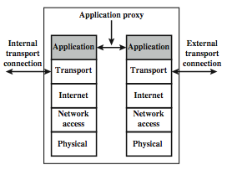
3. Application Level Gateway (or Proxy)
The Figure illustrates an application-level gateway
only supports a specific list of application services
Notes:
Stallings Figure 22.1d (along with 4/e Figure 20.1b) illustrates an application-level gateway (or proxy server), emphasizing that it only supports a specific list of application services.

