Slide 1

Cryptography
An Introduction
Continued…
Shon Harris
CISSP, 5th Edition

Slide 2
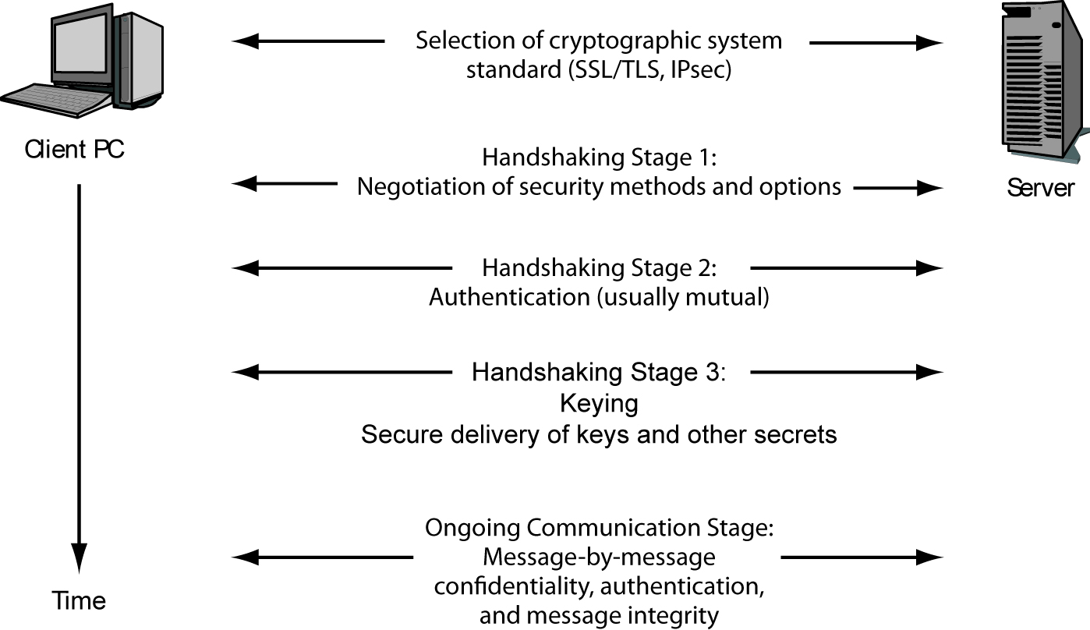
3.19.5 Cryptographic System

Slide 3
3.19.6 Secure Shell
Secure Shell (SSH) functions as a type of tunneling mechanism that provides terminal-like access to remote computers. SSH is a program and a protocol that can be used to log into another computer over a network.
For example, the program can let Paul, who is on computer A, access computer B’s files, run applications on computer B, and retrieve files from computer B without ever physically touching that computer. SSH provides authentication and secure transmission over vulnerable channels like the Internet.

Slide 4
Secure Shell
SSH should be used instead of Telnet, FTP, rlogin, rexec, or rsh, which provide the same type of functionality SSH offers but in a much less secure manner. SSH is a program and a set of protocols that work together to provide a secure tunnel between two computers.
The two computers go through a handshaking process and exchange (via Diffie-Hellman) a session key that will be used during the session to encrypt and protect the data sent. The steps of an SSH connection are outlined in the Figure.

Slide 5
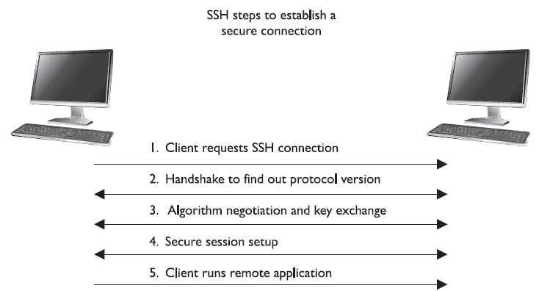
Once the handshake takes place and a secure channel is established, the two computers have a pathway to exchange data with the assurance that the information will be encrypted and its integrity will be protected.

Slide 6
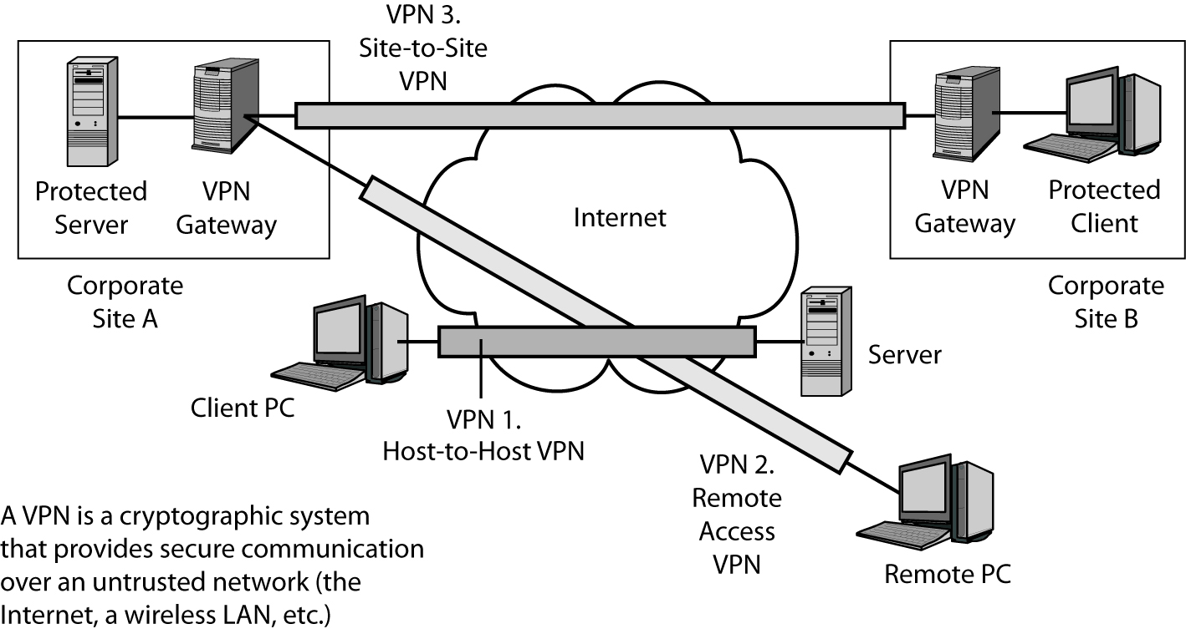
3.19.7 Virtual Private Networks (VPNs)
Raymond Panko

Slide 7
3.19.8 IPSEC (Internet Protocol Security)
The Internet Protocol Security (IPSec) protocol suite provides a method of setting up a secure channel for protected data exchange between two devices. The devices that share this secure channel can be two servers, two routers, a workstation and a server, or
two gateways between different networks.
IPSec is a widely accepted standard for providing
network layer protection. It can be more flexible and less expensive than end-to-end and link encryption methods.

Slide 8
IPSEC (Internet Protocol Security)
IPSec has strong encryption and authentication methods, and although it can be used to enable tunneled communication between two computers, it is usually employed to establish virtual private networks (VPNs) among networks across the Internet.
IPSec is not a strict protocol that dictates the type of algorithm, keys, and authentication method to use. Rather, it is an open, modular framework that provides a lot of flexibility for companies when they choose to use this type of technology.

Slide 9
IPSEC (Internet Protocol Security)
IPSec uses two basic security protocols: Authentication Header (AH) and Encapsulating Security Payload (ESP).
AH is the authenticating protocol, and ESP is an authenticating and encrypting protocol that uses cryptographic mechanisms to provide source authentication, confidentiality, and message integrity.

Slide 10
IPSEC (Internet Protocol Security)
IPSec can work in one of two modes: transport mode, in which the payload of the message is protected, and tunnel mode, in which the payload and the routing and header information are protected.
ESP in transport mode encrypts the actual message information so it cannot be sniffed and uncovered by an unauthorized entity. Tunnel mode provides a higher level of protection by also protecting the header and trailer data an attacker may find useful.

Slide 11
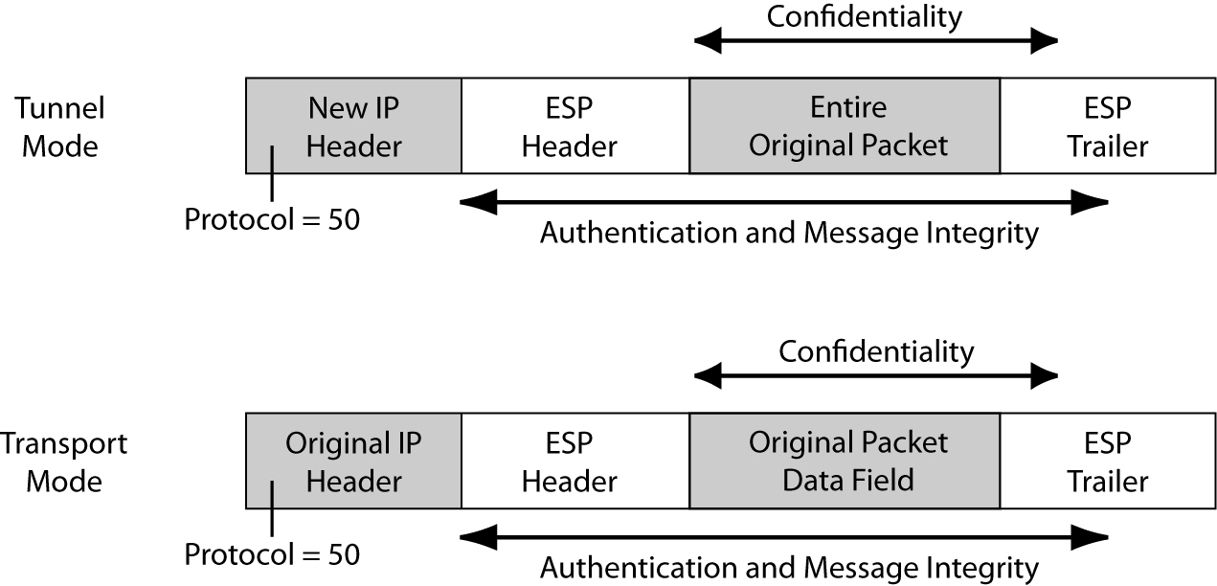
IPsec Encapsulating Security Payload (ESP) Header and Trailer in Transport and Tunnel Modes

Slide 12
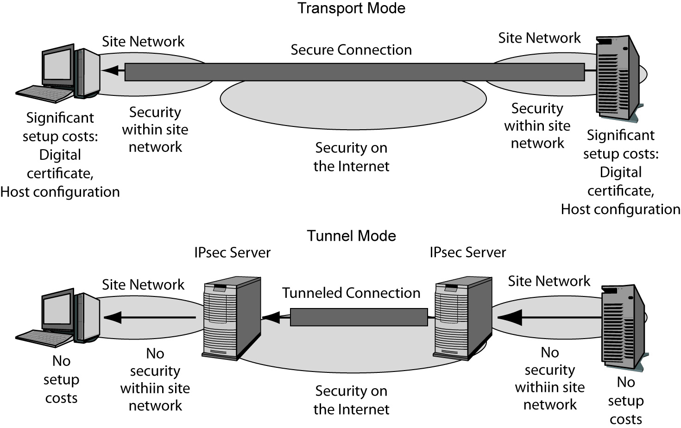
IPsec Operation: Transport Mode
1.
End-to-End
Security
(Good)
2.
Security in
Site Network
(Good)
3.
Setup Cost
On Each Host
(Costly)

Slide 13
IPsec Operation: Tunnel Mode
2.
No Security in
Site Network
(Bad)
3.
No Setup Cost
On Each Host
(Good)
Raymond Panko

Slide 14
Comparing IPsec Transport and Tunnel Modes
Characteristic | Transport Mode | Tunnel Mode
Uses an IPsec VPN Gateway? | No | Yes
Cryptographic Protection | All the way from the source host to the destination host, including the Internet and the two site networks. | Only over the Internet between the IPsec gateways. Not within the two site networks.
Setup Costs | High. Setup requires the creation of a digital certificate for each client and significant configuration work. | Low. Only the IPsec gateways must implement IPsec, so only they need digital certificates and need to be configured.
Raymond Panko

Slide 15
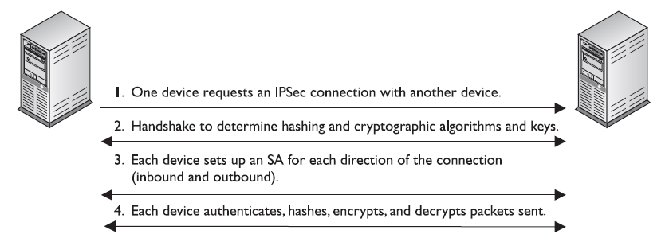
The Figure shows the high-level view of the steps of setting up an IPSec connection.

Slide 16
IPSEC (Internet Protocol Security)
Each device will have at least one security association (SA) for each secure connection it uses. The SA, which is critical to the IPSec architecture, is a record of the configurations the device needs to support an IPSec connection.
When two devices complete their handshaking process, which means they have agreed upon a long list of parameters they will use to communicate, these data must be recorded and stored somewhere, which is in the SA. The SA can contain the authentication and encryption keys, the agreed-upon algorithms, the key lifetime, and the source IP address.

Slide 17
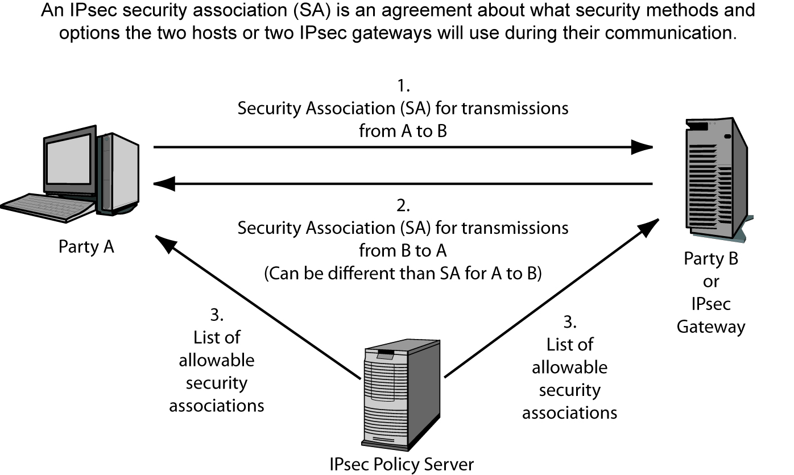
IPsec Security Associations

Slide 18
IPSEC (Internet Protocol Security)
When a device receives a packet via the IPSec protocol, it is the SA that tells the device what to do with the packet. So if device B receives a packet from device C via IPSec, device B will look to the corresponding SA to tell it how to decrypt the packet, how to properly authenticate the source of the packet, which key to use, and how to reply to the message if necessary.
SAs are directional, so a device will have one SA for outbound traffic and a different SA for inbound traffic for each individual communication channel. If a device is connecting to three devices, it will have at least six SAs, one for each inbound and outbound connection per remote device.

Slide 19
IPSEC (Internet Protocol Security)
So how can a device keep all of these SAs organized and ensure that the right SA is invoked for the right connection? With the mighty security parameter index (SPI), that’s how.
Each device has an SPI that keeps track of the different SAs and tells the device which one is appropriate to invoke for the different packets it receives. The SPI value is in the header of an IPSec packet, and the device reads this value to tell it which SA to consult, as depicted in the Figure.

Slide 20
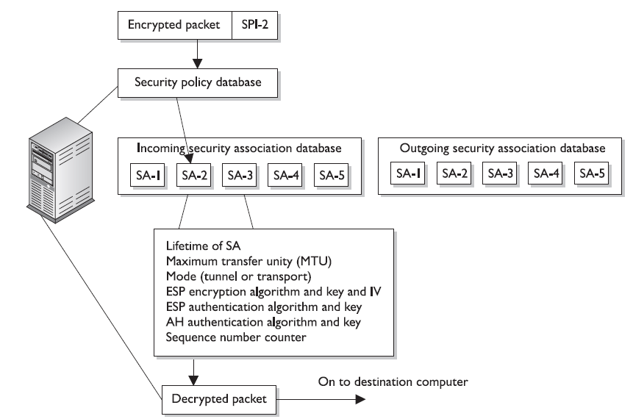

Slide 21
IPSEC (Internet Protocol Security)
IPSec can authenticate the sending devices of the packet by using MAC (covered in the earlier section, “The One-Way Hash”). The ESP protocol can provide authentication, integrity, and confidentiality if the devices are configured for this type of functionality. So if a company just needs to make sure it knows the source of the sender and must be assured of the integrity of the packets, it would choose to use AH.

Slide 22
IPSEC (Internet Protocol Security)
If the company would like to use these services and also have confidentiality, it would use the ESP protocol because it provides encryption functionality. In most cases, the reason ESP is employed is because the company must set up a secure VPN connection.

