Slide 1
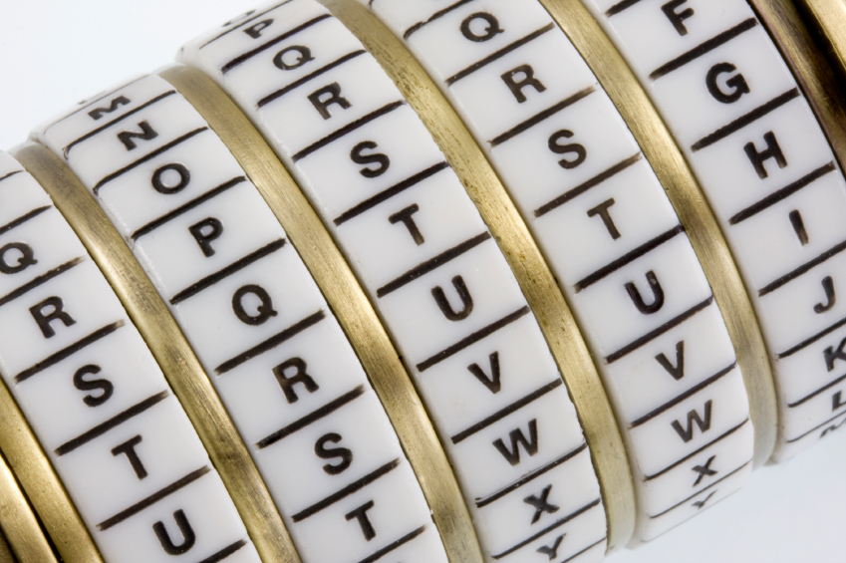
Cryptography
An Introduction
Continued…
Shon Harris
CISSP, 5th Edition

Slide 2
Secure HTTP
Though their names are very similar, there is a difference between Secure HTTP (S-HTTP) and HTTP Secure (HTTPS). S-HTTP is a technology that protects each message sent between two computers, while HTTPS protects the communication channel between two computers, messages and all.
HTTPS uses SSL/TLS and HTTP to provide a protected circuit between a client and server. So, S-HTTP is used if an individual message needs to be encrypted, but if all information that passes between two computers must be encrypted, then HTTPS is used, which is SSL over HTTP.

Slide 3
3.19.3 Secure Electronic Transaction
Secure Electronic Transaction (SET) is a security technology proposed by Visa and MasterCard to allow for more secure credit card transaction possibilities than what is currently available. SET has been waiting in the wings for full implementation and acceptance as a standard for quite some time.
Although SET provides an effective way of transmitting credit card information, businesses and users do not see it as efficient because it requires more parties to coordinate their efforts, more software installation and configuration for each entity involved, and more effort and cost than the widely used SSL method.

Slide 4
Secure Electronic Transaction
SET is a cryptographic protocol and infrastructure developed to send encrypted credit card numbers over the Internet. The following entities would be involved with a SET transaction, which would require each of them to upgrade their software, and possibly their hardware:

Slide 5
Secure Electronic Transaction
• Issuer (cardholder’s bank) The financial institution that provides a credit card to the individual.
• Cardholder The individual authorized to use a credit card.
• Merchant The entity providing goods.
• Acquirer (merchant’s bank) The financial institution that processes payment cards.
• Payment gateway This processes the merchant payment. It may be an acquirer.

Slide 6
Secure Electronic Transaction
To use SET, a user must enter his credit card number into his electronic wallet software. This information is stored on the user’s hard drive or on a smart card. The software then creates a public key and a private key that are used specifically for encrypting financial information before it is sent.
Let’s say Ahmad wants to use his electronic credit card to buy his brother a gift from a web site. When he finds the perfect gift and decides to purchase it, he sends his encrypted credit card information to the merchant’s web server. The merchant does not decrypt the credit card information, but instead digitally signs it and sends it on to its processing bank.

Slide 7
Secure Electronic Transaction
At the bank, the payment server decrypts the information, verifies that Ahmad has the necessary funds, and transfers the funds from Ahmad’s account to the merchant’s account. Then the payment server sends a message to the merchant telling it to finish the transaction, and a receipt is sent to Ahmad and the merchant.
At each step, an entity verifies a digital signature of the sender and digitally signs the information before it is sent to the next entity involved in the process. This would require all entities to have digital certificates and to participate in a PKI.

Slide 8
Secure Electronic Transaction
This is basically a very secure way of doing business over the Internet, but today everyone seems to be happy enough with the security SSL provides. They do not feel motivated enough to move to a different and more encompassing technology.
The lack of motivation comes from all of the changes that would need to take place to our current processes and the amount of money these changes would require.

Slide 9
3.19.4 Cookies
Cookies are text files that a browser maintains on a user’s hard drive. Cookies have different uses, and some are used for demographic and advertising information. As a user travels from site to site on the Internet, the sites could be writing data to the cookies stored on the user’s system.
The sites can keep track of the user’s browsing and
spending habits and the user’s specific customization for certain sites. For example, if Bilal goes to mainly gardening sites on the Internet, those sites will most likely record this information and the types of items in which he shows most interest.

Slide 10
Cookies
Then, when Bilal returns to one of the same or similar sites, it will retrieve his cookies, find he has
shown interest in gardening books in the past, and present him with its line of gardening books.
This increases the likelihood of Bilal purchasing a book of his liking. This is a way of zeroing in on the right marketing tactics for the right person. The servers at the web site determine how cookies are actually used.

Slide 11
Cookies
When a user adds items to his shopping cart on a site, such data are usually added to a cookie. Then, when the user is ready to check out and pay for his items, all the data in this specific cookie are extracted and the totals are added.
As stated before, HTTP is a stateless protocol, meaning a web server has no memory of any prior connections. This is one reason to use cookies. They retain the memory between HTTP connections by saving prior connection data to the client’s computer.

Slide 12
Cookies
For example, if you carry out your banking activities online, your bank’s web server keeps track of your activities through the use of cookies. When you first go to its site and are looking at public information, such as branch locations, hours of operation, and
CD rates, no confidential information is being transferred back and forth.
Once you make a request to access your bank account, the web server sets up an SSL connection
and requires you to send credentials.

Slide 13
Cookies
Once you send your credentials and are authenticated, the server generates a cookie with your authentication and account information
in it. The server sends it to your browser, which either saves it to your hard drive or keeps it in memory.
So, suppose you look at your checking account, do some work there, and then request to view your savings account information. The web server sends a request to see if you have been properly authenticated for this activity by checking your cookie.

Slide 14
Cookies
Most online banking software also periodically requests your cookie, to ensure no man-in-the-middle attacks are going on and that someone else has not hijacked the session. It is also important to ensure that secure connections time out.
This is why cookies have timestamps within them. If you have ever worked on a site that has an SSL connection set up for you and it required you to reauthenticate, the reason is that your session has been idle for a while and, instead of leaving a secure connection open, the web server software closed it out.

Slide 15
Cookies
A majority of the data within a cookie is meaningless to any entities other than the servers at specific sites, but some cookies can contain usernames and passwords for different accounts on the Internet.
The cookies that contain sensitive information should be encrypted by the server at the site that distributes them, but this does not always happen, and a nosey attacker could find this data on the user’s hard drive and attempt to use it for mischievous activity.

Slide 16
Cookies
Some people who live on the paranoid side of life do
not allow cookies to be downloaded to their systems (controlled through browser security controls). Although this provides a high level of protection against different types of cookie abuse, it also reduces their functionality on the Internet.
Some sites require cookies because there is specific data within the cookies that the site must utilize correctly in order to provide the user with the services he requested.

