Slide 1
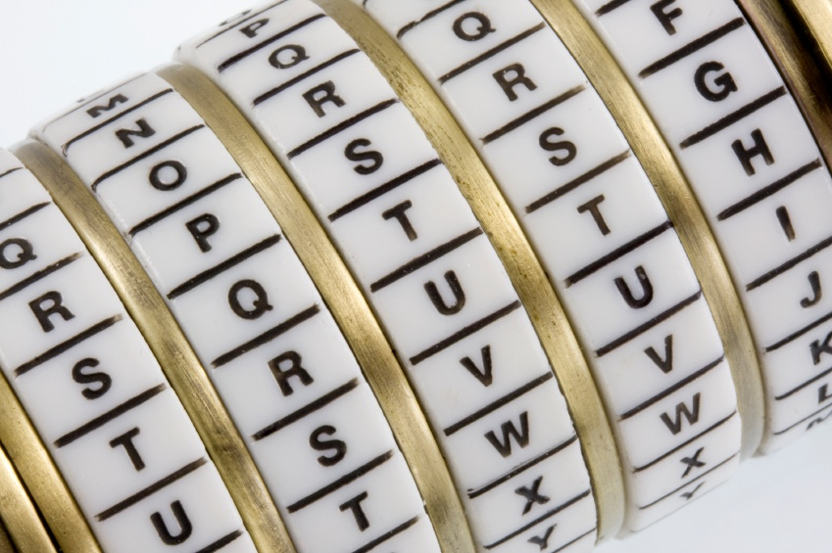
Cryptography
An Introduction
Continued…
Shon Harris
CISSP, 5th Edition

Slide 2
S/MIME
Secure MIME (S/MIME) is a standard for encrypting and digitally signing electronic mail and for providing secure data transmissions.
S/MIME extends the MIME standard by allowing for the encryption of e-mail and attachments. The encryption and hashing algorithms can be specified by the user of the mail package, instead of having it dictated to them.

Slide 3
S/MIME
S/MIME provides confidentiality through encryption algorithms, integrity through hashing algorithms, authentication through the use of X.509 public key certificates, and non-repudiation
through cryptographically signed message digests.

Slide 4
Pretty Good Privacy
Pretty Good Privacy (PGP) was designed by Phil Zimmerman as a freeware e-mail security
program and was released in 1991. It was the first widespread public key encryption program. PGP is a complete cryptosystem that uses cryptographic protection to protect e-mail and files.
It can use RSA public key encryption for key management and use IDEA symmetric cipher for bulk encryption of data, although the user has the option of picking different types of algorithms for these functions.

Slide 5
Pretty Good Privacy
PGP can provide confidentiality by using the IDEA encryption algorithm, integrity by using the MD5 hashing algorithm,
authentication by using the public key certificates, and nonrepudiation by using cryptographically signed messages. PGP uses its own type of digital certificates rather than what is used in PKI, but they both have similar purposes.

Slide 6
3.18.1 Quantum Cryptography
Because of the need to always build a better algorithm, some very smart people have mixed quantum physics and cryptography, which has resulted in a system (if built correctly) that is unbreakable and where any eavesdroppers can be detected.
In traditional cryptography, we try to make it very hard for an eavesdropper to break an algorithm
and uncover a key, but we cannot detect that an eavesdropper is on the line. In quantum
cryptography, however, not only is the encryption very strong, but an eavesdropper can be detected.

Slide 7
Quantum Cryptography
Quantum cryptography can be carried out using various methods. So, we will walk through one version to review how all this works.
Let’s say Tom and Kathy are spies and need to send their data back and forth with the assurance it won’t be captured. To do so, they need to establish a symmetric encryption key on both ends, one for Tom and one for Kathy.

Slide 8
Quantum Cryptography
In quantum cryptography, photon polarization is commonly used to represent bits (1 or 0). Polarization is the orientation of electromagnetic waves, which is what photons are. Photons are the particles that make up light.
The electromagnetic waves have an orientation of horizontal or vertical, or left hand or right hand.
Think of a photon as a jellybean. As a jellybean flies through the air, it can be vertical (standing up straight), horizontal (lying on its back), left handed (tilted to the left), or right handed (tilted to the right). (This is just to conceptually get your head around the idea of polarization.)

Slide 9
Quantum Cryptography
Now both Kathy and Tom each have their own photon gun, which they will use to send photons (information) back and forth to each other. They also have a mapping between the polarization of a photon and a binary value.
The polarizations can be represented as vertical (|), horizontal (–), left (\), or right (/), and since we only have two values in binary, there must be some overlap.

Slide 10
3.18.2 Quantum Cryptography Example
In this example, a photon with a vertical (|) polarization maps to the binary value of 0. A left polarization (\) maps to 1, a right polarization (/) maps to 0, and a horizontal polarization (–) maps to 1. This mapping (or encoding) is the binary values that
make up an encryption key.
Tom must have the same mapping to interpret what Kathy sends to him. Tom will use this as his map so when he receives a photon with the polarization of (\), he will write down a 1. When he receives a photon with the polarization of (|), he will write down a 0. He will do this for the whole key, and use these values as the key to decrypt a message Kathy sends him.

Slide 11
Quantum Cryptography
Note: If it helps, think about it this way. Tom receives a jellybean that is horizontal and he writes down a 1. The next jellybean he receives is tilted to the right, so he writes down 0. The next jellybean is vertical, so he writes down 1. He does this for all of the jellybeans Kathy sends his way. Now he has a string of binary values that is the encryption key his system will use to
decrypt the messages Kathy sends to him.

Slide 12
Quantum Cryptography
So they both have to agree upon a key, which is the mapping between the polarization states of the photons and how those states are represented in a binary value. This happens at the beginning of a communication session over a dedicated fiber line.
Once the symmetric key is established, it can be used by Kathy and Tom to encrypt and decrypt messages that travel over a more public communication path, like the Internet. The randomness of the polarization and the complexity of creating a symmetric key in this manner help ensure that an eavesdropper will not uncover the encryption key.

Slide 13
Quantum Cryptography
Since this type of cryptography is based on quantum physics and not strictly mathematics, the sender and receiver can be confident that no eavesdropper is listening to the communication path used to establish their key and that a man-in-the-middle attack
is not being carried out.
This is because, at the quantum level, even “looking” at an atom or a subatomic particle changes its attributes. This means that if there is an eavesdropper carrying out a passive attack, such as sniffing, the receiver would know because just this simple act changes the characteristics (polarization) of the photons.

Slide 14
Quantum Cryptography
This means that as the jellybeans are sent from Kathy to Tom, if Sean tries to view the jellybeans, the ones that were traveling in a horizontal manner could be tilting left, and ones that were traveling in a vertical manner could now be traveling horizontally.
Some people in the industry think quantum cryptography is used between the U.S. White House and the Pentagon and between some military bases and defense contractor
locations. This type of information is classified Top Secret by the U.S. government, and unless you know the secret handshake and have the right decoder ring, you will not
be privy to this type of information.

Slide 15
3.19 Internet Security
The Web is not the Internet. The Web runs on top of the Internet, in a sense. The Web is the collection of HTTP servers that hold and process web sites we see. The Internet is the collection of physical devices and communication protocols used to traverse
these web sites and interact with them.
The web sites look the way they do because their creators used a language that dictates the look, feel, and functionality of the page. Web browsers enable users to read web pages by enabling them to request and accept web pages via HTTP, and the user’s browser converts the language (HTML, DHTML, and XML) into a format that can be viewed on the monitor. The browser is the user’s window to the World Wide Web.

Slide 16
Internet Security
Browsers can understand a variety of protocols and have the capability to process many types of commands, but they do not understand them all. For those protocols or commands the user’s browser does not know how to process, the user can download and install a viewer or plug-in, a modular component of code that integrates itself into
the system or browser.
This is a quick and easy way to expand the functionality of the
browser. However, this can cause serious security compromises, because the payload of the module can easily carry viruses and malicious software that users don’t discover
until it’s too late.

Slide 17
Internet Protocols
Why do we connect to the Internet? At first, this seems a basic question, but as we dive deeper into the query, complexity creeps in. We connect to download MP3s, check e-mail, order security books, look at web sites, communicate with friends, and perform various other tasks.
But what are we really doing? We are using services provided by a computer’s protocols and software. The services may be file transfers provided by FTP, remote connectivity provided by Telnet, Internet connectivity provided by HTTP, secure
connections provided by SSL, and much, much more. Without these protocols, there would be no way to even connect to the Internet.

Slide 18
3.19.1 HTTP
TCP/IP is the protocol suite of the Internet, and HTTP is the protocol of the Web. HTTP sits on top of TCP/IP. When a user clicks a link on a web page with his mouse, his browser uses HTTP to send a request to the web server hosting that web site. The web
server finds the corresponding file to that link and sends it to the user via HTTP.
So where is TCP/IP in all of this? The TCP protocol controls the handshaking and maintains the connection between the user and the server, and the IP protocol makes sure the file is routed properly throughout the Internet to get from the web server to the user.

Slide 19
HTTP
HTTP is a stateless protocol, which means the client and web server make and break a connection for each operation. When a user requests to view a web page, that web server finds the requested web page, presents it to the user, and then terminates the connection.

Slide 20
3.19.2 HTTP Secure
HTTP Secure (HTTPS) is HTTP running over SSL. (HTTP works at the application layer and SSL works at the transport layer.) Secure Sockets Layer (SSL) uses public key encryption and provides data encryption, server authentication, message integrity, and optional
client authentication.
When a client accesses a web site, that web site may have both secured and public portions. The secured portion would require the user to be authenticated in some fashion. When the client goes from a public page on the web site to a secured page, the web server will start the necessary tasks to invoke SSL and protect this type of communication.

Slide 21
HTTP Secure
The server sends a message back to the client, indicating a secure session should be established, and the client in response sends its security parameters. The server compares those security parameters to its own until it finds a match.
This is the handshaking phase. The server authenticates to the client by sending it a digital certificate, and if the client decides to trust the server, the process continues. The server can require the client to send over a digital certificate for mutual authentication, but that is rare.

Slide 22
HTTP Secure
The client generates a session key and encrypts it with the server’s public key. This encrypted key is sent to the web server, and they both use this symmetric key to encrypt the data they send back and forth. This is how the secure channel is established.
SSL keeps the communication path open until one of the parties requests to end the session. The session is usually ended when the client sends the server a FIN packet, which is an indication to close out the channel.

Slide 23
HTTP Secure
SSL requires an SSL-enabled server and browser. SSL provides security for the connection but does not offer security for the data once received. This means the data are encrypted while being transmitted, but not after the data are received by a computer.
So if a user sends bank account information to a financial institution via a connection protected by SSL, that communication path is protected, but the user must trust the financial institution that receives this information, because at this point, SSL’s job is
done.

Slide 24
HTTP Secure
The user can verify that a connection is secure by looking at the URL to see that it includes https://. The user can also check for a padlock or key icon, depending on the browser type, which is shown at the bottom corner of the browser window.
In the protocol stack, SSL lies beneath the application layer and above the network layer. This ensures SSL is not limited to specific application protocols and can still use the communication transport standards of the Internet. Different books and technical resources place SSL at different layers of the OSI model, which may seem confusing at first.

Slide 25
HTTP Secure
SSL is actually made up of two protocols: one works at the lower end of the session layer, and the other works at the top of the transport layer. This is why one resource will state that SSL works at the session layer and another resource puts it in the transport layer. We will use the latter definition; the SSL protocol works at the transport layer.
Although SSL is almost always used with HTTP, it can also be used with other types of protocols. So if you see a common protocol that is followed by an s, that protocol is using SSL to encrypt its data.

Slide 26
HTTP Secure
SSL is currently at version 3.0. Since SSL was developed by Netscape, it is not an open-community protocol. This means the technology community cannot easily extend SSL to interoperate and expand in its functionality. If a protocol is proprietary in nature, as SSL is, the technology community cannot directly change its specifications and functionality.
If the protocol is an open-community protocol, then its specifications can be modified by individuals within the community to expand what it can do and what technologies it can work with. So the open-community version of SSL is Transport Layer Security (TLS). The differences between SSL 3.0 and TLS is slight, but TLS is more extensible and is backward compatible with SSL.

