Slide 1
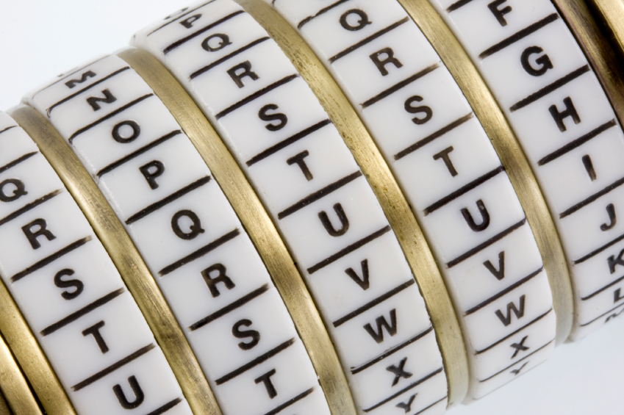
Cryptography
An Introduction
Continued…
Shon Harris
CISSP, 5th Edition

Slide 2
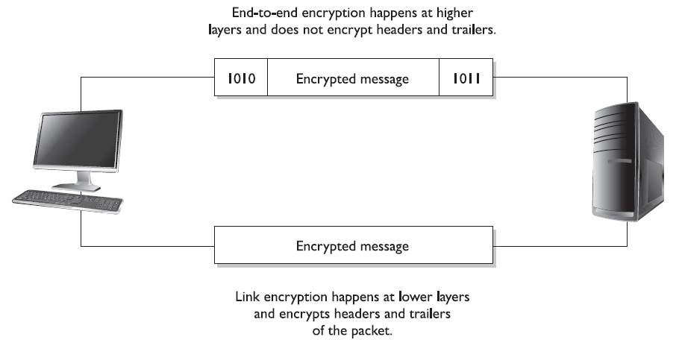
Link and end-to-end encryption happen at different OSI layers.

Slide 3
Encryption At Different Layers
• End-to-end encryption happens within the applications.
• SSL encryption takes place at the transport layer.
• PPTP encryption takes place at the data link layer.
• Link encryption takes place at the data link and physical layers.

Slide 4
Multipurpose Internet Mail Extension
Multipurpose Internet Mail Extension (MIME) is a technical specification indicating how multimedia data and e-mail attachments are to be transferred.
The Internet has mail standards that dictate how mail is to be formatted, encapsulated, transmitted, and opened. If a message or document contains a binary attachment, MIME dictates how that portion of the message should be handled.

Slide 5
Multipurpose Internet Mail Extension
When an attachment contains an audio clip, graphic, or some other type of multimedia component, the e-mail client will send the file with a header that describes the file type. For example, the header might indicate that the MIME type is Image and that
the subtype is jpeg.

Slide 6
Multipurpose Internet Mail Extension
Although this will be in the header, many times systems also use the file’s extension to identify the MIME type. So, in the preceding example, the file’s name might be stuff.jpeg.
The user’s system will see the extension .jpeg, or see the data in the header field, and look in its association list to see what program it needs to initialize to open this particular file. If the system has JPEG files associated with the Explorer application, then Explorer will open and present the picture to the user.

Slide 7
Multipurpose Internet Mail Extension
Sometimes systems either do not have an association for a specific file type or do not have the helper program necessary to review and use the contents of the file.
When a file has an unassociated icon assigned to it, it might require the user to choose the Open With command and choose an application in the list to associate this file with
that program. So when the user double-clicks that file, the associated program will initialize and present the file. If the system does not have the necessary program, the web
site might offer the necessary helper program, like Acrobat or an audio program that plays WAV files.

Slide 8
Multipurpose Internet Mail Extension
MIME is a specification that dictates how certain file types should be transmitted and handled. This specification has several types and subtypes, enables different computers to exchange data in varying formats, and provides a standardized way of presenting the data.
So if Sean views a funny picture that is in GIF format, he can be sure that when he sends it to Debbie, it will look exactly the same.

Slide 9
S/MIME
Secure MIME (S/MIME) is a standard for encrypting and digitally signing electronic mail and for providing secure data transmissions.
S/MIME extends the MIME standard by allowing for the encryption of e-mail and attachments. The encryption and hashing algorithms can be specified by the user of the mail package, instead of having it dictated to them.

Slide 10
S/MIME
S/MIME follows the Public Key Cryptography Standards (PKCS).
S/MIME provides confidentiality through encryption algorithms, integrity through hashing algorithms, authentication through the use of X.509 public key certificates, and non-repudiation
through cryptographically signed message digests.

Slide 11
Privacy-Enhanced Mail
Privacy-Enhanced Mail (PEM) is an Internet standard to provide secure e-mail over the Internet and for inhouse communication infrastructures. The protocols within PEM provide authentication, message integrity, encryption, and key management.
This standard was developed to provide compatibility with many types of key-management processes and symmetric and public key methods of encryption. It was also designed to be compatible with PKCS.

Slide 12
Privacy-Enhanced Mail
PEM is a series of message authentication and encryption technologies developed by several governing groups. PEM can use AES for encryption and RSA for sender authentication
and key management. It also provides support for non-repudiation.
The following are specific components that can be used in PEM:

Slide 13
Privacy-Enhanced Mail
• Messages encrypted with AES in CBC mode
• Public key management, provided by using RSA
• X.509 standard, used for certification structure and format
PEM has not caught on to the extent the developers had planned. The main issue is that PEM provides too much structure for different environments that require more flexibility in their secure communication infrastructure.

Slide 14
Pretty Good Privacy
Pretty Good Privacy (PGP) was designed by Phil Zimmerman as a freeware e-mail security
program and was released in 1991. It was the first widespread public key encryption program. PGP is a complete cryptosystem that uses cryptographic protection to protect e-mail and files.
It can use RSA public key encryption for key management and use IDEA symmetric cipher for bulk encryption of data, although the user has the option of picking different types of algorithms for these functions.

Slide 15
Pretty Good Privacy
PGP can provide confidentiality by using the IDEA encryption algorithm, integrity by using the MD5 hashing algorithm,
authentication by using the public key certificates, and nonrepudiation by using cryptographically signed messages. PGP uses its own type of digital certificates rather than what is used in PKI, but they both have similar purposes.
The user’s private key is generated and encrypted when the application asks the user to randomly type on his keyboard for a specific amount of time. Instead of using passwords, PGP uses passphrases. The passphrase is used to encrypt the user’s private key that is stored on the users hard drive.

Slide 16
Pretty Good Privacy
PGP does not use a hierarchy of CAs, or any type of formal trust certificates, but instead relies on a “web of trust” in its key management approach. Each user generates
and distributes his or her public key, and users sign each other’s public keys, which creates a community of users who trust each other. This is different from the CA approach,
where no one trusts each other; they only trust the CA.

Slide 17
Pretty Good Privacy
For example, if Mark and Joe want to communicate using PGP, Mark can give his public key to Joe. Joe signs Mark’s key and keeps a copy for himself. Then, Joe gives a copy of his public key to Mark so they can start communicating securely.
Later, Mark would like to communicate with Sally, but Sally does not know Mark and does not know if she can trust him. Mark sends Sally his public key, which has been signed by Joe. Sally has Joe’s public key, because they have communicated before, and she trusts Joe. Because Joe signed Mark’s public key, Sally now also trusts Mark and sends her public key and begins communicating with him.

Slide 18
Pretty Good Privacy
So, basically, PGP is a system of “I don’t know you, but my buddy Joe says you are an all right guy, so I will trust you on Joe’s word.”

Slide 19
3.17.6 Pretty Good Privacy
Each user keeps in a file, referred to as a key ring, a collection of public keys he has received from other users. Each key in that ring has a parameter that indicates the level of trust assigned to that user and the validity of that particular key.
If Steve has known Liz for many years and trusts her, he might have a higher level of trust indicated on her stored public key than on Tom’s, whom he does not trust much at all.

Slide 20
Pretty Good Privacy
There is also a field indicating who can sign other keys within Steve’s realm of trust. If Steve receives a
key from someone he doesn’t know, like Kevin, and the key is signed by Liz, he can look at the field that pertains to whom he trusts to sign other people’s keys. him.
If the field indicates that Steve trusts Liz enough to sign another person’s key, Steve will accept Kevin’s
key and communicate with him because Liz is vouching for him. However, if Steve receives a key from Kevin and it is signed by untrustworthy Tom, Steve might choose to not trust Kevin and not communicate with him.

