Slide 1

Cryptography
An Introduction
Continued…
Shon Harris
CISSP, 5th Edition

Slide 2
Digital Signatures
A digital signature is a hash value that has been encrypted with the sender’s private key. The act of signing means encrypting the message’s hash value with a private key.
From our earlier example if Ahmad wants to ensure that the message he sends to Bilal is not modified and he wants him to be sure it came only from him, he can digitally sign the message. This means that a one-way hashing function would be run on the message, and then Ahmad would encrypt that hash value with his private key.

Slide 3
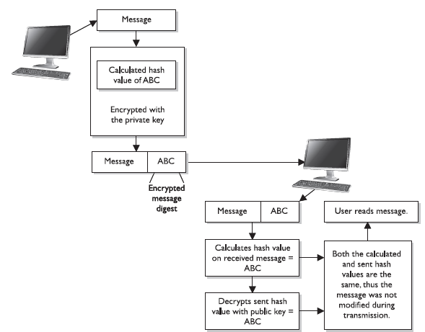

Slide 4
Public Key Infrastructure (PKI)
PKI provides authentication, confidentiality, non-repudiation, and integrity of the
messages exchanged. PKI is a hybrid system of symmetric and asymmetric key algorithms
and methods, which were discussed in earlier sections.

Slide 5
Public Key Infrastructure (PKI)
The infrastructure assumes that the receiver’s identity can be positively ensured through certificates and that an asymmetric algorithm will automatically
carry out the process of key exchange.

Slide 6
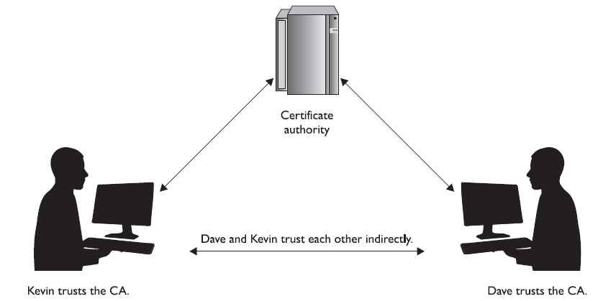
When the CA signs the certificate, it binds the individual’s identity to the public key, and the CA takes liability for the authenticity of that individual. It is this trusted third party (the CA) that allows people who have never met to authenticate to each other and to communicate in a secure method.

Slide 7
PKI Security Services
PKI supplies the following security services:
• Confidentiality
• Access control
• Integrity
• Authentication
• Nonrepudiation

Slide 8
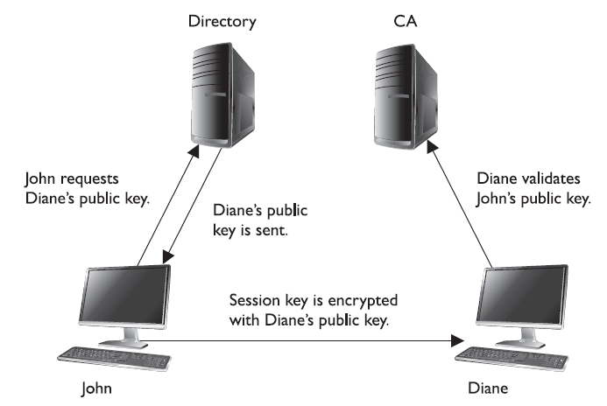
CA & User Relationships

Slide 9
Certificates
One of the most important pieces of a PKI is its digital certificate. A certificate is the mechanism used to associate a public key with a collection of components in a manner that is sufficient to uniquely identify the claimed owner.
The standard for how the CA creates the certificate is X.509, which dictates the different fields used in the certificate and the valid values that can populate those fields.

Slide 10
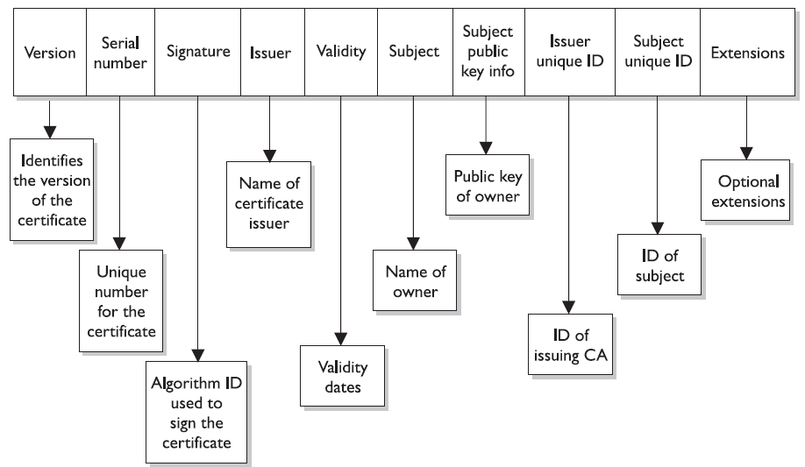
Structure Of A Certificate

Slide 11
3.15.1 Key Management
Cryptography can be used as a security mechanism to provide confidentiality, integrity, and authentication, but not if the keys are compromised in any way. The keys can be captured, modified, corrupted, or disclosed to unauthorized individuals.
Cryptography is based on a trust model. Individuals must trust each other to protect their own keys, trust the administrator who is maintaining the keys, and trust a server that holds, maintains, and distributes the keys.

Slide 12
Key Management
Many administrators know that key management causes one of the biggest headaches in cryptographic implementation. There is more to key maintenance than using them to encrypt messages.
The keys must be distributed securely to the right entities and updated continuously.
They must also be protected as they are being transmitted and while they are being stored on each workstation and server.
The keys must be generated, destroyed, and recovered properly.

Slide 13
Key Management
Key management can be handled through
manual or automatic processes.
The keys are stored before and after distribution. When a key is distributed to a user, it does not just hang out on the desktop. It needs a secure place within the file system to be stored and used in a controlled method. The key, the algorithm that will use the key, configurations, and parameters are stored in a module that also needs to be protected.

Slide 14
Key Management
If an attacker is able to obtain these components, he could masquerade as another user and decrypt, read, and re-encrypt messages not intended for him.
Historically, physical cryptographic keys were kept in secured boxes and delivered by
escorted couriers. The keys could be distributed to a main server, and then the local administration would distribute them, or the courier would visit each computer individually.

Slide 15
Key Management
Some implementations distributed a master key to a site, and then that key was used to generate unique secret keys to be used by individuals at that location.
Today, most key distributions are handled by a protocol through automated means and not
manually by an individual. A company must evaluate the overhead of key management, the required security level, and cost-benefit issues to decide how it will conduct key management, but overall, automation provides a more accurate and secure approach.

Slide 16
3.15.2 Kerberos Protocol
When using the Kerberos protocol , a Key Distribution Center (KDC) is used to store, distribute, and maintain cryptographic session and secret keys.
This method provides an automated method of key distribution. The computer that wants to access a service on another computer requests access via the KDC. The KDC then generates a session key to be used between the requesting computer and the computer providing the requested resource or service.

Slide 17
The automation of this process reduces the possible errors that can happen through a manual process, but if the ticket granting service (TGS) portion of the KDC gets compromised in any way, then all the computers and their services are affected and possibly compromised.
In some instances, keys are still managed through manual means.

Slide 18
Unfortunately, although many companies use cryptographic keys, they rarely if ever change them, either because of the hassle of key management or because the network administrator is already overtaxed with other tasks or does not realize the task actually needs to take place.
The frequency of use of a cryptographic key has a direct correlation to how often the key should be changed. The more a key is used, the more likely it is to be captured and compromised. If a key is used infrequently, then this risk drops dramatically.

Slide 19
A small departmental store might only change its cryptography keys every month, whereas an information warfare military unit might change them every day or every week. The important thing is to change the keys using a secure method.
Key management is the most challenging part of cryptography and also the most crucial. It is one thing to develop a very complicated and complex algorithm and key method, but if the keys are not securely stored and transmitted, it does not really matter how strong the algorithm is.

Slide 20
3.15.3 Key Management Principles
Keys should not be in cleartext outside the cryptography device. As stated previously,
many cryptography algorithms are known publicly, which puts more stress on protecting
the secrecy of the key.
If attackers know how the actual algorithm works, in many cases all they need to figure out is the key to compromise a system. This is why keys
should not be available in cleartext—the key is what brings secrecy to encryption.

Slide 21
Key Management Principles
These steps, and all of key distribution and maintenance, should be automated and hidden from the user. These processes should be integrated into software or the operating system.
It only adds complexity and opens the doors for more errors when processes are done manually and depend upon end users to perform certain functions.

Slide 22
Key Management Principles
Keys are at risk of being lost, destroyed, or corrupted. Backup copies should be available and easily accessible when required.
If data are encrypted and then the user accidentally loses the necessary key to decrypt it, this information would be lost forever if there were not a backup key to save the day.
The application being used for cryptography may have key recovery options, or it may require copies of the keys to be kept in a secure place.

Slide 23
Key Management Principles
Different scenarios highlight the need for key recovery or backup copies of keys.
For example, if Bob has possession of all the critical bid calculations, stock value information, and corporate trend analysis needed for tomorrow’s senior executive presentation, and Bob has an unfortunate confrontation with a bus, someone is going to need to access this data after the funeral.

Slide 24
Key Management Principles
Similarly, if the vice president did not know that running a large magnet over the floppy disk that holds his private key was not a good idea, he would want his key replaced immediately instead of listening to a lecture about electromagnetic fields and how they rewrite sectors on media.
Of course, having more than one key increases the chance of disclosure, so a company needs to decide whether it wants to have key backups and, if so, what precautions to put into place to protect them properly.

Slide 25
Key Management Principles
A company can choose to have multiparty control for emergency key recovery. This means that if a key must be recovered, more than one person is needed for this process. The key recovery process could require two or more other individuals to present their private keys or authentication information.
These individuals should not all be members of the IT department. There should be a member from management, an individual from security, and one individual from the IT department. All of these requirements reduce the potential for abuse and would require collusion for fraudulent activities to take place.

Slide 26
3.15.4 Rules For Keys & Key Management
Key management is critical for proper protection. The following are responsibilities that fall under the key management umbrella:
• The key length should be long enough to provide the necessary level of protection.
• Keys should be stored and transmitted by secure means.
• Keys should be extremely random, and the algorithm should use the full spectrum of the keyspace.

Slide 27
Rules For Keys & Key Management
• The key’s lifetime should correspond with the sensitivity of the data it is protecting. (Less secure data may allow for a longer key lifetime, whereas more sensitive data might require a shorter key lifetime.)
• The more the key is used, the shorter its lifetime should be.
• Keys should be backed up or escrowed in case of emergencies.
• Keys should be properly destroyed when their lifetime comes to an end.

