Slide 1
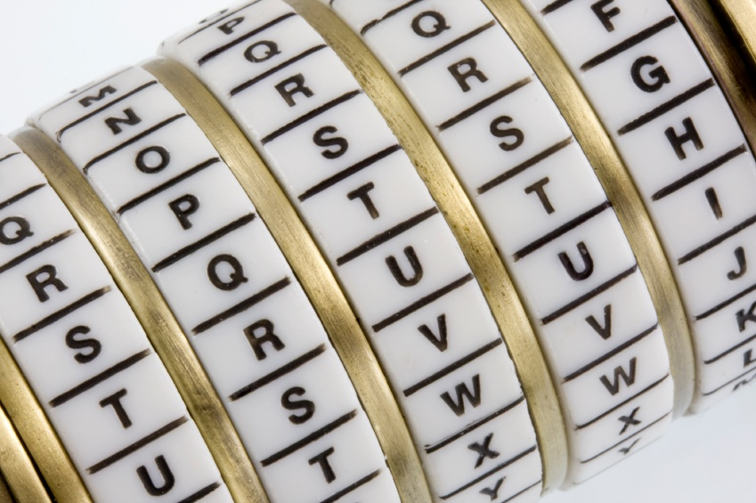
Cryptography
An Introduction
Continued…
Shon Harris
CISSP, 5th Edition

Slide 2
3.14.7 Certificates
One of the most important pieces of a PKI is its digital certificate. A certificate is the mechanism used to associate a public key with a collection of components in a manner that is sufficient to uniquely identify the claimed owner.
The standard for how the CA creates the certificate is X.509, which dictates the different fields used in the certificate and the valid values that can populate those fields.

Slide 3
Certificates
We are currently at version 4 of this standard, which is often denoted as X.509v4. Many cryptographic protocols use this type of certificate, including SSL.
The certificate includes the serial number, version number, identity information,
algorithm information, lifetime dates, and the signature of the issuing authority, as shown in the Figure.

Slide 4
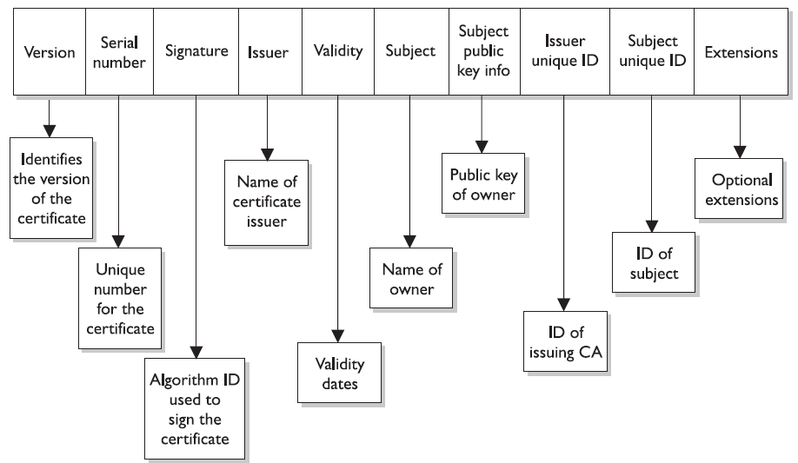
Structure Of A Certificate

Slide 5
3.14.8 The Registration Authority
The registration authority (RA) performs the certification registration duties. The RA establishes and confirms the identity of an individual, initiates the certification process with a CA on behalf of an end user, and performs certificate life-cycle management functions.
The RA cannot issue certificates, but can act as a broker between the user and the CA. When users need new certificates, they make requests to the RA, and the RA verifies all necessary identification information before allowing a request to go to the CA.

Slide 6
3.14.9 PKI Example
Now that we know some of the main pieces of a PKI and how they actually work together, let’s walk through an example. First, suppose that John needs to obtain a digital certificate for himself so he can participate in a PKI. The following are the steps to do so:

Slide 7
PKI Example
1. John makes a request to the RA.
2. The RA requests certain identification information from John, such as a copy
of his driver’s license, his phone number, his address, and other identifying
information.
3. Once the RA receives the required information from John and verifies it, the
RA sends his certificate request to the CA.

Slide 8
PKI Example
4. The CA creates a certificate with John’s public key and identity information embedded.
(The private/public key pair is generated either by the CA or on John’s machine, which depends on the systems’ configurations. If it is created at the CA, his private key needs to be sent to him by secure means. In most cases, the user generates this pair and sends in his public key during the registration process.)

Slide 9
PKI Example
Now John is registered and can participate in a PKI. John and Diane decide they want to communicate, so they take the following steps, shown in the Figure.
5. John requests Diane’s public key from a public directory.
6. The directory, sometimes called a repository, sends Diane’s digital certificate.

Slide 10
PKI Example
7. John verifies the digital certificate and extracts her public key. John uses this public key to encrypt a session key that will be used to encrypt their messages. John sends the encrypted session key to Diane. John also sends his certificate,
containing his public key, to Diane.
8. When Diane receives John’s certificate, her browser looks to see if it trusts the CA that digitally signed this certificate. Diane’s browser trusts this CA and, after she verifies the certificate, both John and Diane can communicate using encryption.

Slide 11
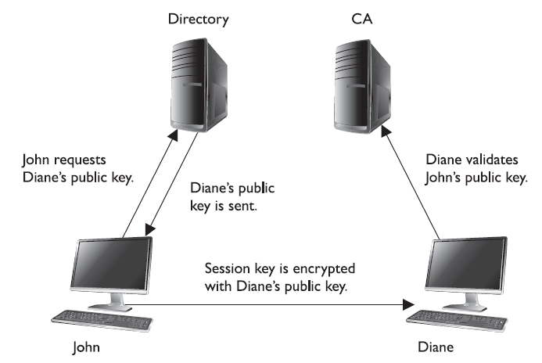
CA & User Relationships

Slide 12
PKI Components
A PKI may be made up of the following entities and functions:
• CA
• RA
• Certificate repository
• Certificate revocation system
• Key backup and recovery system
• Automatic key update
• Management of key histories
• Timestamping
• Client-side software

Slide 13
3.14.10 PKI Security Services
PKI supplies the following security services:
• Confidentiality
• Access control
• Integrity
• Authentication
• Nonrepudiation

Slide 14
PKI
A PKI must retain a key history, which keeps track of all the old and current public keys that have been used by individual users. For example, if Kevin encrypted a symmetric key with Dave’s old public key, there should be a way for Dave to still access this data. This can only happen if the CA keeps a proper history of Dave’s old certificates and keys.

Slide 15
NOTE: Another important component that must be integrated into a PKI is a
reliable time source that provides a way for secure time-stamping. This comes
into play when true non-repudiation is required.

