Slide 1

Cryptography
An Introduction
Continued…
Shon Harris
CISSP, 5th Edition

Slide 2
3.14.2 Definition Of Public Key Infrastructure (PKI)
Public key infrastructure (PKI) consists of programs, data formats, procedures, communication protocols, security policies, and public key cryptographic mechanisms working in a comprehensive manner to enable a wide range of dispersed people to communicate in a secure and predictable fashion.
In other words, a PKI establishes a level of trust within an environment.

Slide 3
Public Key Infrastructure (PKI)
PKI provides authentication, confidentiality, non-repudiation, and integrity of the
messages exchanged. PKI is a hybrid system of symmetric and asymmetric key algorithms
and methods, which were discussed in earlier sections.

Slide 4
Public Key Infrastructure (PKI)
The infrastructure assumes that the receiver’s identity can be positively ensured through certificates and that an asymmetric algorithm will automatically
carry out the process of key exchange.

Slide 5
Public Key Infrastructure (PKI)
The infrastructure therefore contains the pieces
that will identify users, create and distribute certificates, maintain and revoke certificates,
distribute and maintain encryption keys, and enable all technologies to communicate and work together for the purpose of encrypted communication and
authentication.
Public key cryptography is one piece in PKI, but many other pieces make up this infrastructure.

Slide 6
Example
An analogy can be drawn with the e-mail protocol Simple Mail Transfer Protocol (SMTP). SMTP is the technology used to get e-mail messages from here to there, but many other things must be in place before this protocol can be productive.
We need e-mail clients, e-mail servers, and e-mail messages, which together build a type
of infrastructure—an e-mail infrastructure.
PKI is made up of many different parts: certificate
authorities, registration authorities, certificates, keys, and users.

Slide 7
3.14.3 PKI Components
Each person who wants to participate in a PKI requires a digital certificate, which is
a credential that contains the public key for that individual along with other identifying
information.
The certificate is created and signed (digital signature) by a trusted third party, which is a certificate authority (CA).

Slide 8
When the CA signs the certificate, it binds the individual’s identity to the public key, and the CA takes liability for the authenticity of that individual. It is this trusted third party (the CA) that allows people who have never met to authenticate to each other and to communicate in a secure method.
If Kevin has never met Dave, but would like to communicate securely with him, and they both trust the same CA, then Kevin could retrieve Dave’s digital certificate and start the process.

Slide 9
3.14.4 Certificate Authorities (CAs)
A CA is a trusted organization (or server) that maintains and issues digital certificates. When a person requests a certificate, the registration authority (RA) verifies that individual’s identity and passes the certificate request off to the CA.
The CA constructs the certificate, signs it, sends it to the requester, and maintains the certificate over its lifetime.
When another person wants to communicate with this person, the CA will basically vouch for that person’s identity.

Slide 10
Certificate Authorities (CAs)
When Dave receives a digital certificate from
Kevin, Dave will go through steps to validate it. Basically, by providing Dave with his digital certificate, Kevin is stating, “I know you don’t know or trust me, but here is this document that was created by someone you do know and trust. The document says I
am a good guy and you should trust me.”
Once Dave validates the digital certificate, he extracts Kevin’s public key, which is embedded within it. Now Dave knows this public key is bound to Kevin.

Slide 11
Certificate Authorities (CAs)
He also knows that if Kevin uses his private key to create a digital signature and Dave can properly
decrypt it using this public key, it did indeed come from Kevin.
The CA can be internal to an organization. Such a setup would enable the company to control the CA server, configure how authentication takes place, maintain the certificates, and recall certificates when necessary.

Slide 12
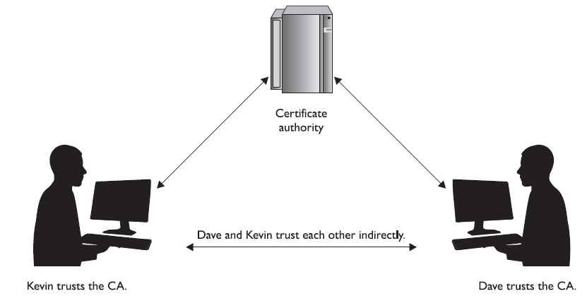
Remember the man-in-the-middle attack covered earlier in the section “The Diffie-Hellman Algorithm”? This attack is possible if two users are not working in a PKI environment and do not truly know the identity of the owners of the public keys.

Slide 13
More and more organizations are setting up their own internal PKIs. When these independent PKIs need to interconnect to allow for secure communication to take place (either between departments or between different companies), there must be a way for the two root CAs to trust each other.
The two CAs do not have a CA above them they can both trust, so they must carry out cross certification. A cross certification is the process undertaken by CAs to establish a trust relationship in which they rely upon each other’s digital certificates and public keys as if they had issued them themselves. When this is set up, a CA for one company can validate digital certificates from the other company and vice versa.

Slide 14
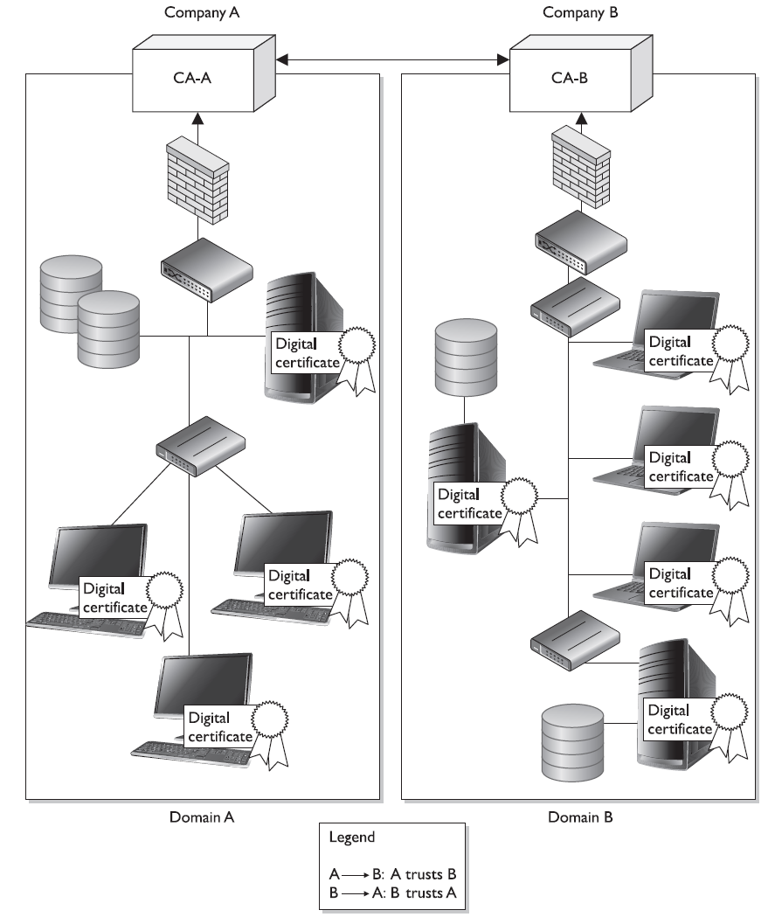

Slide 15
3.14.5 Certificate Revocation List (CRL)
The CA is responsible for creating and handing out certificates, maintaining them, and revoking them if necessary. Revocation is handled by the CA, and the revoked certificate information is stored on a certificate revocation list (CRL).
This is a list of every certificate that has been revoked. This list is maintained and updated periodically. A certificate may be revoked because the key holder’s private key was compromised or because the CA discovered the certificate was issued to the wrong person.

Slide 16
CRL Analogy
An analogy for the use of a CRL is how a driver’s license is used by a police officer. If an officer pulls over Faheem for speeding, the officer will ask to see Faheem’s license. The officer will then run a check on the license to find out if Faheem is wanted for any other infractions of the law and to verify the license has not expired. The same thing happens when a person compares a certificate to a CRL. If the certificate became invalid for some reason, the CRL is the mechanism for the CA to let others know this information.

Slide 17
CRL Challenges
CRLs are the thorn in the side of many PKI implementations. They are challenging for a long list of reasons. It is interesting to know that, by default, web browsers do not check a CRL to ensure that a certificate is not revoked.
So when you are setting up an SSL connection to do e-commerce over the Internet, you could be relying on a certificate that has actually been revoked.
Not good.

Slide 18
3.14.6 OCSP
Online Certificate Status Protocol (OCSP) is being used more and more rather than the cumbersome CRL approach. When using just a CRL, the user’s browser must either check a central CRL to find out if the certification has been revoked or continually push out CRL values to the clients to ensure they have an updated CRL.

Slide 19
OCSP Advantages
If OCSP is implemented, it does this work automatically in the background. It carries out real-time validation of a certificate and reports back to the user whether the certificate is valid, invalid, or unknown.
OCSP checks the CRL that is maintained by the CA. So the CRL is still being used, but now we have a protocol developed specifically to check the CRL during a certificate validation process.

