Slide 1
History Of Cryptography
Wikipedia
http://en.wikipedia.org/wiki/History_of_cryptography

Slide 2
Back Ground
Lap top or Hard Disk Get Stolen
Need to Encrypt Hard Drive , So that no one else can read the information .
Required Password over H.D.
Needs cryptography.

Slide 3
DLP , Data Loss Prevention
Mechanism to protect critical Data of an Organization .
Person working in Organization has left the Organization but have Critical Data of the company over his USB .
Dangerous for Enterprise level Organization.
Need to put some Security for Copying data from Company’s Computers .

Slide 4
Email Security ;
In an Enterprise level organization , Email is very imp entity to work on .
No body is allowed to read or interpret an email of Higher level employs of an Organization .
Need to encrypt an Email by using PGP tool , which allow encrypted email to be sent over the network.

Slide 5
VPN , virtual Private Network .
Allow Secure Communication over an un secured Channel i.e Internet .
IPSec would be used to send and Recv data over VPNs.
To connect two bank offices in a City , we need to establish VPN connection for Secure Communication.

Slide 6
Data Base Security
Network Admin might have access to all assets of a company even a database.
Wee must have to ensure if an unexpected transaction has been made inside a database .
An Event log has been triggered for that transaction.
Clerk is authorized to transfer 1 Million in a day but if more then 1 million transaction has been made , Security event must be triggered in order to inform Higher Authorties.

Slide 7
So to protect all these assets by different mechanism is called cryptography !
We use cryptography to protect all these assets as we discussed in earlier slides.
Cryptography evolved from thousand of years and currently it takes a current form that we are using today .
To hide and Protect information from outside world by using mathematical techniques is called Cryptography.

Slide 8
Objectives
Provide a perspective on how cryptography has evolved over thousands of years
Understand the cryptographic tools and techniques that have formed the basis for modern cryptographic developments
Establish a foundation for the rest of the course

Slide 9
1.2.1 Classical Cryptography
The history of cryptography begins thousands of years ago. Until recent decades, it has been the story of what might be called classic cryptography — that is, of methods of encryption that use pen and paper, or perhaps simple mechanical aids.

Slide 10
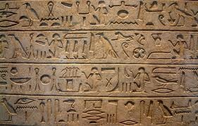
Egypt’s Old Kingdom
The earliest known use of cryptography is found in non-standard hieroglyphs carved into monuments from Egypt's Old Kingdom
( 4500+ years ago).

Slide 11
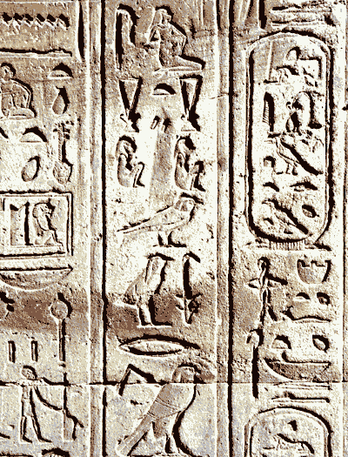
These are not thought to be serious attempts at secret communications, however, but rather to have been attempts at mystery, intrigue, or even amusement for literate onlookers.

Slide 12
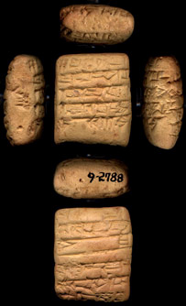
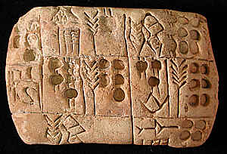
Some clay tablets from Mesopotamia somewhat later are clearly meant to protect information—they encrypt recipes, presumably commercially valuable.

Slide 13
1.2.2 A Scytale – an early device for encryption
One of the oldest known examples is the Spartan scytale (scytale /skɪtəli/, rhymes with Italy, a baton). The scytale was first mentioned by the Greek poet Archilochus who lived in the 7th century B.C. (over 2500 years ago).

Slide 14
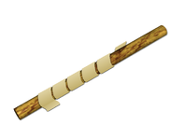
Scytale
The ancient Greeks, and the Spartans in particular, are said to have used this cipher to communicate during military campaigns.
Sender and recipient each had a cylinder
(called a scytale) of exactly the same radius. The sender wound a narrow ribbon of parchment
around his cylinder, then wrote on it lengthwise.
After the ribbon is unwound, the writing
could be read only by a person who had a cylinder of exactly the same circumference.

Slide 15
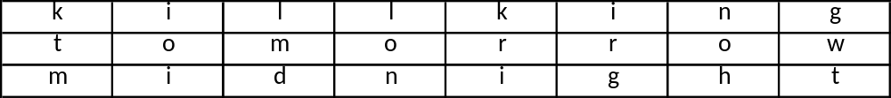
Scytale encryption example
Original message: Kill king tomorrow midnight
Encoded Message: ktm ioi lmd lon kri irg noh gwt

Slide 16
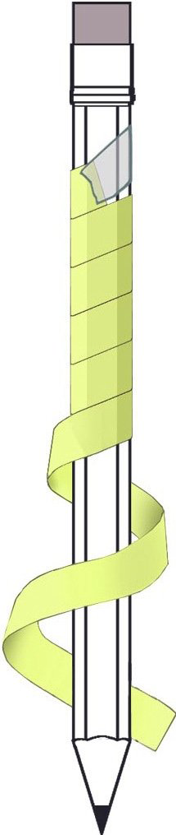

Slide 17


1.2.3 Greek and Roman Use Of Cryptography
The Greeks of Classical times are said to have known of ciphers (e.g., the scytale transposition cipher claimed to have been used by the Spartan military).

Slide 18

Another Greek method was developed by Polybius (now called the "Polybius Square").
Each letter is represented by its coordinates in the grid. For example, "BAT" becomes "12 11 44“
Developed for telegraphy e.g. pairs of torches

Slide 19


The Romans knew something of cryptography (e.g., the Caesar cipher and its variations).
The method is named after Julius Caesar, who used it to communicate with his generals.

Slide 20

1.2.4 Ceasar Cipher
The Ceasar Cipher is an example of what is called a shift cipher. To encode a message, letters are replaced with a letter that is a fixed number of letters beyond the current letter.

Slide 21
Later still, Hebrew scholars made use of simple monoalphabetic substitution ciphers (such as the Atbash cipher) beginning perhaps around 500 to 600 BC
The Atbash cipher is a very specific case of a substitution cipher where the letters of the alphabet are reversed. In otherwords, all As are replaced with Zs, all Bs are replaced with Ys, and so on.
Example
Plaintext: This is a secret message
Ciphertext: Gsrh rh z hvxivg nvhhztv

Slide 22
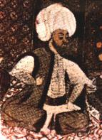
Abū Yūsuf Yaʻqūb ibn Isḥāq al-Kindī
801–873 CE

Slide 23
1.2.5 Cryptography From Muslim History
(Medieval Cryptography)
Al- Kindi, wrote a book on cryptology, the "Risalah fi Istikhraj al-Mu'amma" (Manuscript for the Deciphering Cryptographic Messages), circa 850CE.
This book apparently antedates Western European cryptography works by 300 years and predates writings on probability and statistics by Pascal and Fermat by nearly 800 years.

Slide 24
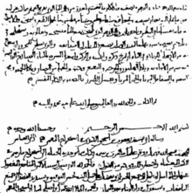
The first page of al-Kindi's manuscript On Deciphering Cryptographic Messages,
containing the oldest known description of cryptanalysis by frequency analysis

Slide 25
In mathematics, al-Kindi played an important role in introducing Arabic numerals to the Islamic and Christian world.
He was a pioneer in cryptanalysis and cryptology, and devised new methods of breaking ciphers, including the frequency analysis method.
Using his mathematical and medical expertise, he developed a scale to allow doctors to quantify the potency of their medication.

Slide 26
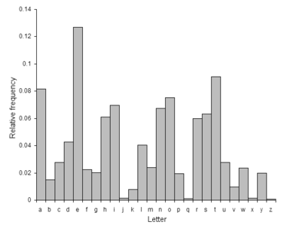
Relative frequencies of letters in the English language

Slide 27
In his book entitled Risalah fi Istikhraj al-Mu'amma (Manuscript for the Deciphering Cryptographic Messages), Al-Kindi described the first cryptanalysis techniques, including some for polyalphabetic ciphers, cipher classification, Arabic phonetics and syntax, and, most importantly, gave the first descriptions on frequency analysis.
He also covered methods of encipherments, cryptanalysis of certain encipherments, and statistical analysis of letters and letter combinations in Arabic.

Slide 28


1.2.6 Cryptography In The Renaissance Period
Essentially all ciphers remained vulnerable to the cryptanalytic technique of frequency analysis until the development of the polyalphabetic cipher, and many remained so thereafter.
The polyalphabetic cipher was most clearly explained by Leon Battista Alberti around the year 1467, for which he was called the "father of Western cryptology".

Slide 29
In Europe, cryptography became (secretly) more important as a consequence of political competition and religious revolution. For instance, in Europe during and after the Renaissance, citizens of the various Italian states—the Papal States and the Roman Catholic Church included—were responsible for rapid proliferation of cryptographic techniques.
Outside of Europe, after the end of the Muslim Golden Age at the hand of the Mongols, cryptography remained comparatively undeveloped.

Slide 30
1.2.7 Cryptography from 1800 to World War II
Although cryptography has a long and complex history, it wasn't until the 19th century that it developed anything more than ad hoc approaches to either encryption or cryptanalysis (the science of finding weaknesses in crypto systems).
Understanding of cryptography at this time typically consisted of rules of thumb; for example, Auguste Kerckhoffs' cryptographic writings in the latter 19th century.

Slide 31
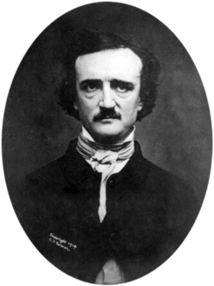
Edgar Allan Poe used systematic methods to solve ciphers in the 1840s. In particular he placed a notice of his abilities in the Philadelphia paper Alexander's Weekly (Express) Messenger, inviting submissions of ciphers, of which he proceeded to solve almost all.

Slide 32
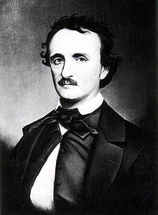
His success created a public stir for some months. He later wrote an essay on methods of cryptography which proved useful as an introduction for novice British cryptanalysts attempting to break German codes and ciphers during World War I, and a famous story, The Gold-Bug, in which cryptanalysis was a prominent element.

Slide 33
In World War I the Admiralty's Room 40 broke German naval codes and played an important role in several naval engagements during the war, notably in detecting major German sorties into the North Sea that led to the battles of Dogger Bank and Jutland as the British fleet was sent out to intercept them.

Slide 34
In 1917, Gilbert Vernam proposed a teletype cipher in which a previously-prepared key, kept on paper tape, is combined character by character with the plaintext message to produce the cyphertext. This led to the development of electromechanical devices as cipher machines.
Mathematical methods proliferated in the period prior to World War II (notably in William F. Friedman's application of statistical techniques to cryptanalysis and cipher development and in Marian Rejewski's initial break into the German Army's version of the Enigma system) in 1932.

Slide 35
World War II Cryptography
By World War II, mechanical and electromechanical cipher machines were in wide use, although—where such machines were impractical—manual systems continued in use.

Slide 36
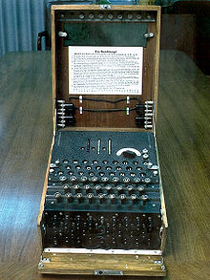
The Enigma machine was widely used by Nazi Germany; its cryptanalysis
by the Allies provided vital intelligence.

Slide 37
Allied cipher machines used in WWII included the British TypeX and the American SIGABA; both were electromechanical rotor designs similar in spirit to the Enigma, albeit with major improvements. Neither is known to have been broken by anyone during the War.
US troops in the field used the M-209 and the still less secure M-94 family machines. British agents initially used 'poem ciphers' (memorized poems were the encryption/decryption keys), but later in the War, they began to switch to one-time pads.

Slide 38
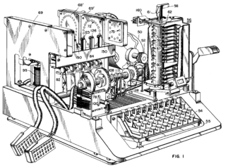
SIGABA is described in U.S. Patent 6,175,625, filed in 1944 but not issued until 2001.

Slide 39
1.2.8 Modern Cryptography
Both cryptography and cryptanalysis have become far more mathematical since World War II. Even so, it has taken the wide availability of computers, and the Internet as a communications medium, to bring effective cryptography into common use by anyone other than national governments or similarly large enterprises.

Slide 40
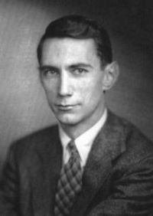
Shannon
The era of modern cryptography really begins with Claude Shannon, arguably the father of mathematical cryptography, with the work he did during WWII on communications security.
In 1949 he published Communication Theory of Secrecy Systems in the Bell System Technical Journal and a little later the book The Mathematical Theory of Communication (expanding on an earlier article "A Mathematical Theory of Communication") with Warren Weaver. Both included results from his WWII work.
Claude Elwood Shannon (1916-2001)

Slide 41
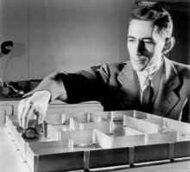
These, in addition to his other works on information and communication theory established a solid theoretical basis for cryptography and also for much of cryptanalysis. And with that, cryptography more or less disappeared into secret government communications organizations such as NSA, GCHQ, and their equivalents elsewhere.
Very little work was again made public until the mid 1970s, when everything changed.

Slide 42
1.9 The First Encryption Standard
The mid-1970s saw two major public (i.e., non-secret) advances. First was the publication of the draft Data Encryption Standard in the U.S. Federal Register on 17 March 1975.
The proposed DES cipher was submitted by a research group at IBM, at the invitation of the National Bureau of Standards (now NIST), in an effort to develop secure electronic communication facilities for businesses such as banks and other large financial organizations.

Slide 43
After 'advice' and modification by NSA, acting behind the scenes, it was adopted and published as a Federal Information Processing Standard Publication in 1977 (currently at FIPS 46-3).
DES was the first publicly accessible cipher to be 'blessed' by a national agency such as NSA. The release of its specification by National Bureau of Standards (NBS) stimulated an explosion of public and academic interest in cryptography.

Slide 44
The aging DES was officially replaced by the Advanced Encryption Standard (AES) in 2001 when NIST announced FIPS 197. After an open competition, NIST selected Rijndael, submitted by two Belgian cryptographers, to be the AES.

Slide 45
Regardless of DES' inherent quality, the DES key size (56-bits) was thought to be too small by some even in 1976, perhaps most publicly by Whitfield Diffie. There was suspicion that government organizations even then had sufficient computing power to break DES messages; clearly others have achieved this capability.

Slide 46
Public key
The second development, in 1976, was perhaps even more important, for it fundamentally changed the way cryptosystems might work. This was the publication of the paper New Directions in Cryptography by Whitfield Diffie and Martin Hellman.
It introduced a radically new method of distributing cryptographic keys, which went far toward solving one of the fundamental problems of cryptography, key distribution, and has become known as Diffie-Hellman key exchange. The article also stimulated the almost immediate public development of a new class of enciphering algorithms, the asymmetric key algorithms.

