Slide 1
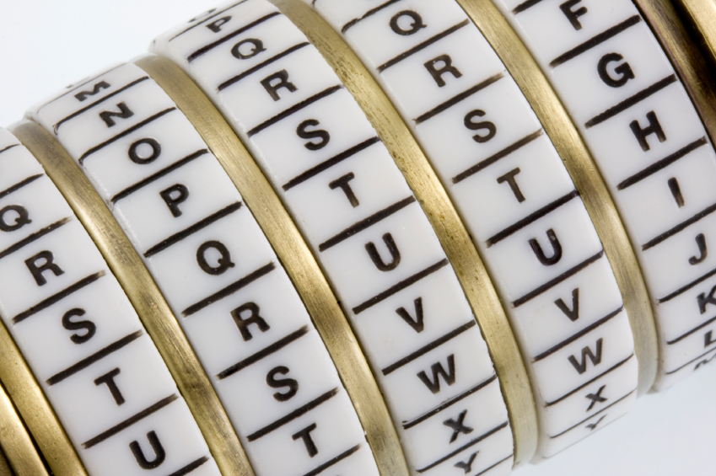
Cryptography
An Introduction
Continued…
Shon Harris
CISSP, 5th Edition

Slide 2
Examples of Symmetric Algorithms
Data Encryption Standard (DES)
Triple-DES (3DES)
Blowfish
IDEA (International Data Encryption Algorithm)
RC4, RC5, and RC6
Advanced Encryption Standard (AES)

Slide 3
Examples of Asymmetric Key Algorithms
Diffie-Hellman
RSA (Rivest-Shamir-Adleman)
El Gamal
Elliptic curve cryptosystem (ECC)
Digital Signature Algorithm (DSA)
Merkle-Hellman Knapsack

Slide 4
Examples of Message Digest (Hashing) Algorithms
MD2
MD4
MD5
HAVAL
Secure Hash Algorithm (SHA)
SHA Versions
  SHA-1, SHA-256, SHA-384, SHA-512

Slide 5
MAC Authentication
A private key is bound to an individual; a symmetric key is not. MAC authentication provides the weakest form of authentication because it is not bound to a user, just to a computer or device.

Slide 6
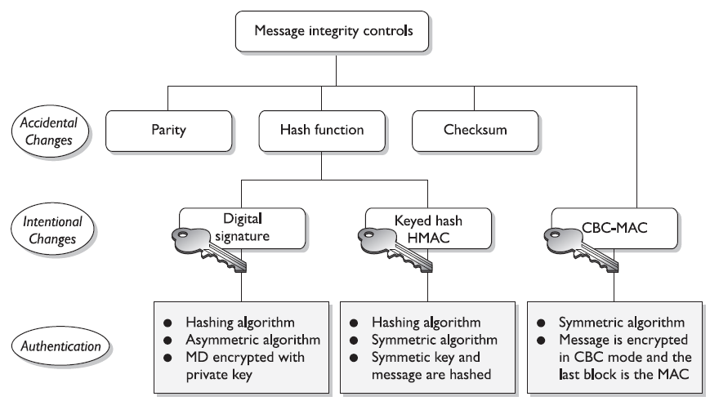
Review Of Message Integrity Controls

Slide 7
3.13.1 Digital Signatures
A digital signature is a hash value that has been encrypted with the sender’s private key. The act of signing means encrypting the message’s hash value with a private key, as shown in the Figure
From our earlier example if Ahmad wants to ensure that the message he sends to Bilal is not modified and he wants him to be sure it came only from him, he can digitally sign the message. This means that a one-way hashing function would be run on the message, and then Ahmad would encrypt that hash value with his private key.

Slide 8
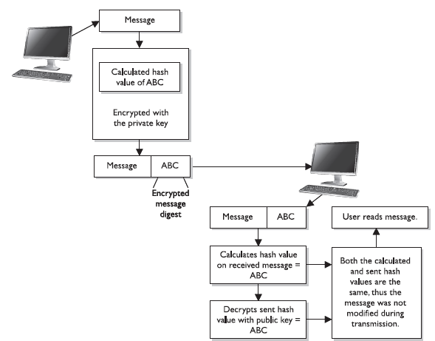

Slide 9
Digital Signatures
When Bilal receives the message, he will perform the hashing function on the message, and come up with his own hash value.
Then he will decrypt the sent hash value (digital signature) with Ahmad’s public key. He then compares the two values, and if they are the same, he can be sure the message was not altered during transmission.
He is also sure the message came from Ahmad because the value was encrypted with his private key.

Slide 10
Digital Signatures
The hashing function ensures the integrity of the message, and the signing of the hash value provides authentication and non-repudiation. The act of signing just means the value was encrypted with a private key.
We need to be clear on all the available choices within cryptography, because different steps and algorithms provide different types of security services:

Slide 11
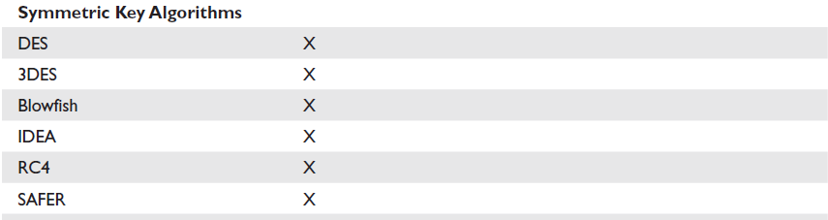
Services Provided By Symmetric Key Algorithms

Slide 12
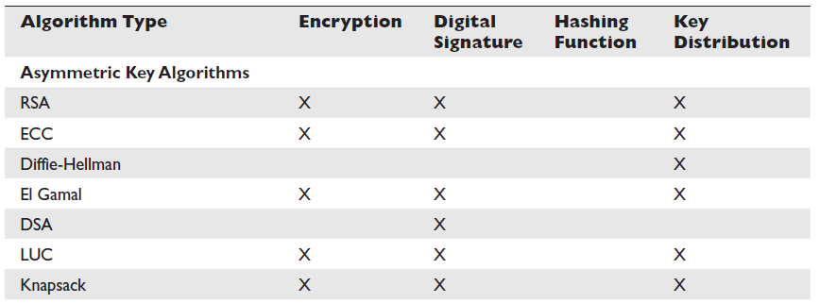
Services Provided By Asymmetric Key Algorithms

Slide 13
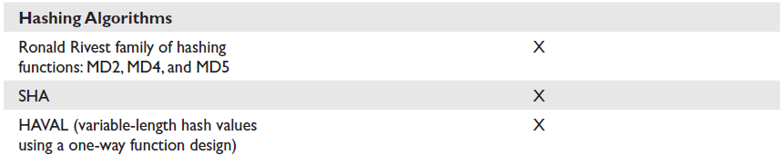
Services Provided By Hashing Algorithms

Slide 14
Digital Signatures
• A message can be encrypted, which provides confidentiality
• A message can be hashed, which provides integrity
• A message can be digitally signed, which provides authentication, nonrepudiation, and integrity
• A message can be encrypted and digitally signed, which provides confidentiality, authentication, nonrepudiation, and integrity

Slide 15
Some algorithms can only perform encryption, whereas others support digital signatures and encryption. When hashing is involved, a hashing algorithm is used, not an encryption algorithm.
It is important to understand that not all algorithms can necessarily provide all security services. Most of these algorithms are used in some type of combination to provide all the necessary security services required of an environment. The Table shows the services provided by the algorithms.

Slide 16
3.13.2 Digital Signature Standard (DSS)
Because digital signatures are so important in proving who sent which messages, the U.S. government decided to establish standards pertaining to their functions and acceptable use.
In 1991, NIST proposed a federal standard called the Digital Signature Standard (DSS). It was developed for federal departments and agencies, but most vendors also designed their products to meet these specifications.

Slide 17
Digital Signature Standard (DSS)
The federal government requires its departments to use DSA, RSA, or the elliptic curve digital signature algorithm (ECDSA) and SHA.
SHA creates a 160-bit message digest output, which is then inputted into one of the three mentioned digital signature algorithms. SHA is used to ensure the integrity of the message, and the other algorithms are used to digitally sign the message.
This is an example of how two different algorithms are combined to provide the right combination of security services.

Slide 18
RSA and DSA are the best known and most widely used digital signature algorithms.
DSA was developed by the NSA. Unlike RSA, DSA can be used only for digital signatures, and DSA is slower than RSA in signature verification. RSA can be used for digital signatures, encryption, and secure distribution of symmetric keys.

Slide 19
3.14.1 Public Key Infrastructure (PKI)
Public key infrastructure (PKI) consists of programs, data formats, procedures, communication protocols, security policies, and public key cryptographic mechanisms working in a comprehensive manner to enable a wide range of dispersed people to communicate in a secure and predictable fashion.
In other words, a PKI establishes a level of trust within an environment.

Slide 20
Public Key Infrastructure (PKI)
PKI is an ISO authentication framework that uses
public key cryptography and the X.509 standard.
The framework was set up to enable authentication to happen across different networks and the Internet. Particular protocols and algorithms are not specified, which is why PKI is called a framework and not
a specific technology.

Slide 21
Public Key Infrastructure (PKI)
PKI provides authentication, confidentiality, non-repudiation, and integrity of the
messages exchanged. PKI is a hybrid system of symmetric and asymmetric key algorithms
and methods, which were discussed in earlier sections.

Slide 22
Public Key Infrastructure (PKI)
There is a difference between public key cryptography and PKI. Public key cryptography is another name for asymmetric algorithms, while PKI is what its name states—it is an infrastructure.
The infrastructure assumes that the receiver’s identity can be positively ensured through certificates and that an asymmetric algorithm will automatically
carry out the process of key exchange.

