Slide 1
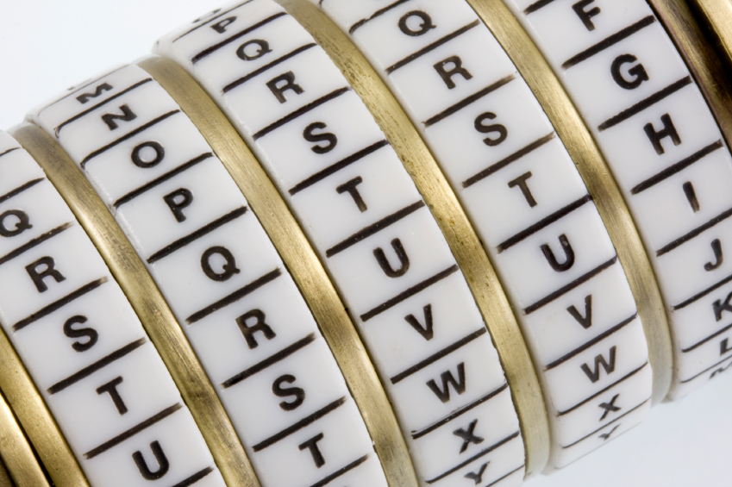
Cryptography
An Introduction
Continued…
Shon Harris
CISSP, 5th Edition

Slide 2
Review
CRCs are used to identify data modifications, but these are commonly used lower in the network stack. Since these functions work lower in the network stack, they are used to identify modifications (as in corruption) when the packet is transmitted
from one computer to another.

Slide 3
Review
HMAC, CBC-MAC, and CMAC work higher in the network stack and can identify not only transmission errors (accidental), but also more nefarious modifications, as in an attacker messing with a message for his own benefit.
This means all of these technologies (except CRC) can identify intentional, unauthorized modifications and accidental changes—three in one!

Slide 4
3.11.4 CMAC
Cipher-Based Message Authentication Code
As with most things in security, the industry found some security issues with CBCMAC and created Cipher-Based Message Authentication Code (CMAC). CMAC provides the same type of data origin authentication and integrity as CBC-MAC, but is more secure mathematically.
CMAC is a variation of CBC-MAC. It is approved to work with AES and Triple DES.

Slide 5
CMAC
Cipher-Based Message Authentication Code
So here is how CMAC works: the symmetric algorithm (AES or 3DES) creates the symmetric key. This key is used to create subkeys. The subkeys are used individually to encrypt the individual blocks of a message as shown in the Figure.
This is the exactly how CBC-MAC works, but with some better magic that works underneath the hood.

Slide 6
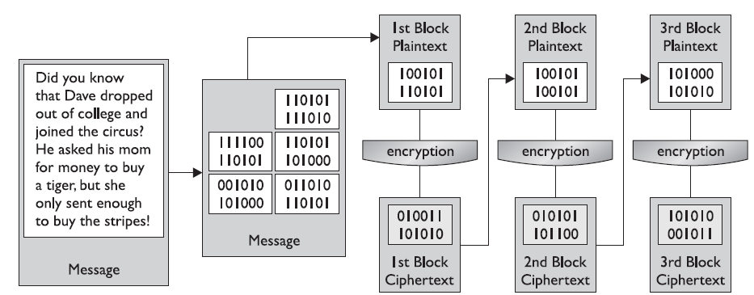
Cipher Block Chaining Mode Process
CMAC is a block cipher–based message authentication code algorithm. This means that it can provide the authentication of the data origin (as in the computer it was sent from) but not the person who sent it.

Slide 7
Hash Functionality
1. Sender puts a message through a hashing algorithm and generates a message digest (MD) value.
2. Sender sends message and MD value to receiver.
3. Receiver runs just the message through the same hashing algorithm and creates an independent MD value.
4. Receiver compares both MD values. If they are the same, the message was not modified.
SERVICES PROVIDED
Integrity; not confidentiality or authentication. Can detect only unintentional modifications.

Slide 8
HMAC Functionality
1. Sender concatenates a message and secret key and puts the result through a hashing algorithm. This creates a MAC value.
2. Sender appends the MAC value to the message and sends it to the receiver.
3. The receiver takes just the message and concatenates it with his own symmetric key. This results in an independent MAC value.
4. The receiver compares the two MAC values. If they are the same, the receiver knows the message was not modified and knows from which system it came.
SERVICES PROVIDED
Integrity and data origin authentication; confidentiality is not provided.

Slide 9
CBC-MAC Functionality
1. Sender encrypts a message with a symmetric block algorithm in CBC mode.
2. The last block is used as the MAC.
3. The plaintext message and the appended MAC are sent to the receiver.
4. The receiver encrypts the message, creates a new MAC, and compares the two values. If they are the same, the receiver knows the message was not modified and from which system it came.
SERVICES PROVIDED
Data origin authentication and integrity.

Slide 10
CMAC Functionality
CMAC works the same way as the CBC-MAC, but is based on more complex logic and mathematical functions.

Slide 11
Types Of Hashing Algorithms
As stated earlier, the goal of using a one-way hash function is to provide a fingerprint of the message. If two different messages produce the same hash value, it would be easier for an attacker to break that security mechanism, because patterns would be revealed.
A strong one-hash function should not provide the same hash value for two or more different messages. If a hashing algorithm takes steps to ensure it does not create the same hash value for two or more messages, it is said to be collision free.

Slide 12
3.11.5 Desired Features Of Cryptographic Hash Functions
• The hash should be computed over the entire message.
• The hash should be a one-way function so messages are not disclosed by their values.
• Given a message and its hash value, computing another message with the same hash value should be impossible.
• The function should be resistant to birthday attacks (explained in the upcoming section “Attacks Against One-Way Hash Functions”).

Slide 13
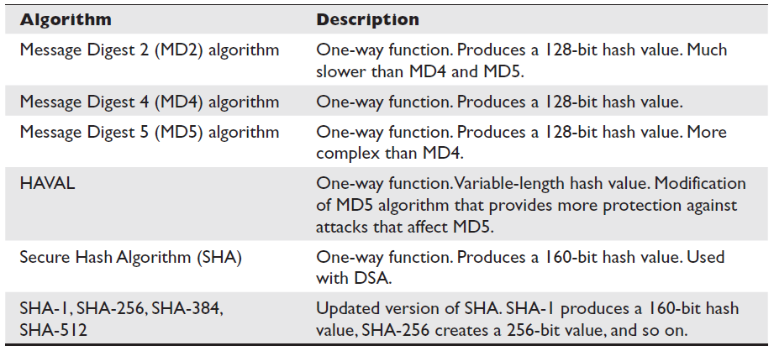
3.12 Hashing Algorithms Used Today

Slide 14
3.12.1 MD2
MD2 is a one-way hash function designed by Ron Rivest that creates a 128-bit message digest value.
It is not necessarily any weaker than the other algorithms in the “MD” family, but it is much slower.

Slide 15
3.12.2 MD4
MD4 is a one-way hash function designed by Ron Rivest. It also produces a 128-bit message digest value.
It is used for high-speed computation in software implementations and is optimized for microprocessors.

Slide 16
3.12.3 MD5
MD5 was also created by Ron Rivest and is the newer version of MD4. It still produces a 128-bit hash, but the algorithm is more complex, which makes it harder to break. MD5 added a fourth round of operations to be performed during the hashing functions and makes several of its mathematical operations carry out more steps or more complexity to provide a higher level of security.
Recent research has shown MD5 to be subject to collision attacks, and it is therefore no longer suitable for applications like SSL certificates and digital signatures that require collision attack resistance.

Slide 17
3.12.4 SHA
SHA was designed by NSA and published by NIST to be used with the Digital Signature Standard (DSS). SHA was designed to be used in digital signatures and was developed when a more secure hashing algorithm was required for U.S. government applications.
SHA produces a 160-bit hash value, or message digest. This is then inputted into an asymmetric algorithm, which computes the signature for a message.

Slide 18
SHA…
SHA is similar to MD4. It has some extra mathematical functions and produces a
160-bit hash instead of a 128-bit hash, which makes it more resistant to brute force attacks, including birthday attacks.
SHA was improved upon and renamed SHA-1. Recently, newer versions of this algorithm
(collectively known as the SHA-2 family) have been developed and released:
SHA-256, SHA-384, and SHA-512.

Slide 19
3.12.5 HAVAL
HAVAL is a variable-length one-way hash function and is a modification of MD5. It processes message blocks twice the size of those used in MD5; thus, it processes blocks of 1,024 bits.
HAVAL can produce hashes from 128 to 256 bits in length.

Slide 20
3.12.6 Tiger
Ross Anderson and Eli Biham developed a hashing algorithm called Tiger in 1995. It was designed to carry out hashing functionalities on 64-bit systems and to be faster than MD5 and SHA-1. The resulting hash value is 192 bits.
Designwise most hash algorithms (MD5, RIPEMD, SHA-0, and SHA-1) are derivatives or have been built upon the MD4 architecture. Tiger was built upon a different type of architecture with the goal of not being vulnerable to the same type of attacks that could be successful toward the other hashing algorithms.

