Slide 1
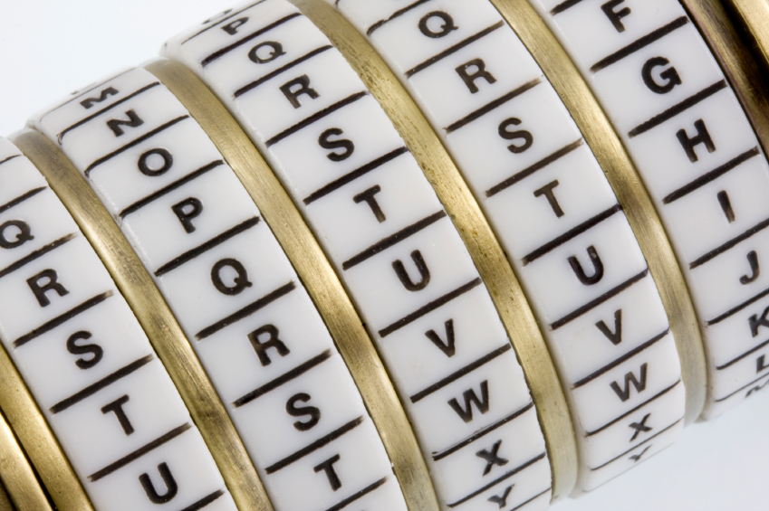
Cryptography
An Introduction
Continued…
Shon Harris
CISSP, 5th Edition

Slide 2
3.11 Message Integrity
Parity bits and cyclic redundancy check (CRC) functions have been used in protocols to detect modifications in streams of bits as they are passed from one computer to another, but they can usually detect only unintentional modifications.
Unintentional modifications can happen if a spike occurs in the power supply, if there is interference or attenuation on a wire, or if some other type of physical condition happens that causes the corruption of bits as they travel from one destination to another.

Slide 3
Message Integrity
Parity bits cannot identify whether a message was captured by an intruder, altered, and then sent on to the intended destination. The intruder can just recalculate a new parity value that includes his changes, and the receiver would never know the difference.
For this type of protection, hash algorithms are required to successfully detect intentional and unintentional
unauthorized modifications to data. We will now dive into hash algorithms and their characteristics.

Slide 4
The One-Way Hash
A one-way hash is a function that takes a variable-length string and a message and produces a fixed-length value called a hash value.
For example, if Ahmad wants to send a message to Bilal and he wants to ensure the message does not get altered in an unauthorized fashion while it is being transmitted, he would calculate a hash value for the message and append it to the message itself.

Slide 5
The One-Way Hash
When Bilal receives the message,
he performs the same hashing function Ahmad used and then compares his result with
the hash value sent with the message.
If the two values are the same, Bilal can be
sure the message was not altered during transmission. If the two values are different,
Bilal knows the message was altered, either intentionally or unintentionally, and he discards the message.

Slide 6
The One-Way Hash
The hashing algorithm is not a secret—it is publicly known. The secrecy of the oneway hashing function is its “one-wayness.” The function is run in only one direction, not the other direction.
This is different from the one-way function used in public key cryptography, in which security is provided based on the fact that, without knowing a
trapdoor, it is very hard to perform the one-way function backward on a message and come up with readable plaintext.

Slide 7
The One-Way Hash
The hashing one-way function takes place without the use of any keys. Lets take a look at an example…

Slide 8
One-way Hash Example
if Irfan writes a message, calculates a message digest, appends the digest to the message, and sends it on to Furqan, Khalid can intercept this message, alter Irfan’s message, recalculate another message digest, append it to the message, and send it on to Furqan. When Furqan receives it, he verifies the message digest, but never knows the message was actually altered by Khalid. Furqan thinks the message came straight from Irfan and it was never modified, because the two message digest values are the same. If Irfan wanted more protection than this, he would need to use message authentication code (MAC).

Slide 9
3.11.1 Message Authentication Codes (MACs)
A MAC function is an authentication scheme derived by applying a secret key to a message in some form. This does not mean the symmetric key is used to encrypt the message, though.
You should be aware of two basic types of MACs: a hash MAC (HMAC), and CBC-MAC.

Slide 10
HMAC Example
In the previous example, if Irfan were to use an HMAC function instead of just a plain hashing algorithm, a symmetric key would be concatenated with his message. The result of this process would be put through a hashing algorithm, and the result would be a MAC value. This MAC value is then appended to his message and sent to Furqan. If Khalid were to intercept this message and modify it, he would not have the necessary symmetric key to create the MAC value that Furqan will attempt to generate.

Slide 11
Terminology
The idea of a hashing function is simple. You run a message through a hashing algorithm, which in turn generates a hashing value.
A hashing value can also be called a message digest or fingerprint.

Slide 12
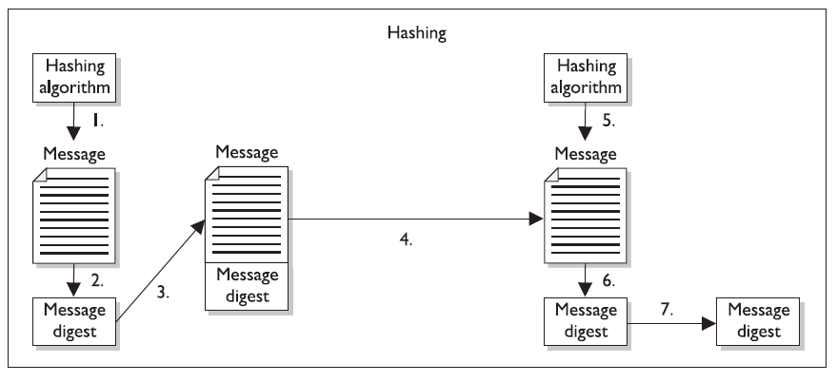

Slide 13
1. The sender puts the message through a hashing function.
2. A message digest value is generated.
3. The message digest is appended to the message.
4. The sender sends the message to the receiver.
5. The receiver puts the message through a hashing function.
6. The receiver generates his own message digest value.
7. The receiver compares the two message digest values. If they are the same, the message has not been altered.

Slide 14
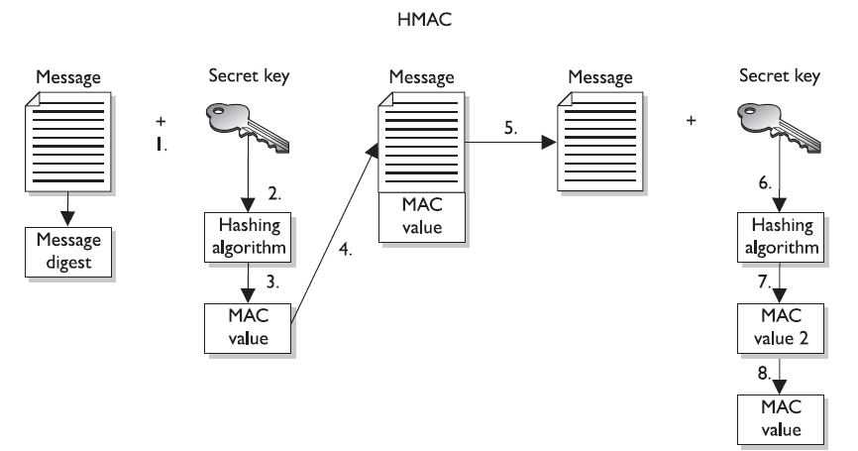

Slide 15
1. The sender concatenates a symmetric key with the message.
2. The result is put through a hashing algorithm.
3. A MAC value is generated.
4. The MAC value is appended to the message.
5. The sender sends the message to the receiver. (Just the message with the attached MAC value. The sender does not send the symmetric key with the message.)
6. The receiver concatenates a symmetric key with the message.
7. The receiver puts the results through a hashing algorithm and generates his own MAC value.
8. The receiver compares the two MAC values. If they are the same, the message has not been modified.

Slide 16
Concatenation
Now, when we say that the message is concatenated with a symmetric key, we don’t mean a symmetric key is used to encrypt the message. The message is not encrypted in an HMAC function, so there is no confidentiality being provided.
Think about throwing a message in a bowl and then throwing a symmetric key in the same bowl. If you dump the contents of the bowl into a hashing algorithm, the result will be a MAC value.

Slide 17
HMAC & Symmetric Keys
This type of technology requires the sender and receiver to have the same symmetric key.
The HMAC function does not involve getting the symmetric key to the destination securely. That would have to happen through one of the other technologies we have discussed already (Diffie-Hellman and key agreement, or RSA and key exchange).

Slide 18
3.11.2 CBC-MAC
If a CBC-MAC is being used, the message is encrypted with a symmetric block cipher in CBC mode, and the output of the final block of ciphertext is used as the MAC.
The sender does not send the encrypted version of the message, but instead sends the plaintext version and the MAC attached to the message. The receiver receives the plaintext message and encrypts it with the same symmetric block cipher in CBC mode and calculates an independent MAC value. The receiver compares the new MAC value with the MAC value sent with the message. This method does not use a hashing algorithm as does HMAC.

Slide 19
CBC-MAC
The use of the symmetric key ensures that the only person who can verify the integrity of the message is the person who has a copy of this key.
No one else can verify the data’s integrity, and if someone were to make a change to the data, he could not generate the MAC value (HMAC or CBC-MAC) the receiver would be looking for. Any modifications would be detected by the receiver.

Slide 20
CBC-MAC
Now the receiver knows that the message came from the system that has the other copy of the same symmetric key, so MAC provides a form of authentication.
It provides data origin authentication, sometimes referred to as system authentication.
This is different from user authentication, which would require the use of a private key.

Slide 21
CBC-MAC
A private key is bound to an individual; a symmetric key is not. MAC authentication provides the weakest form of authentication because it is not bound to a user, just to a computer or device.

