Slide 1
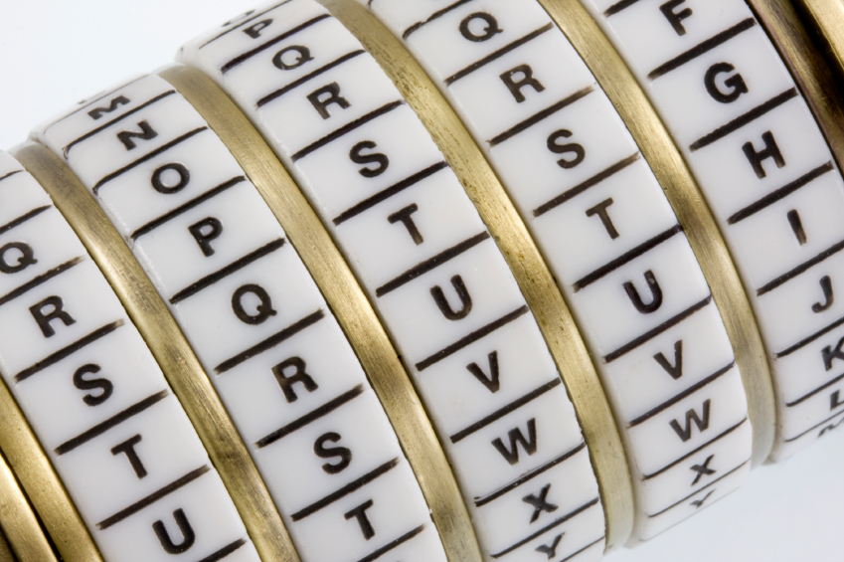
Cryptography
An Introduction
Continued…
Shon Harris
CISSP, 5th Edition

Slide 2
Examples of Symmetric Algorithms
Data Encryption Standard (DES)
Triple-DES (3DES)
Blowfish
IDEA (International Data Encryption Algorithm)
RC4, RC5, and RC6
Advanced Encryption Standard (AES)

Slide 3
Limitations Of Symmetric Key Cryptography
• Security services
Scalability
• Secure key distribution

Slide 4
3.10 Asymmetric Key Algorithms
Diffie-Hellman
RSA (Rivest-Shamir-Adleman)
El Gamal
Elliptic curve cryptosystem (ECC)
Digital Signature Algorithm (DSA)
Merkle-Hellman Knapsack

Slide 5
3.10.1 The Diffie-Hellman Algorithm
The first group to address the shortfalls of symmetric key cryptography decided to attack the issue of secure distribution of the symmetric key. Whitfield Diffie and Martin Hellman worked on this problem and ended up developing the first asymmetric key agreement algorithm, called, naturally, Diffie-Hellman.

Slide 6
The Diffie-Hellman Algorithm
Let’s say that Ahmad and Bilal would like to communicate over an encrypted channel by using Diffie-Hellman. They would both generate a private and public key pair and exchange public keys. Ahmad’s software would take his private key (which is just a numeric value) and Bilal’s public key (another numeric value) and put them through the Diffie-Hellman algorithm.

Slide 7
The Diffie-Hellman Algorithm
Bilal’s software would take his private key and Ahmad’s public key and insert them into the Diffie-Hellman algorithm on his computer. Through this process, Ahmad and Bilal derive the same shared value, which is used to create instances of symmetric keys.

Slide 8
The Diffie-Hellman Algorithm
So, Ahmad and Bilal exchanged information that did not need to be protected (their
public keys) over an untrusted network, and in turn generated the exact same symmetric
key on each system. They both can now use these symmetric keys to encrypt, transmit,
and decrypt information as they communicate with each other.

Slide 9
The Diffie-Hellman Algorithm
The preceding example describes key agreement, which is different from key exchange, the functionality used by the other asymmetric algorithms that will be discussed in this chapter.
With key exchange functionality, the
sender encrypts the symmetric key with the receiver’s public key before transmission.

Slide 10
The Diffie-Hellman algorithm enables two systems to exchange a symmetric key securely without requiring a previous relationship or prior arrangements. The algorithm allows for key distribution, but does not provide encryption or digital signature functionality. The algorithm is based on the difficulty of calculating discrete logarithms in a finite field.

Slide 11
The original Diffie-Hellman algorithm is vulnerable to a man-in-the-middle attack, because no authentication occurs before public keys are exchanged.
In our example, when Ahmad sends his public key to Bilal, how does Bilal really know it is Ahmad’s public key? What if Rashid spoofed his identity, told Bilal he was Ahmad, and sent over his key? Bilal would accept this key, thinking it came from Ahmad. Let’s walk through the steps of how this type of attack would take place, as illustrated in the Figure.

Slide 12
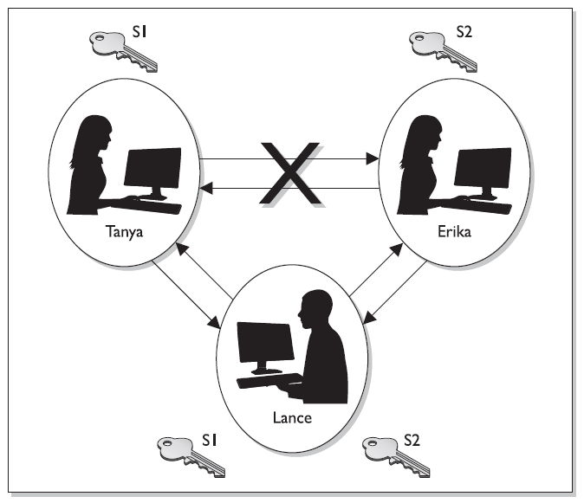
A Man-in-the-middle Attack
Ahmad
Bilal
Rashid

Slide 13
1. Ahmad sends his public key to Bilal, but Rashid grabs the key during transmission so it never makes it to Bilal.
2. Rashid spoofs Ahmad’s identity and sends over his public key to Bilal. Bilal now thinks he has Ahmad’s public key.
3. Bilal sends his public key to Ahmad, but Rashid grabs the key during transmission so it never makes it to Ahmad.

Slide 14
4. Rashid spoofs Bilal’s identity and sends over his public key to Ahmad. Ahmad now thinks he has Bilal’s public key.
5. Ahmad combines his private key and Rashid’s public key and creates symmetric key S1.
6. Rashid combines his private key and Ahmad’s public key and creates symmetric key S1.

Slide 15
7. Bilal combines his private key and Rashid’s public key and creates symmetric key S2.
8. Rashid combines his private key and Bilal’s public key and creates symmetric key S2.
9. Now Ahmad and Rashid share a symmetric key (S1) and Bilal and Rashid share a different symmetric key (S2). Ahmad and Bilal think they are sharing a key between themselves and do not realize Rashid is involved.

Slide 16
10. Ahmad writes a message to Bilal, uses his symmetric key (S1) to encrypt the message, and sends it.
11. Rashid grabs the message and decrypts it with symmetric key S1, reads or modifies the message and re-encrypts it with symmetric key S2, and then sends it to Bilal.
12. Bilal takes symmetric key S2 and uses it to decrypt and read the message.

Slide 17
The countermeasure to this type of attack is to have authentication take place before accepting someone’s public key, which usually happens through the use of digital signatures and digital certificates.
Although the Diffie-Hellman algorithm is vulnerable to a man-in-the-middle attack, it does not mean this type of compromise can take place anywhere this algorithm is deployed. Most implementations include another
piece of software or a protocol that compensates for this vulnerability. But some do not. As a security professional, you should understand these issues.

Slide 18
3.10.2 RSA
RSA, named after its inventors Ron Rivest, Adi Shamir, and Leonard Adleman, is a public key algorithm that is the most popular when it comes to asymmetric algorithms.
RSA is a worldwide de facto standard and can be used for digital signatures, key exchange, and encryption.
It was developed in 1978 at MIT and provides authentication as well as key encryption.

Slide 19
The security of this algorithm comes from the difficulty of factoring large numbers. The public and private keys are functions of a pair of large prime numbers, and the necessary activity required to decrypt a message from ciphertext to plaintext using a private key is comparable to factoring a product into two prime numbers.
A prime number is a positive whole number with no proper divisors, meaning the only numbers that can divide a prime number are 1 and the number itself.

Slide 20
One advantage of using RSA is that it can be used for encryption and digital signatures. Using its one-way function, RSA provides encryption and signature verification, and the inverse direction performs decryption and signature generation.
RSA has been implemented in applications; in operating systems by Microsoft, Apple, Sun, and Novell; and at the hardware level in network interface cards, secure telephones, and smart cards. It can be used as a key exchange protocol, meaning it is used to encrypt the symmetric key to get it securely to its destination.

Slide 21
RSA has been most commonly used with the symmetric algorithm DES, which is quickly being replaced with AES. So, when RSA is used as a key exchange protocol, a cryptosystem generates a symmetric key using either the DES or AES algorithm. Then the system encrypts the symmetric key with the receiver’s public key and sends it to the receiver. The symmetric key is protected because only the individual with the corresponding private key can decrypt and extract the symmetric key.

