Slide 1
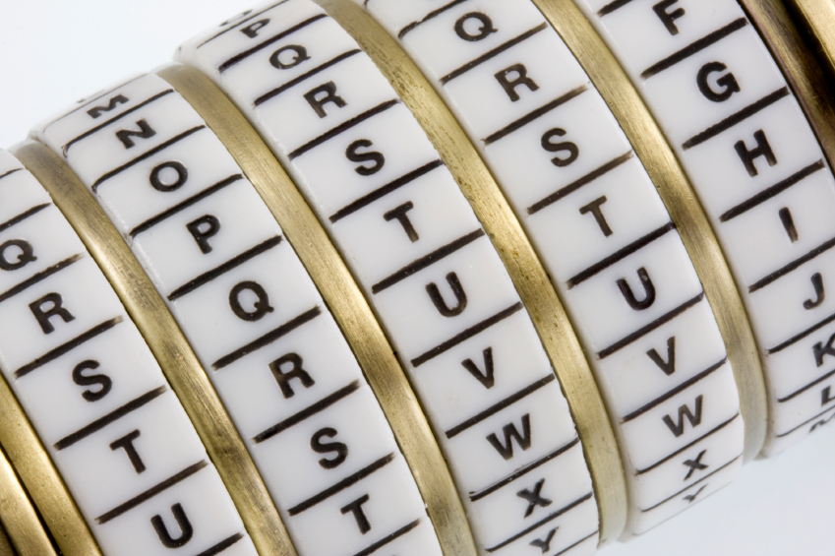
Cryptography
An Introduction
Continued…
Shon Harris
CISSP, 5th Edition

Slide 2
(3.8.1 Contd)
Cipher Feedback Mode (CFB)
If you are going to send an encrypted e-mail to your boss, your e-mail client will use a symmetric block cipher working in CBC mode.
The e-mail client would not use ECB mode, because most messages are long enough to show patterns that can be used to reverse-engineer the process and uncover the encryption key.
The CBC mode is great to use when you need to send large chunks of data at a time

Slide 3
Cipher Feedback Mode (CFB)
But what if you are not sending large chunks of data at one time, but instead are sending a steady stream of data to a destination?
If you are working on a terminal that communicates with a back-end terminal server, what is really going on is that each keystroke and mouse movement you make is sent to the backend server in chunks of eight bits to be processed

Slide 4
Cipher Feedback Mode (CFB)
So even though it seems as though the computer you are working on is carrying out your commands and doing the processing you are requesting, it is not—this is happening on the server.
Thus, if you need to encrypt the data that go from your terminal to the terminal server, you could not use CBC mode because it only encrypts blocks of data 64 bits in size. You have blocks of eight bits you need to encrypt. So we use CFB mode…..

Slide 5
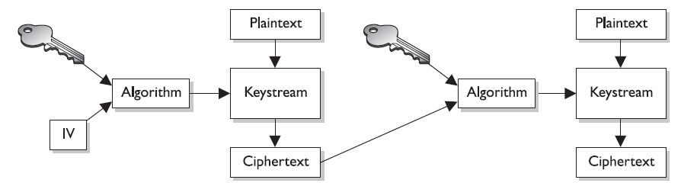
The Figure illustrates how CFB mode works, which is really a combination of a block cipher and a stream cipher.

Slide 6
Cipher Feedback Mode (CFB)
For the first block of eight bits that needs to be
encrypted, we do the same thing we did in CBC mode, which is to use an IV.
Recall how stream ciphers work: The key and the IV are used by the algorithm to create a keystream, which is just a random set of bits. This set of bits is XORed to the block of plaintext, which results in the same size block of ciphertext.

Slide 7
Cipher Feedback Mode (CFB)
So the first block (eight bits) is XORed to the set of bits created through the keystream generator.
Two things take place with this resulting eight-bit block of ciphertext.
One copy goes over the wire to the destination (in our scenario, to the terminal server), and another copy is used to encrypt the next block of eight-bit plaintext.

Slide 8
Adding this copy of ciphertext to the encryption process of the next block adds more randomness to the encryption process.
We walked through a scenario where eight-bit blocks needed to be encrypted, but in reality CFB mode can be used to encrypt any size blocks, even blocks of just one bit.
But since most of our encoding maps eight bits to one character, using CFB to encrypt eight-bit blocks is very common.

Slide 9
Review
We use ECB mode for the process of encrypting small amounts of data, such as a key or PIN value. These components will be around 64 bits or more, so ECB mode works as a true block cipher.
We can use CBC mode to encrypt larger amounts of data , in block sizes of 64 bits.
In situations where you need to encrypt a smaller amount of data, you need the cipher to work like a stream cipher and to encrypt individual bits of the blocks, as in CFB.

Slide 10
Output Feedback Mode
In some cases, you still need to encrypt a small amount of data at a time (one to eight bits), but you need to ensure possible errors do not affect your encryption and decryption processes.

Slide 11
CFB Review
If you look again at the Figure for CFB, you see that the ciphertext from the previous block is used to encrypt the next block of plaintext. What if a bit in the first ciphertext gets corrupted? Then we have corrupted values going into the process of encrypting the next block of plaintext, and this problem just continues because of the use of chaining in this mode.

Slide 12
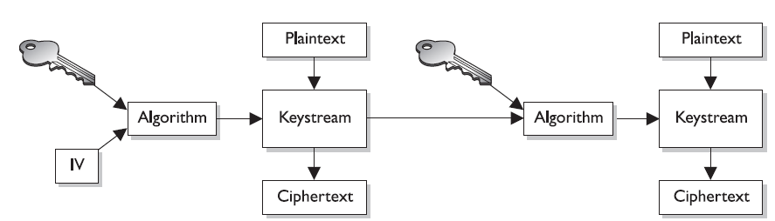
Output Feedback Mode
Now look at the Figure . It looks terribly similar to the previous Figure (CFB), but notice that the values used to encrypt the next block of plaintext are coming directly from the keystream, not from the resulting ciphertext. This is the difference between the two modes.

Slide 13
If you need to encrypt something that would be very sensitive to these types of errors, such as digitized video or digitized voice signals, you should not use CFB mode.
You should use OFB mode instead, which reduces the chance that these types of bit corruptions can take place.
So OFB is a mode that a block cipher can work in when it needs to emulate a stream, because it encrypts small amounts of data at a time, but it has a smaller chance of creating and extending errors throughout the full encryption process.

Slide 14
To ensure OFB and CFB are providing the most protection possible, the size of the ciphertext (in CFB) or keystream values (in OFB) needs to be the same size as the block of plaintext being encrypted.
This means that if you are using CFB and are encrypting eight bits at a time, the ciphertext you bring forward from the previous encryption block needs to be eight bits. Otherwise, you are repeating values over and over, which introduces patterns.
(This is the same reason why a one-time pad should be used only one time and should be as long as the message itself.)

Slide 15
Counter Mode (CTR)
Counter Mode (CTR) is very similar to OFB mode, but instead of using a randomly unique IV value to generate the keystream values, this mode uses an IV counter that increments for each plaintext block that needs to be encrypted. The unique counter ensures that each block is XORed with a unique keystream value.

Slide 16
Counter Mode (CTR)
The other difference is that there is no chaining involved, which means no ciphertext
is brought forward to encrypt the next block. Since there is no chaining, the encryption
of the individual blocks can happen in parallel, which increases the performance.
The main reason CTR would be used instead of the other modes is performance.

Slide 17
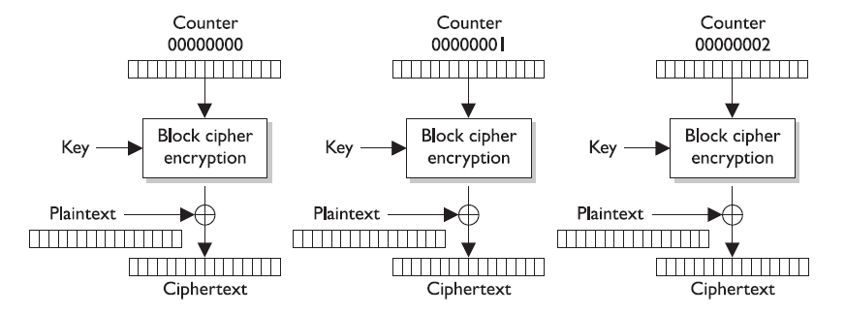
This mode has been around for quite some time and is used in encrypting ATM cells for virtual circuits, in IPSec, and is now integrated in the new wireless security standard, 802.11i.

Slide 18
Why Use CTR ?
A developer would choose to use this mode in these situations because individual ATM cells or packets going through an IPSec tunnel or over radio frequencies may not arrive at the destination in order. Since chaining is not involved, the destination
can decrypt and begin processing the packets without having to wait for the full message to arrive and then decrypt all the data.

Slide 19
3.8.2 Triple DES (3DES)
We went from DES to Triple-DES (3DES), so it might seem we skipped Double-DES. We did. Double-DES has a key length of 112 bits, but there is a specific attack against Double-DES that reduces its work factor to about the same as DES. Thus, it is no more secure than DES. So let’s move on to 3DES.

Slide 20
Triple DES (3DES)
Many successful attacks against DES and the realization that the useful lifetime of DES was about up brought much support for 3DES. NIST knew that a new standard had to be created, which ended up being AES, but a quick fix was needed in the meantime to provide more protection for sensitive data. The result: 3DES (also known as TDEA—Triple Data Encryption Algorithm).

Slide 21
3DES Performance
3DES uses 48 rounds in its computation, which makes it highly resistant to differential cryptanalysis. However, because of the extra work 3DES performs, there is a heavy performance hit. It can take up to three times longer than DES to perform encryption and decryption.

Slide 22
3DES Modes
Although NIST has selected the Rijndael algorithm to replace DES as the AES, NIST and others expect 3DES to be around and used for quite some time. 3DES can work in different modes, and the mode chosen dictates the number of keys used and what functions are carried out

Slide 23
3DES Modes
DES-EEE3 Uses three different keys for encryption, and the data are encrypted, encrypted, encrypted
DES-EDE3 Uses three different keys for encryption, and the data are encrypted, decrypted, and encrypted
DES-EEE2 The same as DES-EEE3 but uses only two keys, and the first and third encryption processes use the same key
DES-EDE2 The same as DES-EDE3 but uses only two keys, and the first and third encryption processes use the same key

Slide 24
EDE ?
EDE may seem a little odd at first. How much protection could be provided by encrypting something, decrypting it, and encrypting it again? The decrypting portion here is decrypted with a different key. When data are encrypted with one symmetric key and decrypted with a different symmetric key, it is jumbled even more. So the data are not actually decrypted in the middle function, they are just run through a decryption process with a different key. Pretty tricky.

