Slide 1
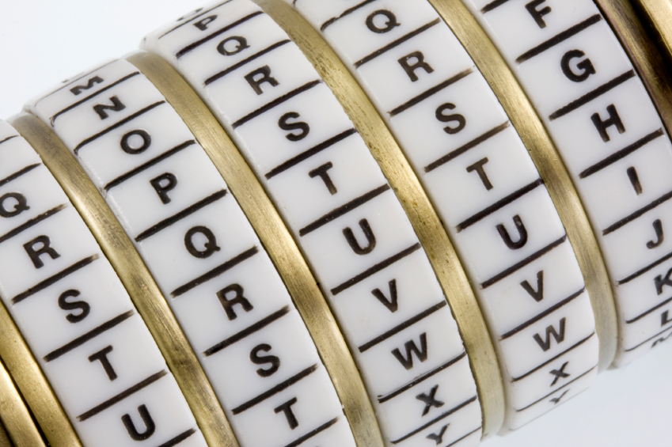
Cryptography
An Introduction
Continued…
Shon Harris
CISSP, 5th Edition

Slide 2
3.6 Methods Of Encryption
For two entities to be able to communicate via encryption, they must use the same algorithm and, many times, the same key
In some encryption technologies, the receiver and the sender use the same key, and in other encryption technologies, they must use different but related keys for encryption and decryption purposes

Slide 3
Symmetric vs. Asymmetric Algorithms
Cryptography algorithms are either symmetric algorithms, which use symmetric keys (also called secret keys), or asymmetric algorithms, which use asymmetric keys (also called public and private keys)

Slide 4
3.6.1 Symmetric Cryptography
In a cryptosystem that uses symmetric cryptography, the sender and receiver use two instances of the same key for encryption and decryption, as shown in the Figure
So the key has dual functionality, in that it can carry out both encryption and decryption processes

Slide 5
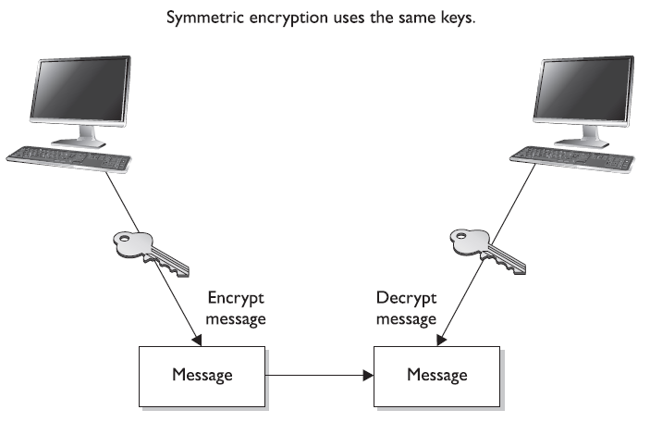

Slide 6
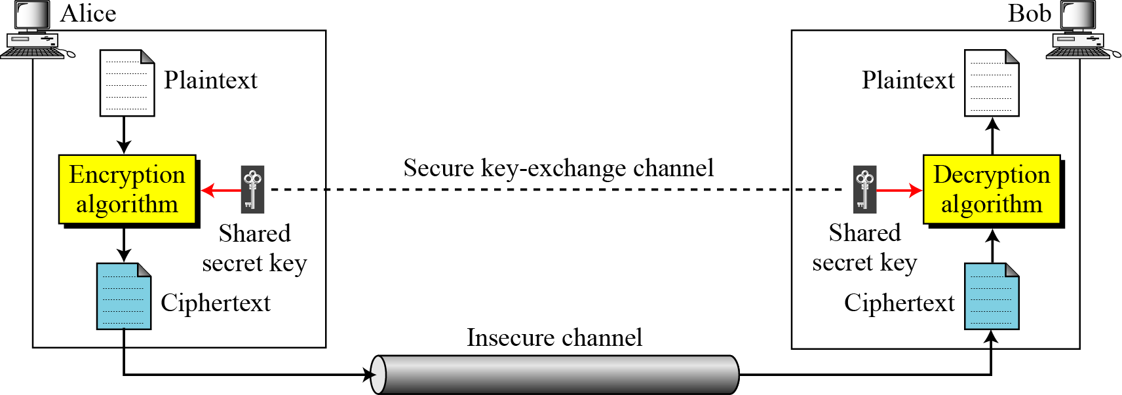
General idea of symmetric-key cipher
Forouzan

Slide 7
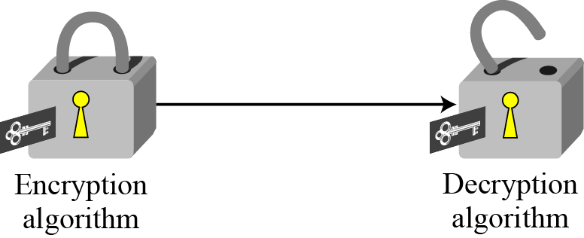
Locking and unlocking with the same key
Symmetric Key Cryptography
Symmetric keys are also called secret keys, because this type of encryption relies on each user to keep the key a secret and properly protected

Slide 8
Each pair of users who want to exchange data using symmetric key encryption must have two instances of the same key
This means that if Alice and Bob want to communicate, both need to obtain a copy of the same key
If Bob also wants to communicate using symmetric encryption with Norm and Dave, he needs to have three separate keys, one for each friend

Slide 9
If ten people needed to communicate securely with each other using symmetric keys, then 45 keys would need to be kept track of
If 100 people were going to communicate, then 4,950 keys would be involved
The equation used to calculate the number of symmetric keys needed is :
N(N – 1)/2 = number of keys

Slide 10
Sharing & Updating Symmetric Keys
If Dan wants to communicate with Norm for the first time, Dan has to figure out how to get the right key to Norm securely
It is not safe to just send it in an e-mail message, because the key is not protected and can be easily intercepted and used by attackers.
Thus, Dan must get the key to Norm through an out-of-band method.
Dan can save the key on a thumb drive and walk over to Norm’s desk, or have a secure courier deliver it to Norm. This is a huge hassle, and each method is insecure.

Slide 11
Strengths & Weaknesses
Of Symmetric Encryption
Strengths
Much faster (less computationally intensive) than asymmetric systems
Hard to break if using a large key size
Weaknesses
Requires a secure mechanism to deliver keys properly
Each pair of users needs a unique key, so as the number of individuals increases, so does the number of keys, possibly making key management overwhelming
Provides confidentiality but not authenticity or nonrepudiation

Slide 12
Examples of Symmetric Algorithms
Data Encryption Standard (DES)
Triple-DES (3DES)
Blowfish
IDEA (International Data Encryption Algorithm)
RC4, RC5, and RC6
Advanced Encryption Standard (AES)

Slide 13
3.6.2 Asymmetric Cryptography
In symmetric key cryptography, a single secret key is used between entities, whereas in public key systems, each entity has different keys, or asymmetric keys
The two different asymmetric keys are mathematically related. If a message is encrypted by one key, the other key is required in order to decrypt the message

Slide 14
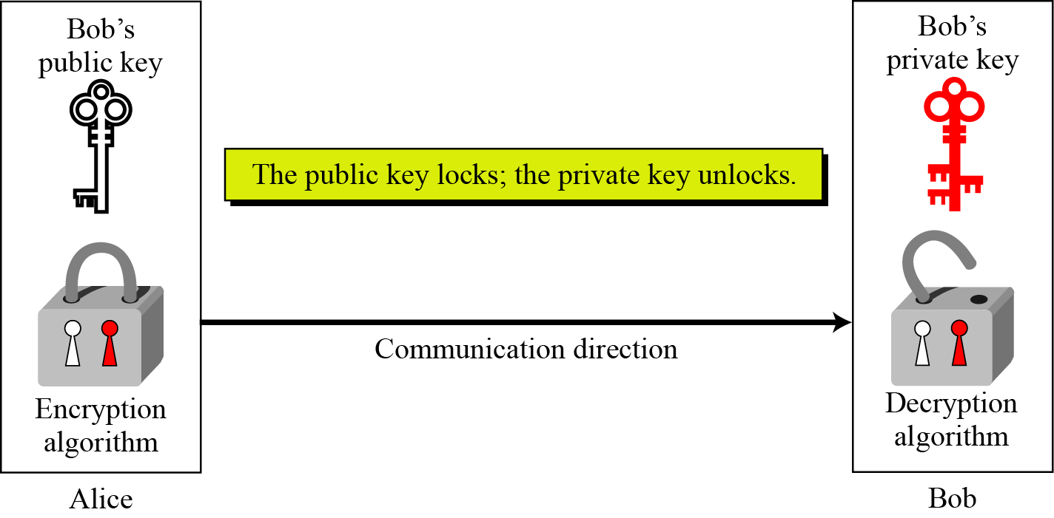
Asymmetric key cryptography uses two separate keys: one private and one public.
Locking and unlocking in asymmetric-key cryptosystem

Slide 15
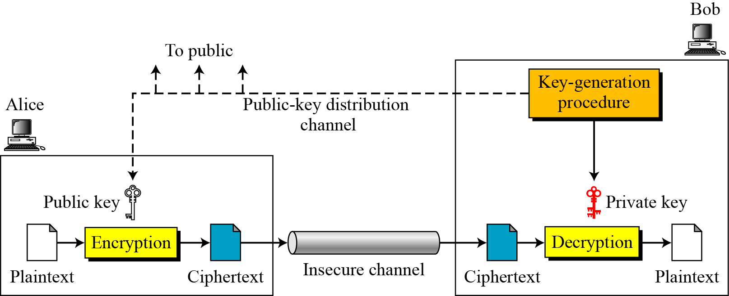
General idea of asymmetric-key cryptosystem

Slide 16
In a public key system, the pair of keys is made up of one public key and one private key. The public key can be known to everyone, and the private key must be known and used only by the owner.
Many times, public keys are listed in directories and databases of e-mail addresses so they are available to anyone who wants to use these keys to encrypt or decrypt data when communicating with a particular person

Slide 17
The public and private keys of an asymmetric cryptosystem are mathematically related
…but if someone gets another person’s public key, he should not be able to figure out the corresponding private key
This means that if an evildoer gets a copy of Bob’s public key, it does not mean he can employ some mathematical magic and find out Bob’s private key
But if someone got Bob’s private key, then there is big trouble—no one other than the owner should have access to a private key

Slide 18
It is not possible to encrypt and decrypt using the same key when using an asymmetric key encryption technology because, although mathematically related, the two keys are not the same key, as they are in symmetric cryptography

Slide 19
Authentication
Bob can encrypt data with his private key, and the receiver can then decrypt it with Bob’s public key
By decrypting the message with Bob’s public key, the receiver can be sure the message really came from Bob
A message can be decrypted with a public key only if the message was encrypted with the corresponding private key
This provides authentication, because Bob is the only one who is supposed to have his private key

Slide 20
Open Message Format
If authentication is the most important security service to the sender, then he would encrypt the data with his private key.
This provides assurance to the receiver that the only person who could have encrypted the data is the individual who has possession of that private key
If the sender encrypted the data with the receiver’s public key, authentication is not provided because this public key is available to anyone

Slide 21
Open Message Format
Encrypting data with the sender’s private key is called an open message format because anyone with a copy of the corresponding public key can decrypt the message
Confidentiality is not ensured.

Slide 22
Confidentiality
Bob can encrypt data with the receivers public key, and the receiver can then decrypt it with his private key
By decrypting the message with his private key, the receiver can be sure no one else can view this message
This provides confidentiality, because the receiver is the only one who is supposed to have his private key

Slide 23
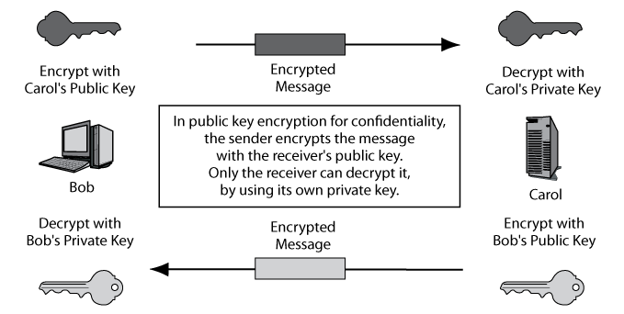
Public Key Encryption for Confidentiality

Slide 24
Secure Message Format
If confidentiality is the most important security service to a sender, he would encrypt the file with the receiver’s public key
This is called a secure message format because it can only be decrypted by the person who has the corresponding private key

Slide 25
Asymmetric algorithms are slower than symmetric algorithms because they use much more complex mathematics to carry out their functions, which requires more processing time
Although they are slower, asymmetric algorithms can provide authentication and nonrepudiation, depending on the type of algorithm being used

Slide 26
Asymmetric systems also provide for easier and more manageable key distribution than symmetric systems and do not have the scalability issues of symmetric systems. The reason for these differences is that, with asymmetric systems, you can send out your public key to all of the people you need to communicate with, instead of keeping track of a unique key for each one of them.

Slide 27
Public key cryptography is asymmetric cryptography. The terms can be used interchangeably.

Slide 28
Strengths & Weaknesses
Of Asymmetric Encryption
Strengths
Better key distribution than symmetric systems
Better scalability than symmetric systems
Can provide authentication and nonrepudiation
Weaknesses
Works much more slowly than symmetric systems
Mathematically intensive tasks

Slide 29
Examples of Asymmetric Key Algorithms
RSA (Rivest-Shamir-Adleman)
Elliptic curve cryptosystem (ECC)
Diffie-Hellman
El Gamal
Digital Signature Algorithm (DSA)
Merkle-Hellman Knapsack

Slide 30
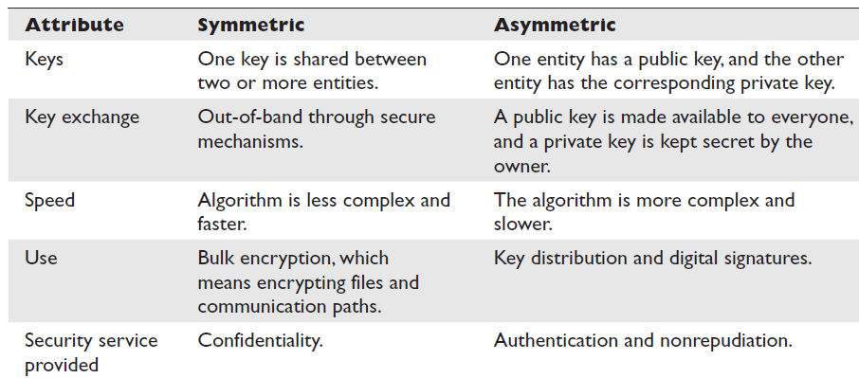
Symmetric Vs. Asymmetric

Slide 31
Core Cryptographic Processes
 | Confidentiality | Authentication
Symmetric Key Encryption | Applicable. Sender encrypts with key shared with the receiver. | Not applicable.
Public Key Encryption | Applicable. Sender encrypts with receiver’s public key. Receiver decrypts with the receiver’s own private key. | Applicable. Sender (supplicant) encrypts with own private key. Receiver (verifier) decrypts with the public key of the true party, usually obtained from the true party’s digital certificate.

