Slide 1
Software Design
Lecture : 8
Notes:
00.26-00.32

Slide 2
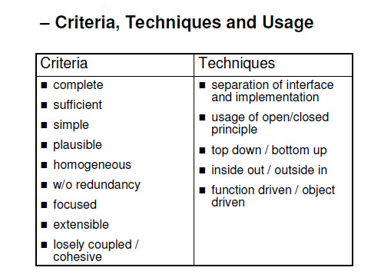
Notes:
02.11-02.40

Slide 3
Complete
Each component has all relevant features within the abstraction; a general interface can be reused.
Notes:
03.02-03.20

Slide 4
Plausible
The decomposition of modules can be easily and
intuitively be understood
Complexity is not a criteria for a good software design.
Notes:
07.00-07.04,07.28-07.31,07.39-07.43

Slide 5
Homogeneous
All the layers / subsystems should focus in same problem set.
Example:
While calculating the annual interest on savings bank should not include details about customer Education!!!
Notes:
09.29-09.32,09.50-10.03,10.07-10.27,10.50-10.57

Slide 6
3-Tier Architecture
Presentation Layer
Business Logic
Data Layer
Notes:
11.45-11.56,12.15-12.32,14.00-14.06,15.44-14.52,16.36-16.40

Slide 7
Focused
Separation of concerns Principle
Decomposition according to the responsibilities within the system
Components working on different tasks should be separated
Notes:
22.06-22.12,22.33-22.40,23.46-23.54

Slide 8
Separation of Concern
Separation of concerns is a recognition of the need for human beings to work within a limited context
The important factor is minimization of interaction points to achieve high cohesion and low coupling
Notes:
25.39-25.54,27.16-27.46

Slide 9
Example of Separation of Concern
Web Content Management
HTML represents abstract structure of the document over the internet.
CSS is used to separate data from style
Two separate files are maintained i-e one for Data (HTML) and other for style (CSS)
Notes:
28.20-28.30,29.56-30.02,31.20-31.50,32.02-32.08

Slide 10
Loosely coupled / Highly Cohesive
Coupling
This refers to how many dependencies there are between modules and the nature of the links. A module which is highly coupled means that it has to use many other modules for its own functionality to work.
Notes:
33.37-33.49,35.00-35.22,

Slide 11
Coupling: Degree of dependence among components
No dependencies
Loosely coupled-some dependencies
High coupling makes modifying parts of the system difficult, e.g., modifying a component affects all the components to which the component is connected.
Highly coupled-many dependencies
Notes:
35.42-36.58

Slide 12
Desired Coupling
The Components should “Loosely Coupled”
Loose Coupling promotes “Separation of concern”
Notes:
38.58-39.10,39.18-39.28

Slide 13
Coupling Example
For example, if both component A and B need to access a database, it would be sensible to put the functionality to handle a database in a single module and allow A and B to use it, rather than building in that functionality to both A and B.
Notes:
40.00-40.20

Slide 14
Range of Coupling
High Coupling
Content
Common
Control
Stamp
Data
Uncoupled
Loose
Low
Notes:
42.12-43.02

Slide 15
Content coupling – Highest Coupling
  Component directly modifies another’s data
  Component refers to local data of another component in terms of numerical displacement
Notes:
45.12-45.22,45.20-45.43,46.48-47.04,

Slide 16
Example of Content Coupling-1
Part of program handles lookup for customer.
When customer not found, component adds customer by directly modifying the contents of the data structure containing customer data.
Notes:
48.03-49.13

Slide 17
Example of Content Coupling-2
Part of program handles lookup for customer.
When customer not found, component adds customer by directly modifying the contents of the data structure containing customer data.
Improvement:
When customer not found, component calls the Add Customer() method that is responsible for maintaining customer data rather than directly modifying data structure.
Notes:
52.50-53.20

