Slide 1
Software Design
Lecture : 7
Notes:
00.13-00.18

Slide 2
Tree-Structures
It’s a combination of subsystem and layers
When you start at the root each node can be reached in exactly one way
Usually the nodes can be placed in different layers a node can be considered as the representative of his subtree
Notes:
02.08-02.13,02.49-03.16,04.35-05.01

Slide 3
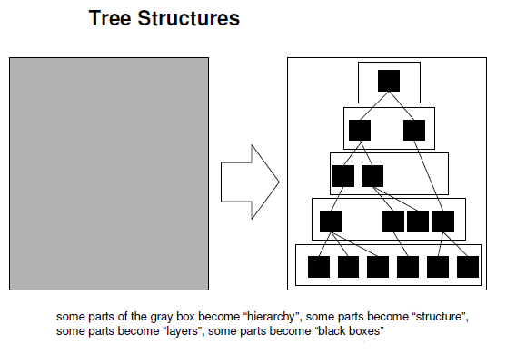
Notes:
06.04-07.24

Slide 4
Problem
An automated ticket issuing system used by passengers at a railway station. The System should also allow reservation of seats and give some route information. The passenger should be able to pay for the ticket at the counter also.
To Do : We have to design the architecture of the above system after selecting a specific principle and proper assumptions.
Notes:
08.55-09.46,11.12-11.31,(15.52-15.57) has to put in slide no 7

Slide 5
Possible Solution - Subsystem Based
Automated Ticketing System
Seat Reservation
Route Information
Transaction
Train Data
Bank Data
Notes:
01.10.36-0.13.40,08.55-09.46,11.12-11.31,(15.52-15.57) from slide no 6
17.03-17.10,18.01-18.10,01.16.38-01.16.49,01.17.09-21.33,21.52-22.20
Time jump

Slide 6
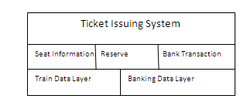
Possible Solution - Layer Based
Notes:
26.51-27.59,28.33-28.40

Slide 7
Internal Abstraction : Modularization
“The process of breaking a system into components to facilitate design and development; an element of modular programming “
Notes:
29.56-30.05,30.27-30.40

Slide 8
Encapsulation
A view of a problem that extracts the essential information relevant to a particular purpose and ignores the remainder of the information.
[IEEE, 1983]
Encapsulation is the grouping of related ideas into one unit, which can thereafter be referred to by a single name.
Notes:
01.32.20-01.32.48
Time jump

Slide 9
Encapsulation
Isolating a system function or a set of data and
operations on those data within a module.
Providing precise specifications for the module
Common elements of an abstraction are grouped
together and separated from other components; e.g.an Abstract Data Type
Notes:
37.31-37.37,38.45-37.52,38.57-39.04

Slide 10
Encapsulation Example
Simple digital alarm clock is a real-world object that a layman can use and understand. They can understand what the alarm clock does, and how to use it through the provided interface (buttons and screen), without having to understand every part inside of the clock. Similarly, if you replaced the clock with non-digital model, the layman could continue to use it in the same way, provided that the interface works the same.
Notes:
42.20-42.56

Slide 11
Another Encapsulation Example
A relational database is encapsulated in the sense that its only public interface is a Query language (SQL for example), which hides all the internal machinery and data structures of the database management system.
Notes:
45.16-45.40

Slide 12
Information hiding
Information Hiding is software design technique in which each module's interfaces reveal as little as possible about the module's inner workings and other modules are prevented from using information about the module that is not in the module's interface specification.
Notes:
01.44.48-0.48.12,48.28-48.50
Time jump

Slide 13
Another Definition of Information Hiding
Every module is characterized by its knowledge of a design decision which it hides from all others. Its interface or definition was chosen to reveal as little as possible about its inner workings.
Notes:
52.50-53.10

Slide 14
Information Hiding
Information hiding gives the designer the freedom to modify how the responsibility is fulfilled by a module/object.
Components should communicate only through well-defined interfaces.
Notes:
55.06-55.13,54.52-54.56

Slide 15
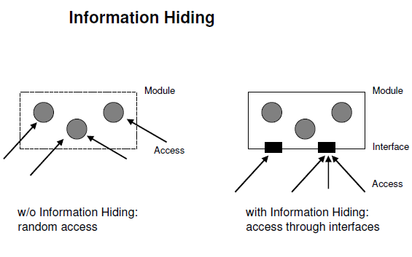
Notes:
54.58-55.53

