Slide 1
Software Design
Lecture : 15

Slide 2
Unified Modelling Language (UML)
Unified Modeling Language (UML) is a standardized general-purpose modeling language in the field of software engineering. The standard is managed, and was created by, the Object Management Group.
The Unified Modeling Language (UML) is used to specify, visualize, modify, construct and document the artifacts of an object-oriented software-intensive system under development

Slide 3
UML Continue
UML offers a standard way to visualize a system's architectural blueprints, including elements such as:
activities
actors
business processes
database schemas
(logical) components
programming language statements
reusable software components.

Slide 4
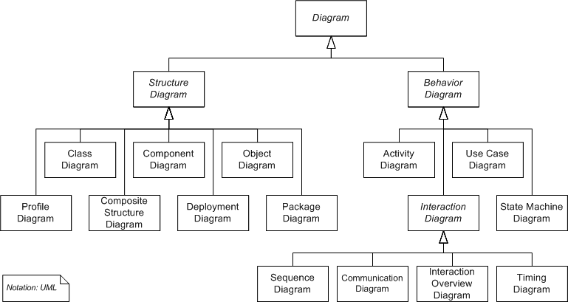

Slide 5
Categories of UML Diagrams (3)
Static
    Use case diagram
    Class diagram
Dynamic
    Object diagram
    State diagram
    Activity diagram
    Sequence diagram
    Collaboration diagram

Slide 6
Implementation
Component diagram
Deployment diagram

Slide 7
Use Case Diagram
When looking at the system as a whole, Use Case Analysis identifies all the major user of the system. It is a functional description of the entire system.
· Use Cases are the main tasks performed by the users of the system.
· Use Cases describe the behavioral aspects of the system.
· Use Cases are used to identify how the system will be used.
· Use Cases are a convenient way to document the functions that the system must
support.
· Use Cases are used to identify the components (classes) of the system.

Slide 8
Roles in Use Case
Actor: A role that a user can play.
Examples: instructor, advisor, student
Actors do not have to be human. An actor such as a sensor may cause a system reaction.
An actor is always outside of the system boundary, an external entity.

Slide 9
Use Cases
Actions on a system initiated by an actor. These are the main tasks performed by each actor. Use cases represent complete functionality of a task.
Example: Register for course

Slide 10
User
Someone who uses the system. The same user can play multiple roles
A user is an instance of an actor.
Example Prof. John Doe plays the role of an instructor and the role of an advisor

Slide 11
Views
Two or more actors interacting with a use case
Example Register for Course involves both the Student registering for the course and the Registrars office sending out a bill for it. Each actor views this task from a different perspective.

Slide 12
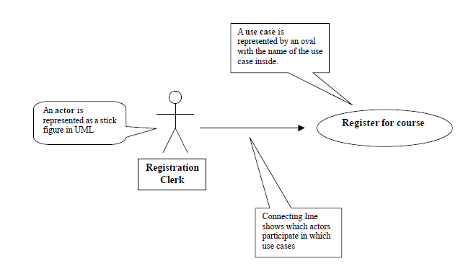
Use Case Symbols

Slide 13
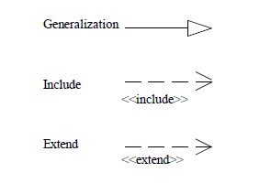
UML use case relationship symbols

Slide 14
Include Relationship
A use case may include another use case. A use case that is included is generally a common behavior that many use cases may need. One use case will use the services of another use case.

Slide 15
Extends
A use case may extend a use case by adding new actions to the base use case.
Extension is on the basis of conditions attached to it.

Slide 16
Example - 1
Use Case: “Take Customer Order”
Basic Steps:
Actor enters Customer details
Identify either customer is new or existing one
Actor enters code for product required
System displays Product details
Actor enters quantity required
Actor enters Payment details
System saves Customer Order
Customer may return faulty goods

Slide 17
Alternative Flows:
In Case of Multiple products:
After step 5, when the Actor enters the quantity required,
Repeat steps 3 to 5 for additional Products
Resume at step 6, to enter Payment details

Slide 18
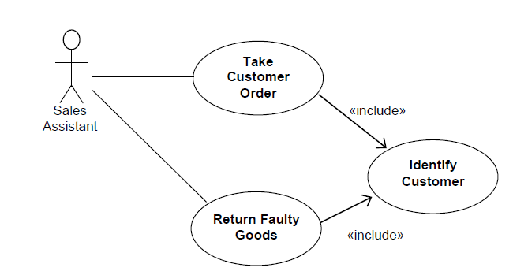
Possible Solution

Slide 19
Example – II
Special Case: Customer specified product
At step 4, when the System displays the Product details, if the product requires customer specified features,
1. Actor enters customer specified requirements, such as size and color.
Resume basic flow at step 5, to enter quantity required,
2. At step 7 where the Customer Order is saved, the additional customer-specific product details must also be saved.

Slide 20
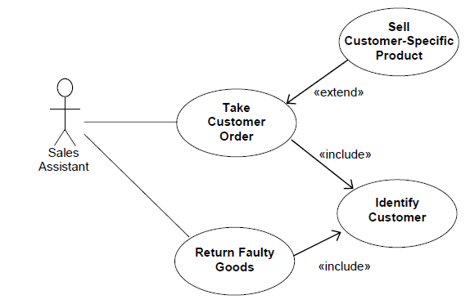
Possible Solution

