Slide 1
Software Design
Lecture : 14

Slide 2
Open / Close Principle
Bertrand Meyer:
“Software entities like classes, modules and functions should be open for extension but closed for modifications”

Slide 3
The “Open/Closed principle” – Usage in
an object oriented paradigm
The Open/Closed principle can be applied in be applied
in object oriented paradigms with the help of inheritance
and polymorphism:
The interface of the module becomes an abstract
class A
If needed new Subclasses of A can be derived; these
subclasses may extend A

Slide 4
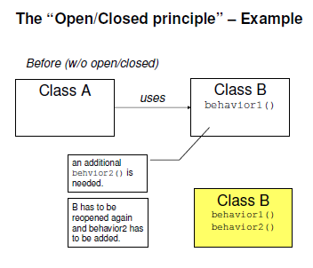

Slide 5
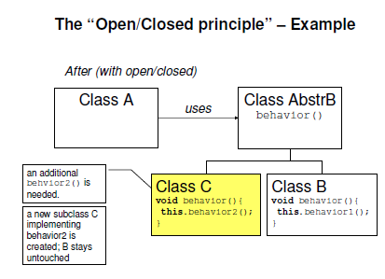

Slide 6
Example
We have to implement the banking system such that there will be an interface for the customer and the bank will be handling different type of accounts in it like savings, current etc; each type of account is having it’s own business logic to implement and policy. Bank foresee the emergence of new type of accounts, we have to design the system which should take into consideration the current requirements and should be able to adopt to future changes.
We have to design it using Open / Close Principle
Provide Java coding for it, design client interface for opening new account

Slide 7
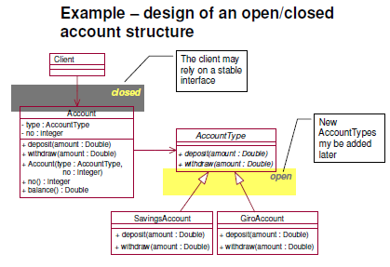

Slide 8
Unified Modelling Language (UML)
Unified Modeling Language (UML) is a standardized general-purpose modeling language in the field of software engineering. The standard is managed, and was created by, the Object Management Group.
The Unified Modeling Language (UML) is used to specify, visualize, modify, construct and document the artifacts of an object-oriented software-intensive system under development

Slide 9
UML Continue
UML offers a standard way to visualize a system's architectural blueprints, including elements such as:
activities
actors
business processes
database schemas
(logical) components
programming language statements
reusable software components.

Slide 10
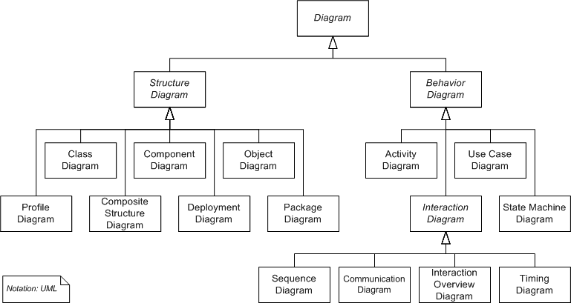

Slide 11
Categories of UML Diagrams (3)
Static
    Use case diagram
    Class diagram
Dynamic
    Object diagram
    State diagram
    Activity diagram
    Sequence diagram
    Collaboration diagram

Slide 12
Implementation
Component diagram
Deployment diagram

