Slide 1
Software Design
Lecture : 13

Slide 2
Software Design Components
Principle
Criteria
Techniques (this lecture)

Slide 3
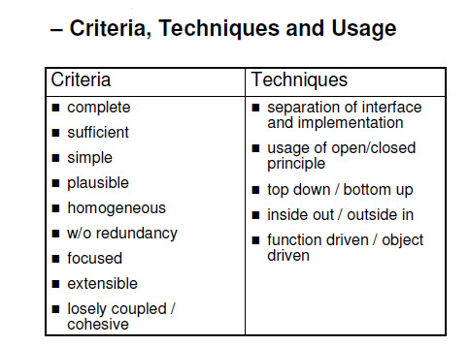

Slide 4
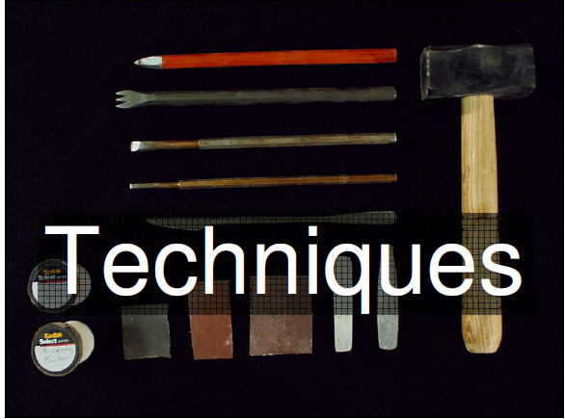

Slide 5
Abstract Classes
Abstract class is a class that can not be instantiated, it exists extensively for inheritance and it must be inherited. There are scenarios in which it is useful to define classes that is not intended to instantiate; because such classes normally are used as base-classes in inheritance hierarchies

Slide 6
Inheritance
It implies the functionality of data sharing between super and sub class.
All the data members and methods of super class are available for use in sub class but not vice-versa.
Subclass extends the functionality of super class to use the base class methods.

Slide 7
Polymorphism
In the context of object-oriented programming, is the ability to create a variable, a function, or an object that has more than one form.
Polymorphism is the ability to process objects differently depending on their data types.
Polymorphism is the ability to redefine methods for derived classes.

Slide 8
Types of Polymorphism
Compile time Polymorphism
Compile time Polymorphism also known as method overloading
Method overloading means having two or more methods with the same name but with different signatures

Slide 9
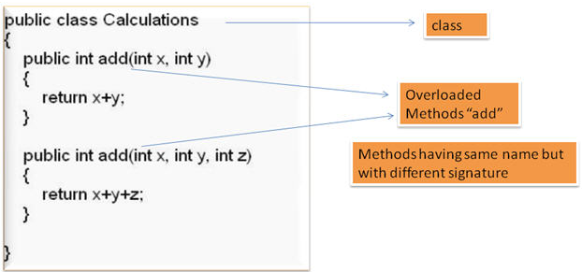
Example of Compile Time Polymorphism

Slide 10
Runtime Polymorphism
Run time Polymorphism also known as method overriding
Method overriding means having two or more methods with the same name , same signature but with different implementation

Slide 11
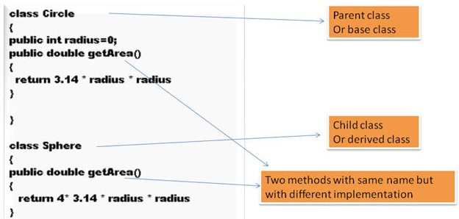
Example of Run-time Polymorphism

Slide 12
Example of Abstract class and Inheritance
In an object-oriented drawing application, you can draw Triangle, rectangles and other graphic objects. They have behavior commonality i-e area calculation but implementation is different.

Slide 13
Abstract Class Figure
Triangle
Area

Slide 14
Code in Eclipse

