Slide 1
Software Design
Lecture : 12

Slide 2
Software Design Components
Principle
Criteria
Techniques (this lecture)

Slide 3
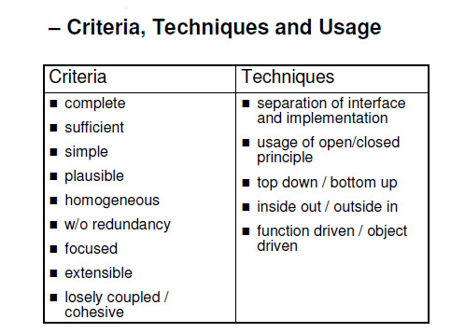

Slide 4
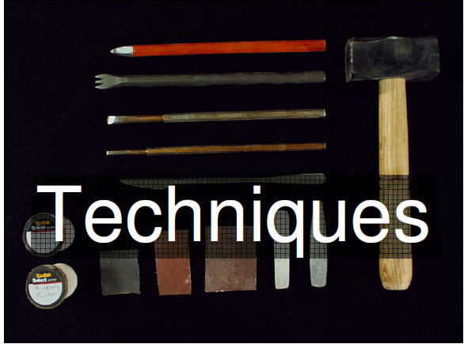

Slide 5
Open / Close Principle
Bertrand Meyer: “Software entities like classes, modules and functions should be closed but open for extension.
Closed
The source code of the module inviolate; no one is allowed to make changes to the code the module can be used without risk

Slide 6
Open / Close Principle
Open
The module is open for extension according to new requirements the module can be extended to behave in new and different ways.

Slide 7
Open / Closed Principle
A module that is open for extension is a module whose behavior can be altered to suit new requirements.
A module that is closed for modification is a module whose source code is frozen and cannot be changed

Slide 8
The “Open/Closed principle” – Usage in an object oriented paradigm
The Open/Closed principle can be applied in object oriented paradigms with the help of inheritance and polymorphism:
The interface of the module becomes an abstract
class A
If needed new Subclasses of A can be derived; these subclasses may extend A

Slide 9
What is Class
Basic implementation unit in OOP.
It encapsulate data members and methods.
Classes have objects or classes are assessed via their objects.
Data members are accessed through getters and setters methods.

Slide 10
public class test
{
int a ;
float b;
public class()
{}
void seta(int a)
{
this.a=a;
}
int geta ()
{
return this.a;
}

Slide 11
Abstract Classes
Abstract class is a class that can not be instantiated, it exists extensively for inheritance and it must be inherited. There are scenarios in which it is useful to define classes that is not intended to instantiate; because such classes normally are used as base-classes in inheritance hierarchies

Slide 12
Inheritance
It implies the functionality of data sharing between super and sub class.
All the data members and methods of super class are available for use in sub class but not vice-versa.
Subclass extends the functionality of super class to use the base class methods.

Slide 13
Example of Abstract class and Inheritance
In an object-oriented drawing application, you can draw circles, rectangles, lines, Bezier curves, and many other graphic objects. These objects all have certain states (for example: position, orientation, line color, fill color) and behaviors (for example: moveTo, rotate, resize, draw) in common.

Slide 14


Slide 15
abstract class GraphicObject
{
int x, y;
void moveTo(int newX, int newY)
{ ... }
abstract void draw();
abstract void resize();
}

Slide 16
class Circle extends GraphicObject
{ void draw()
{ ... }
void resize()
{ ... }
}

Slide 17
Polymorphism
In the context of object-oriented programming, is the ability to create a variable, a function, or an object that has more than one form.
Polymorphism is the ability to process objects differently depending on their data types.
Polymorphism is the ability to redefine methods for derived classes.

Slide 18
Types of Polymorphism
Compile time Polymorphism
Compile time Polymorphism also known as method overloading
Method overloading means having two or more methods with the same name but with different signatures

Slide 19
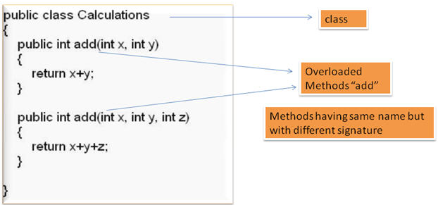
Example of Compile Time Polymorphism

Slide 20
Runtime Polymorphism
Run time Polymorphism also known as method overriding
Method overriding means having two or more methods with the same name , same signature but with different implementation

Slide 21
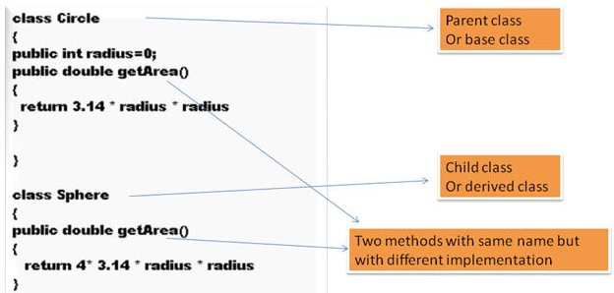
Example of Run-time Polymorphism

Slide 22
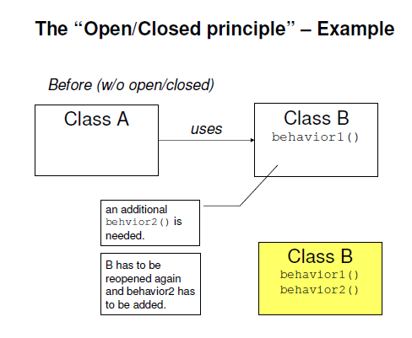

Slide 23
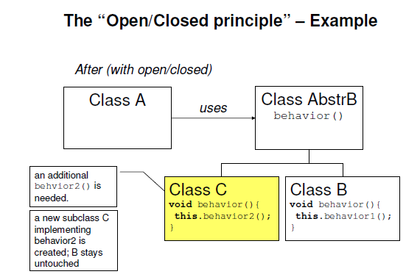

Slide 24
Example
We have to design a banking system in which there are several clients who are availing the facility of maintaining the account in the bank. As an international norm bank is offering multiple type of accounts to it’s customers like savings, current etc. Each account is having a facility of deposit and withdrawal attached with it for it’s client.

Slide 25
Example
Task to do:
We have to design the system in such a way that should accommodate the addition of new account types i-e profit and loss account etc without change in the design of the system

Slide 26
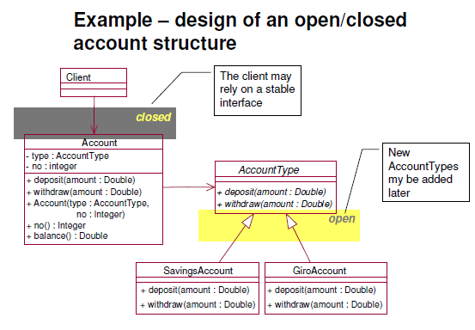

Slide 27
Another Example
You are going to design a library application where a particular request for issuance of book is passed through a issueValidator to approve the issue request. The issuanceValidator looks to see if the balance of book is above certain values and then approves the request.
Given this problem, one of the developer comes up with the following classes. The libraryrequestHandler can assess a issue request. This class holds the balance of remaining books and period of hold of books for a particular student account.

Slide 28
Code in Java

Slide 29
public class libraryRequestHandler {
private int balance;
private int period;
public libraryRequestHandler(int balance, int period) {
this.balance = balance;
this.period = period;
}
public void approverequest(issuanceValidator validator) {
if(validator.isValid(balance))
System.out.println(“Request approved...");
else
System.out.println("Sorry more books are in balance...");
}}

Slide 30
PersonalLoanValidator Class
public class issuanceValidator {
public issueanceValidator() {
}
public boolean isValid(int balance) {
if(balance>5)
return true;
else
return false;
}
}

Slide 31
Task To Do
In future the bank should be able to handle business type of accounts also.
Identify the violation of open/close principle in classes defined.
Reverse Engineered it and generate the class design of the code and create a solution with no violation of open/close principle

