Slide 1
Software Design
Lecture : 10
Notes:
00.43-00.48

Slide 2
Cohesion
A measure of the closeness of the relationships between elements of a component or "module" of a system.
Notes:
02.06-02.22,

Slide 3
Software Design Components
Principle
Criteria (this lecture)
Techniques

Slide 4


Slide 5
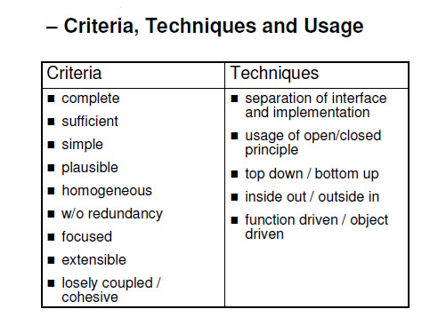

Slide 6
Range of Cohesion
High Cohesion
Functional
Sequential
Communicational
Procedural
Temporal
Logical
Coincidental
Low
Notes:
04.52-05.20,06.13-06.29

Slide 7
Coincidental Cohesion – Lowest Cohesion
Definition: Parts of the component are only related by their location in source code
A coincidentally cohesive module is one whose activities have no meaningful relationship to one another.
Notes:
08.16-08.20,09.54-10.13

Slide 8
Example – Module with multiple argument
Print next line
Reverse string of characters in second argument
Add 7 to 5th argument
Convert 4th argument to float
→ All the above functions have no relationship but they are there in the same module by chance!!
Notes:
I don’t even want to think about it.
10.51-11.20,11.49-11.55,12.25-12.35,12.47-12.51,13.07-13.20,14.36-14.42

Slide 9
Logical Cohesion
Definition: A logically cohesive module is one whose elements contribute to activities of the same general category in which the activity or activities to be executed are selected from outside the module
Several logically related elements are in the same component and one of the elements is selected by the client component.
Notes:
16.01-16.11,19.31-19.48

Slide 10
Example- I/O Operation
A component reads inputs from tape, disk, and network. All the code for these functions are in the same component.
Only one type of reading mechanism will be used by the calling method not all.
Notes:
I don’t even want to think about it.
22.08-22.20,22.48-22.53

Slide 11
Another Example of Logical Cohesion
Someone considering to travel might compile the following list:
GO BY CAR
GO BY TRAIN
GO BY BOAT
GO BY PLANE
They’re all means of transport, of course. But a crucial point is that for any journey, a person must choose a specific subset of these modes of transport. It’s unlikely anyone would use them all on any particular journey.
Notes:
24.25-25.01,25.36-25.44

Slide 12
TEMPORAL COHESION
A temporally cohesive module is one which performs several activities that are related in time.
Temporally cohesive modules typically consist of partial activities whose only relationship to one another is that they are all carried out at a specific time..
Notes:
27.00-27.11

Slide 13
Example
TURN OFF TV
Turn Off the Light
Lock the main door
BRUSH TEETH
These all the activities are related in a sense that these all are performed usually at the end of the day

Slide 14
Example
One of the most common examples of a temporally cohesive module is an initialization routine that initializes data used by many modules throughout a system.
Notes:
I don’t even want to think about it.

Slide 15
Procedural Cohesion
Definition: Elements of a component are related only to ensure a particular order of execution.
Module with (only) procedural cohesion is one supporting different and possibly unrelated activities, in which control passes from one activity to the next.

Slide 16
Example
...
Read part number from data base
update repair record on maintenance file.
...
May be useful to abstract the intent of this sequence. Make the data base and repair record components handle reading and updating. Make component that handles more abstract operation.

Slide 17
Communicational Cohesion
Definition: Module performs a series of actions related by a sequence of steps to be followed by the product and all actions are performed on the same data
A communication ally cohesive module is one which performs several functions on the same input or output data.

Slide 18
Example
Update record in data base and send it to the printer.
Obtain author, title, or price of book from bibliographic record, based on a passed flag.
Notes:
I don’t even want to think about it.

Slide 19
Module Example
module determine customer details
use customer account no
find customer name
find customer loan balance
return customer name, customer loan balance
endmodule

